Slide 1
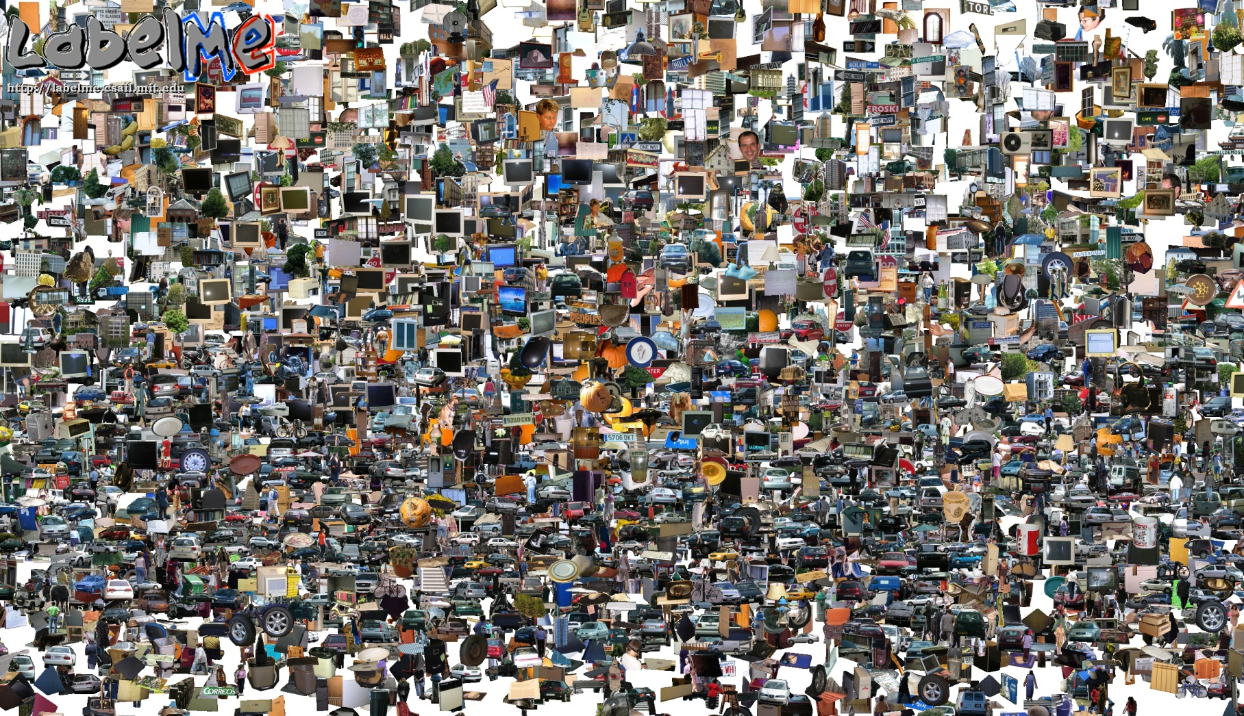
Opportunities of Scale
Computational Photography
Yuxiong Wang, University of Illinois
Slides adopted from Derek Hoiem
Some slides from Alyosha Efros
Graphic from Antonio Torralba

Slide 2
Today’s class: Opportunities of scale
3D Reconstruction
Data-driven methods
  3D reconstruction
  Scene completion
  Im2gps
  Colorizing
  Recognition
  and much more…
Deep network representations

Slide 3
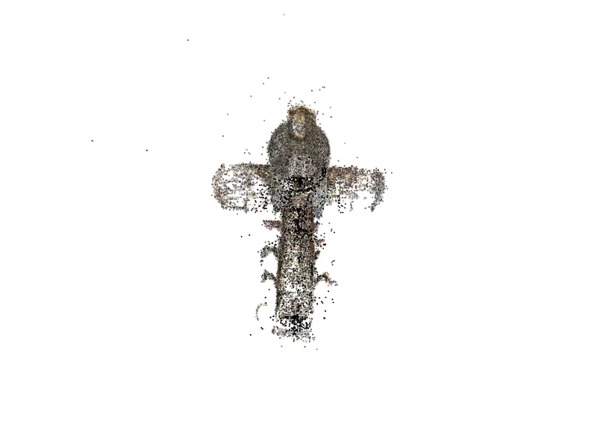
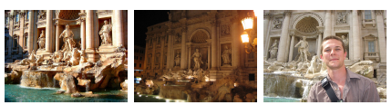
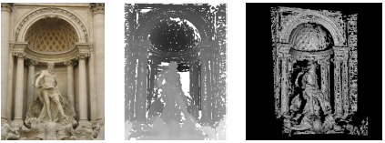
3D Reconstruction from Flickr
Create detailed 3D scenes from thousands of consumer photographs
Challenges include variations in season, lighting, occluding objects, etc.
“Building Rome in a Day”, Agarwal et al. 2009

Slide 4
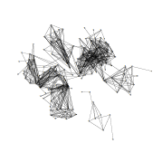
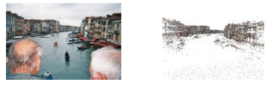
3D Reconstruction from Flickr: How it works
Download ~10,000 images, convert to grayscale, compute SIFT keypoints
Match images
  Get similar images with vocabulary tree (like in recognition from last class)
  Match keypoints across similar images and perform geometric verification with RANSAC (similar to photo stitching)
Form a graph of matched images and features
3D Reconstruction by triangulating points, bundle adjustment

Slide 5
Large-scale 3D Reconstruction
Useful references
Snavely thesis: “Scene Reconstruction and Visualization from Internet Photo Collections”
COLMAP: package for sparse and dense reconstruction (with two related papers) https://colmap.github.io/
List of good papers and tutorials https://github.com/openMVG/awesome_3DReconstruction_list

Slide 6
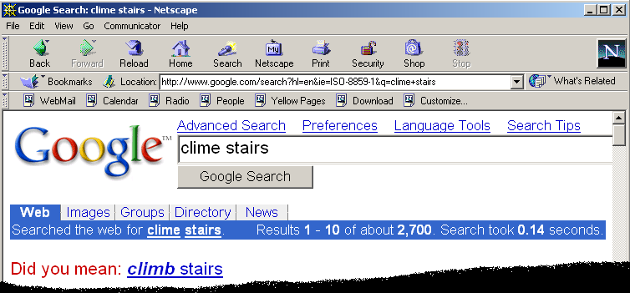
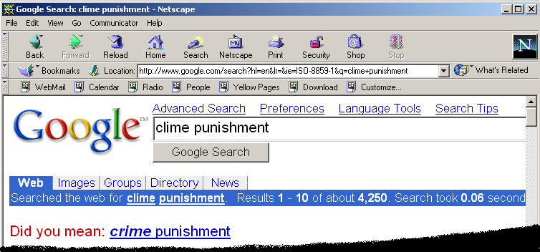
Google and massive data-driven algorithms
A.I. for the postmodern world:
  all questions have already been answered…many times, in many ways
  Google is dumb, the “intelligence” is in the data

Slide 7

Google Translate

Slide 8
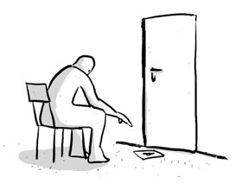
Chinese Room
John Searle (1980)

Slide 9
Image Completion Example
[Hays and Efros. Scene Completion Using Millions of Photographs. SIGGRAPH 2007 and CACM October 2008.]

Slide 10
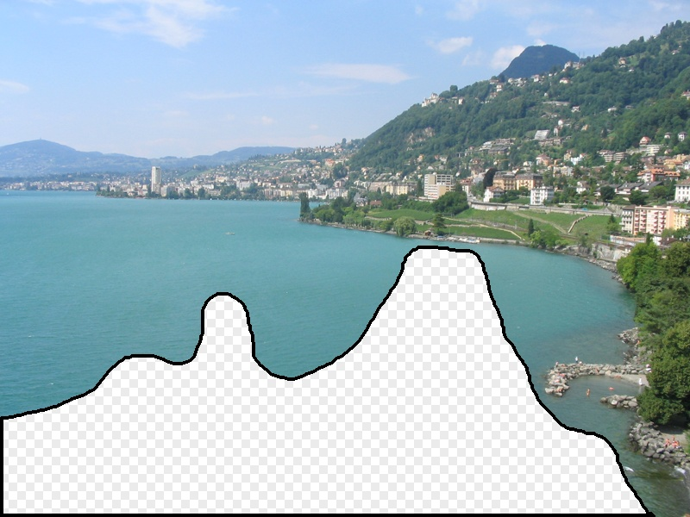
What should the missing region contain?
Notes:
10
What should go here and why?

Slide 11
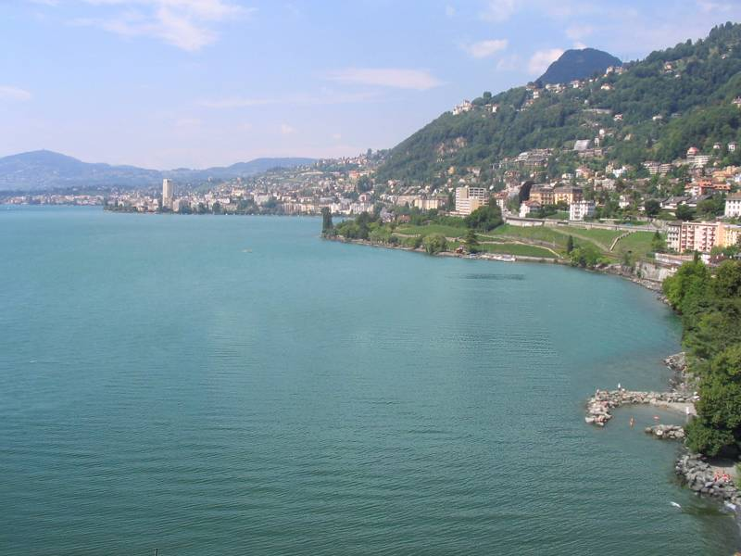

Slide 12
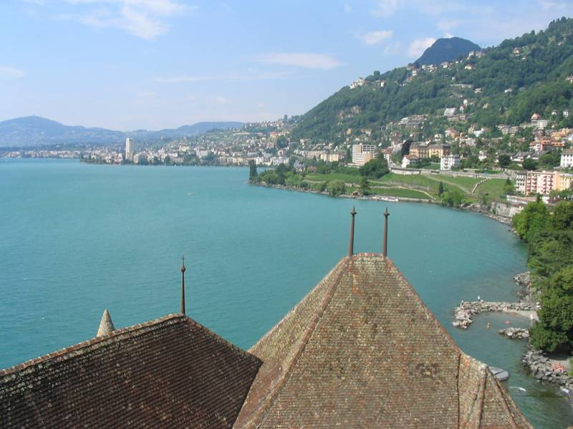
Notes:
12
Introduce gist.

Slide 13
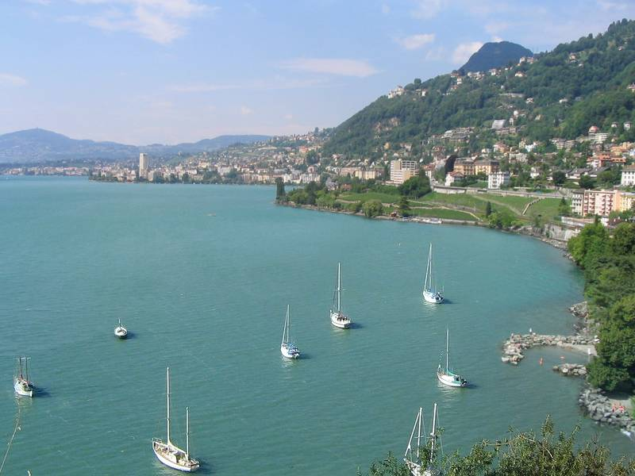

Slide 14
Which is the original?
(a)
(c)
(b)

Slide 15
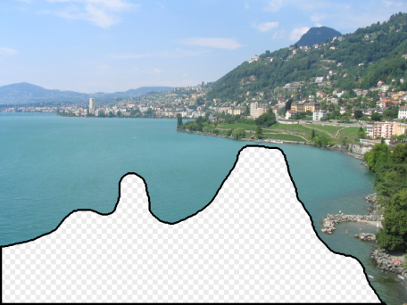
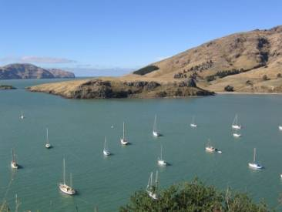
How it works
Find a similar image from a large dataset
Blend a region from that image into the hole
Dataset

Slide 16
General Principal
Huge Dataset
Images
image
matching
Info from Most Similar Images
Input Image
Associated Info
Trick: If you have enough images, the dataset will contain very similar images that you can find with simple matching methods.

Slide 17
How many images is enough?

Slide 18
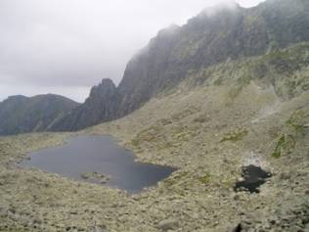
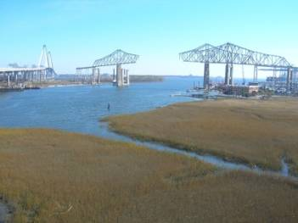
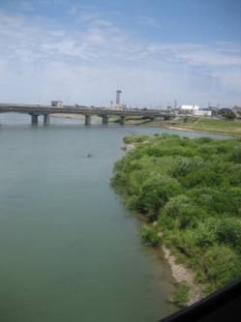
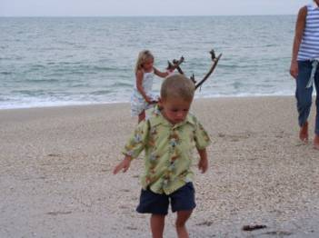
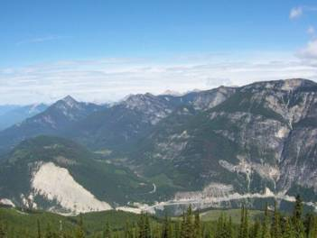
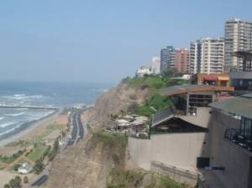
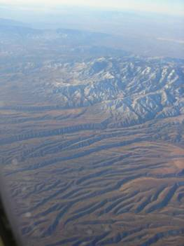
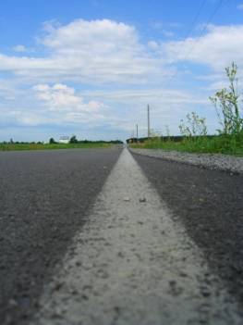

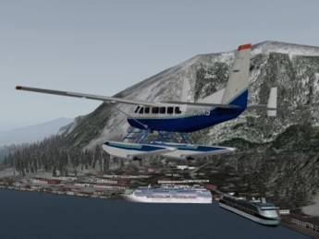
Nearest neighbors from a
collection of 20 thousand images
Notes:
18

Slide 19
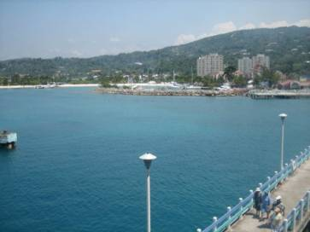
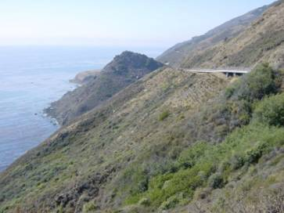
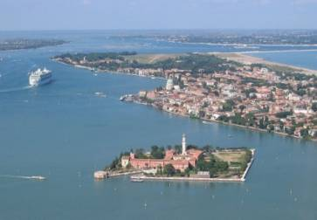
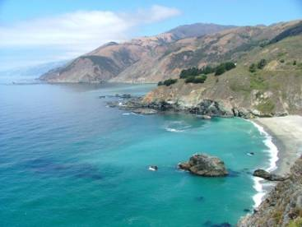

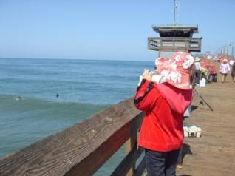
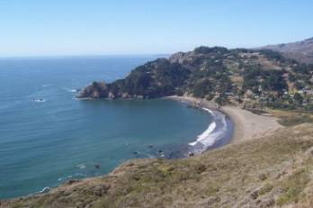
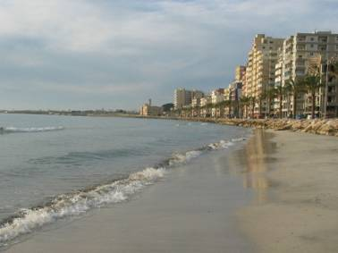
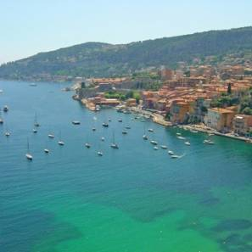
Nearest neighbors from a
collection of 2 million images
Notes:
19

Slide 20
Image Data on the Internet
Now: nobody counts anymore
Facebook (2014)
  250 billion total, +350 million per day
Facebook (2011)
  6 billion images per month
  More than 100 petabytes of images/video
Flickr (2010)
  5 billion photographs
  100+ million geotagged images
Imageshack (as of 2009)
  20 billion
Facebook (as of 2009)
  15 billion

Slide 21
Image completion: how it works
[Hays and Efros. Scene Completion Using Millions of Photographs. SIGGRAPH 2007 and CACM October 2008.]

Slide 22
The Algorithm
Notes:
22
Introduce gist.

Slide 23
Scene Matching
Notes:
23
Introduce gist.

Slide 24
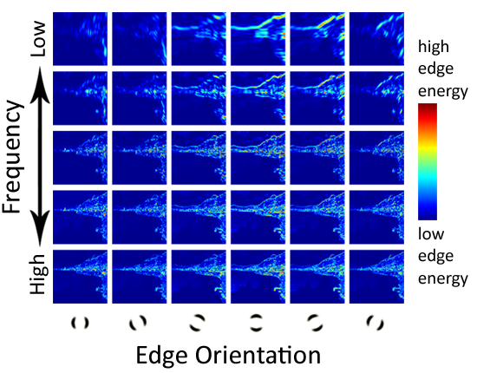
Scene Descriptor
Notes:
Edge energy is just the magnitude of directional derivatives of image intensity.
24

Slide 25
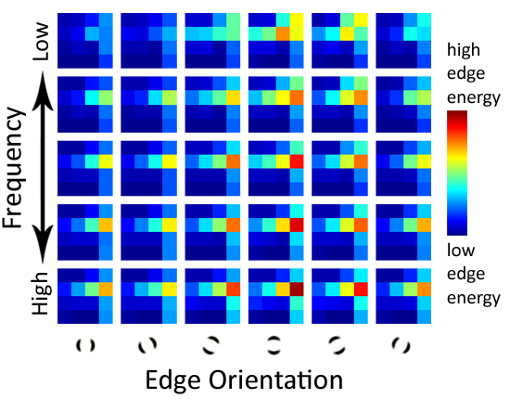
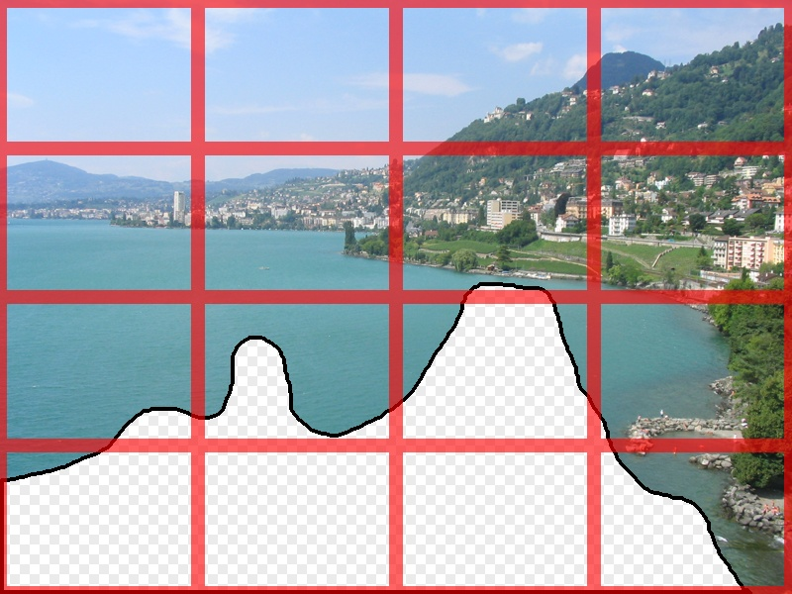
Scene Descriptor
Scene Gist Descriptor
(Oliva and Torralba 2001)

Slide 26

Scene Descriptor
+
Scene Gist Descriptor
(Oliva and Torralba 2001)

Slide 27

2 Million Flickr Images
Notes:
27
Now we take our gist (and mask and color image) and find it’s L2 nearest neighbors in the database of 2.3 million images, and here they are

Slide 28
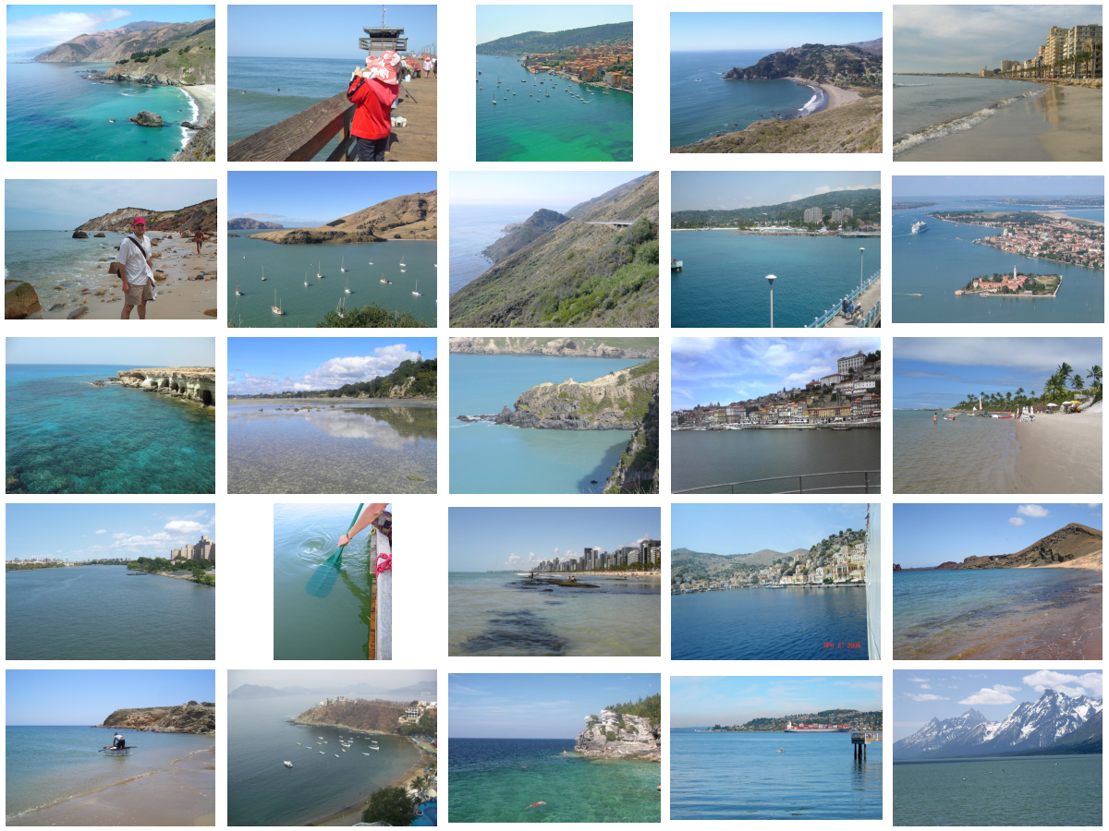
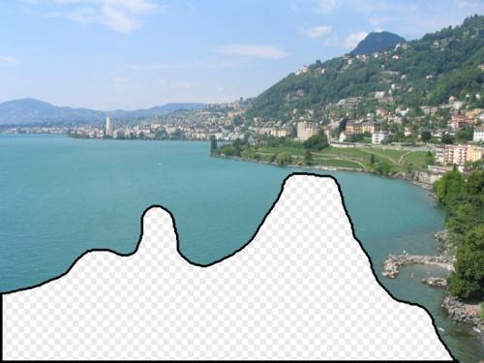
… 200 total
Notes:
28

Slide 29
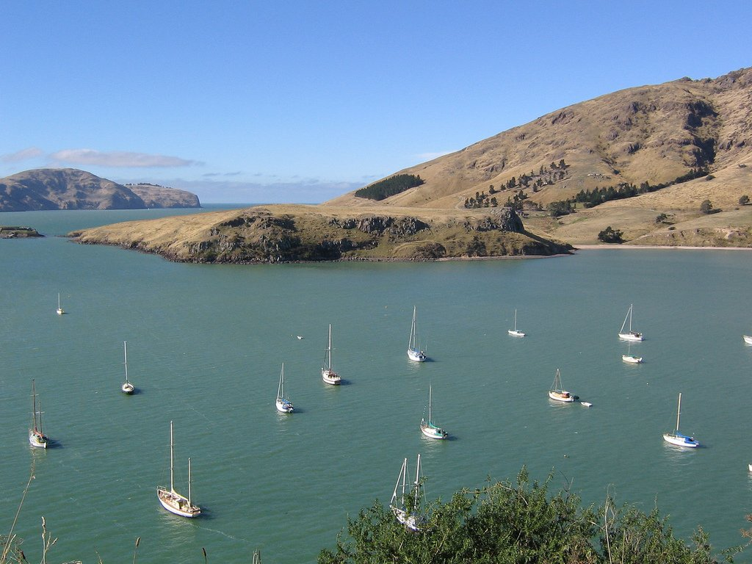

Context Matching

Slide 30
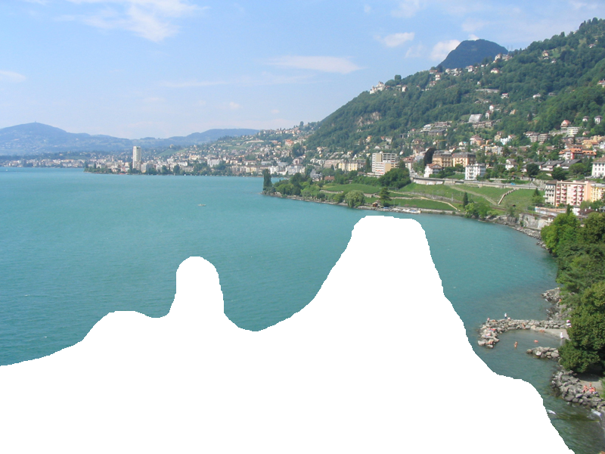

Graph cut + Poisson blending

Slide 31




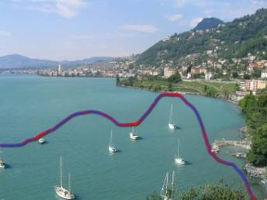
Result Ranking
We assign each of the 200 results a score which is the sum of:
The scene matching distance
The context matching distance
(color + texture)
The graph cut cost
Notes:
31
Johnson et al. used the graph cut cost to sort results for users in Semantic Photo Synthesis

Slide 33
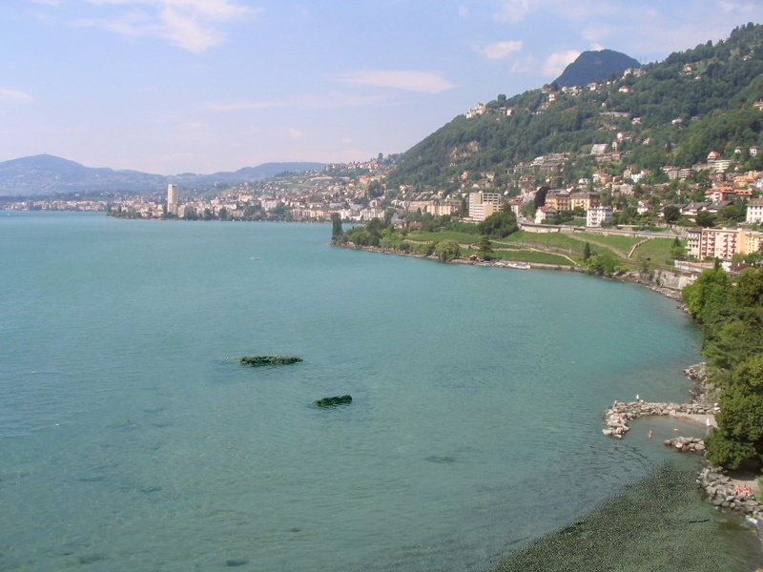

Slide 34
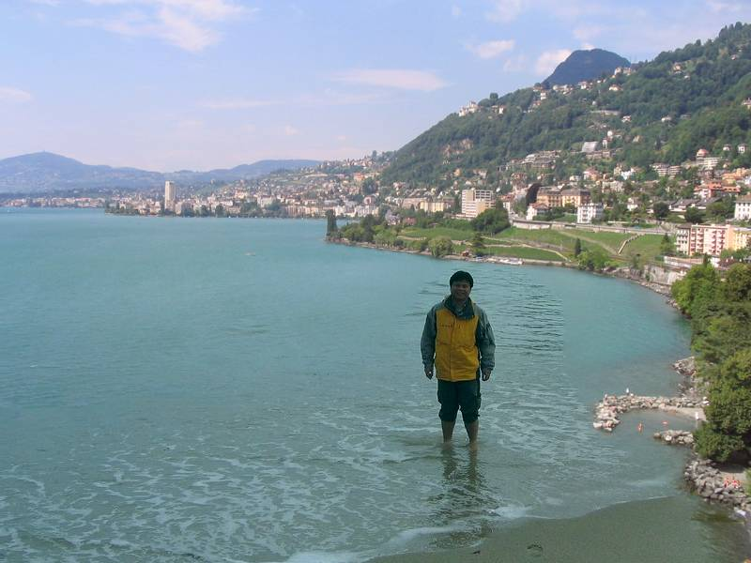

Slide 36
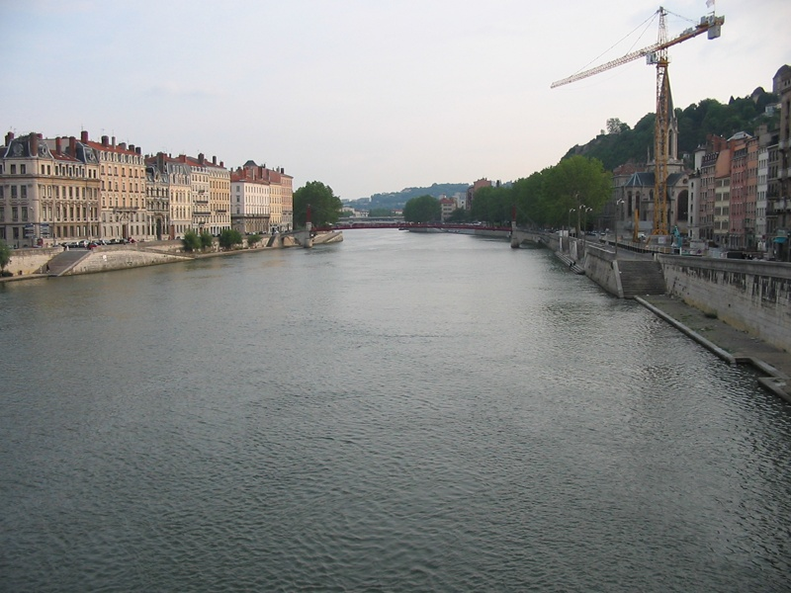
Notes:
36

Slide 37
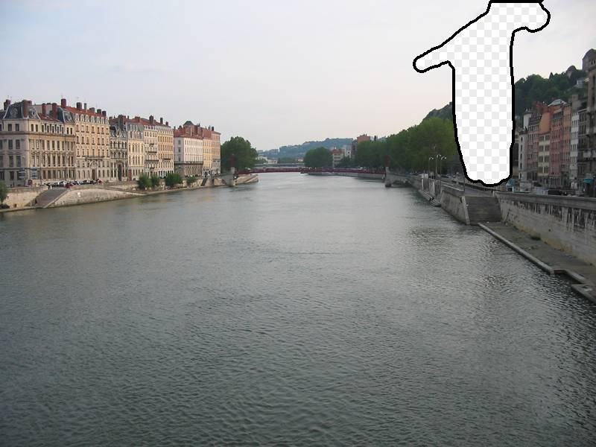
Notes:
37

Slide 38
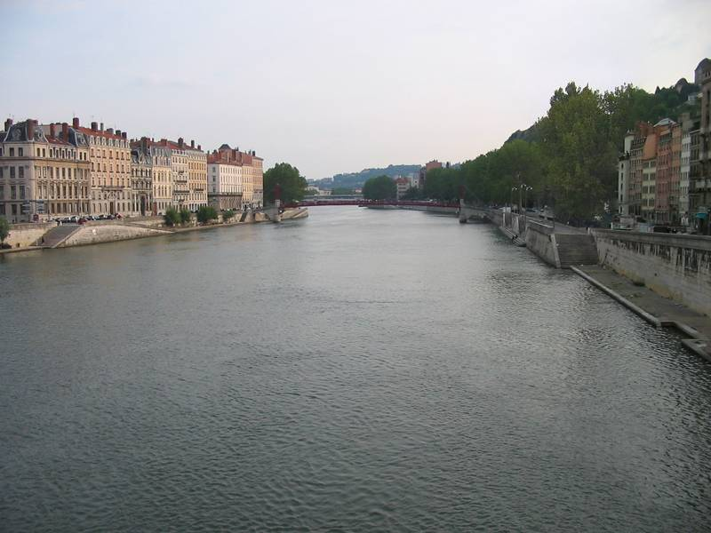
Notes:
38

Slide 39
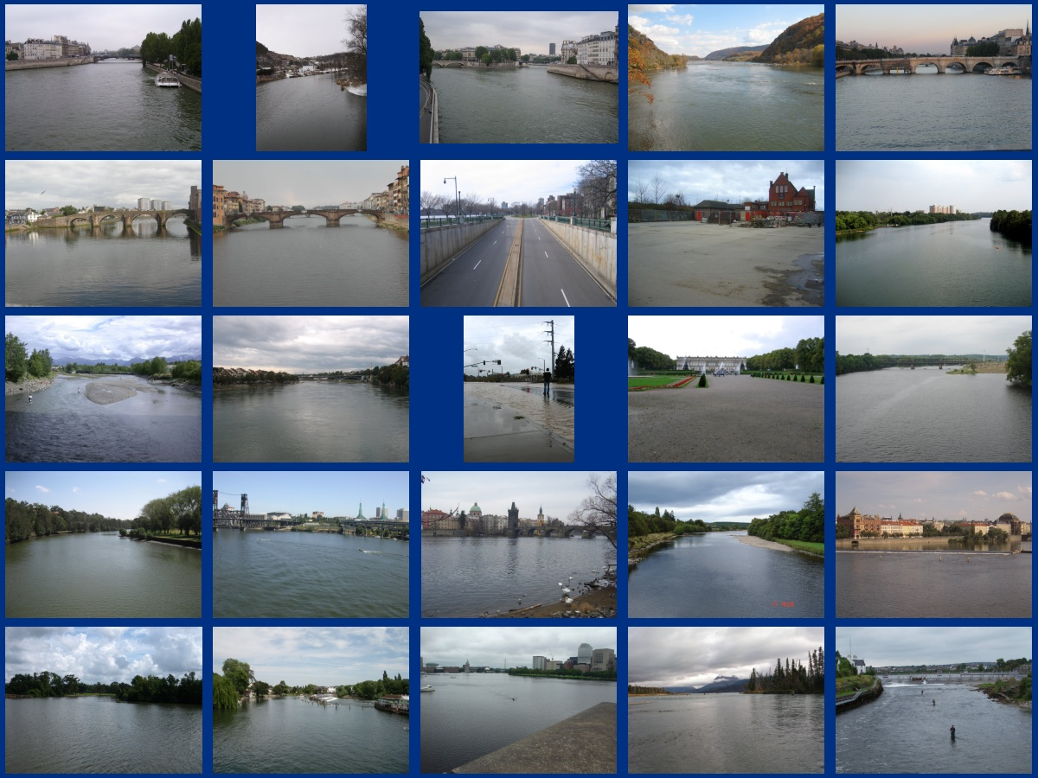
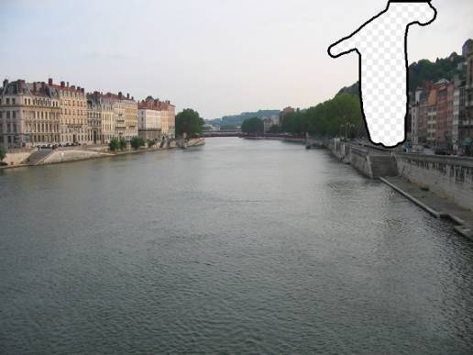
… 200 scene matches
Notes:
39

Slide 40
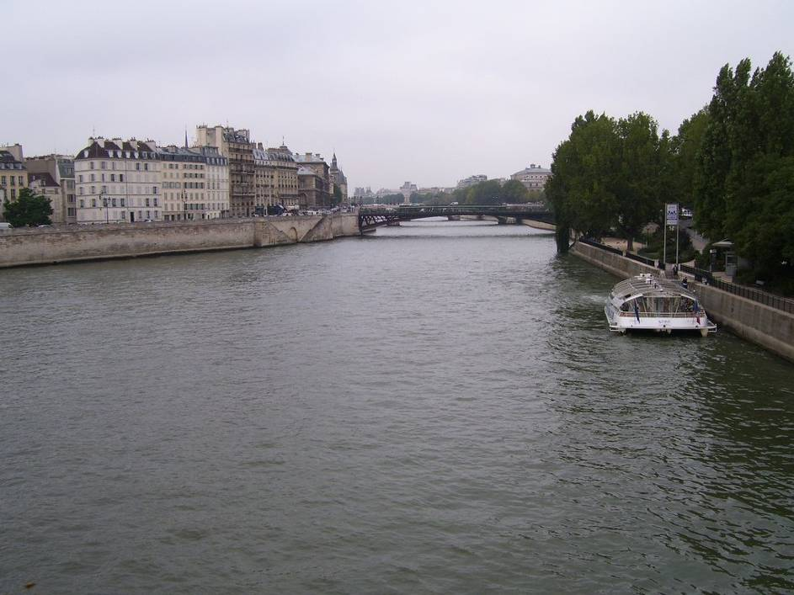
Notes:
40
Not actually the same scene, even though they’re startlingly similar

Slide 42
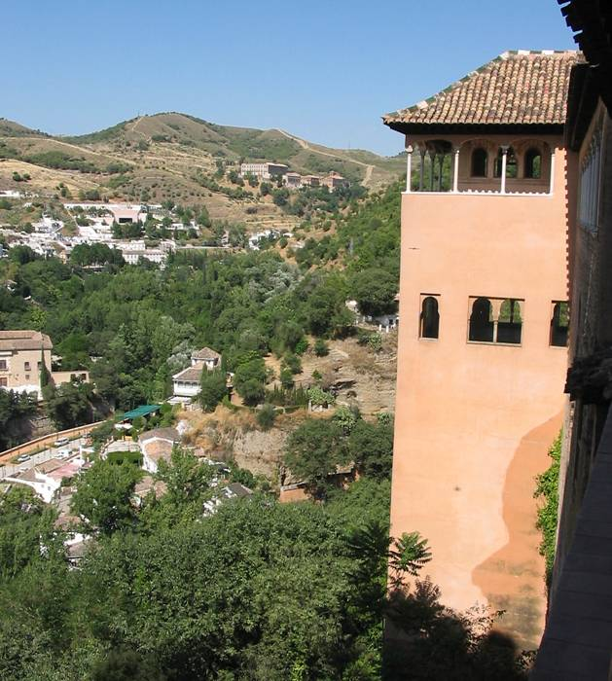

Slide 43
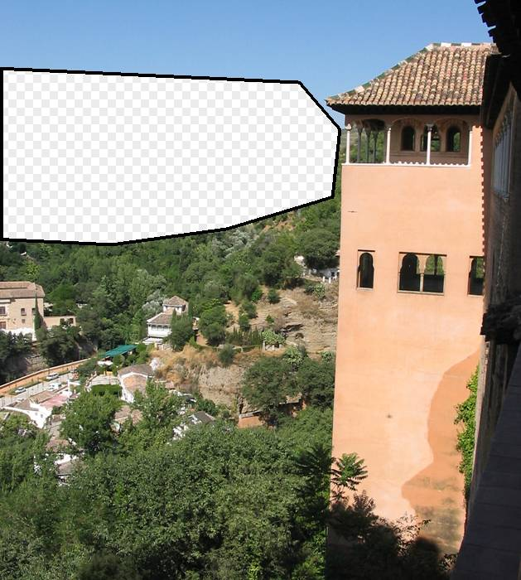

Slide 44


Slide 45


Which is the original?

Slide 46


Slide 47

Notes:
47

Slide 48

Notes:
48
Can justify broader use of image completion here

Slide 49

Diffusion Result
Notes:
49

Slide 50

Efros and Leung result
Notes:
50
Efros and leung result

Slide 51

Scene Completion Result

Slide 52

im2gps (Hays & Efros, CVPR 2008)
6 million geo-tagged Flickr images

Slide 53

How much can an image tell about its geographic location?

Slide 54


Slide 55


Slide 56

Im2gps

Slide 57

Example Scene Matches

Slide 58

Voting Scheme
Notes:
Probability map for that same image
Explain the green circles and how they relate to evaluation
58

Slide 59

im2gps

Slide 60


Slide 61


Slide 62

Population density ranking

Slide 63

Where is This?
[Olga Vesselova, Vangelis Kalogerakis, Aaron Hertzmann, James Hays, Alexei A. Efros. Image Sequence Geolocation. ICCV’09]
Notes:
63

Slide 64

Where is This?

Slide 65

Where are These?
15:14,
June 18th, 2006
16:31,
June 18th, 2006
Notes:
Individually each photograph is 16%, but together they reinforce each other well
65

Slide 66

Where are These?
15:14,
June 18th, 2006
16:31,
June 18th, 2006
17:24,
June 19th, 2006
Notes:
If you know that brits love to vacation in greece…
66

Slide 67
Results
im2gps – 10% (geo-loc within 400 km)
temporal im2gps – 56%

Slide 68

Tiny Images
80 million tiny images: a large dataset for non-parametric object and scene recognition Antonio Torralba, Rob Fergus and William T. Freeman. PAMI 2008.
http://groups.csail.mit.edu/vision/TinyImages/

Slide 69


Slide 70

Human Scene Recognition

Slide 71





Powers of 10
Number of images on my hard drive: 10⁴
Number of images seen during my first 10 years: 10⁸
(3 images/second * 60 * 60 * 16 * 365 * 10 = 630720000)
Number of images seen by all humanity: 10²⁰
106,456,367,669 humans¹ * 60 years * 3 images/second * 60 * 60 * 16 * 365 =
1 from http://www.prb.org/Articles/2002/HowManyPeopleHaveEverLivedonEarth.aspx
Number of photons in the universe: 10⁸⁸
Number of all 32x32 images: 10⁷³⁷³
256 ^{32*32*3} ~ 10⁷³⁷³
Notes:
so don’t listen to anyone claiming to brute force image space
But most of image space is empty, never observed

Slide 72



Scenes are unique
Notes:
Scene and object recognition at human performance is very hard because we are able to deal with so many different kinds of scenes…
Scenes are so unique.

Slide 73









But not all scenes are so original
Notes:
But most scenes are not really like that. Most of the time, scenes are boring places in which nothing really surprising happens. For instance, this street… there is nothing really special about it. In fact, I can easily find thousands of other street pictures that look just like this. Of course, these scenes are different in the details, just as two faces are different, but at a coarser level they are form by similar objects arranged in a similar spatial configuration.

Slide 74
Lots
Of
Images
A. Torralba, R. Fergus, W.T.Freeman. PAMI 2008

Slide 75
Lots
Of
Images
A. Torralba, R. Fergus, W.T.Freeman. PAMI 2008

Slide 76
Lots
Of
Images

Slide 77






Automatic Colorization
Input
Color Transfer
Color Transfer
Matches (gray)
Matches (w/ color)
Avg Color of Match

Slide 78






Automatic Colorization
Input
Color Transfer
Color Transfer
Matches (gray)
Matches (w/ color)
Avg Color of Match

Slide 79
Encoder – Decoder view
Encoder
Decoder
Input
Output
Encoder: maps input to a new representation
Images with similar encodings should have similar outputs
Decoder: maps encoded representation to output

Slide 80
Encoder – Decoder: simple example
Encoder
Decoder
Input
Output
Encoder: shrink image to 32x32 → 1024x1 intensity vector
Decoder: retrieve nearest neighbor in database and copy color channels

Slide 81
Encoder – Decoder: deep network
Learn parameters of convolutional networks so that encoding / decoding satisfies some training objective for training samples
Encoder
Decoder
Input
Output
Encoder: learned convolutional network
Decoder: learn convolutional network

Slide 82
Convolutional network
image
Convolutional layer
Slide: Lazebnik

Slide 83
Convolutional network
feature map
learned weights
image
Convolutional layer
Slide: Lazebnik

Slide 84
Convolutional network
feature map
learned weights
image
Convolutional layer
Slide: Lazebnik

Slide 85





Convolution as feature extraction
...
Input
Feature Map
Slide: Lazebnik

Slide 86
From fully connected to convolutional networks
feature map
learned weights
image
Convolutional layer
Slide: Lazebnik

Slide 87
From fully connected to convolutional networks
next layer
image
Convolutional layer
Slide: Lazebnik

Slide 88
Key operations in a CNN
Feature maps
Spatial pooling
Non-linearity
Convolution (Learned)
...
Input Image
Input
Feature Map
Source: R. Fergus, Y. LeCun
Slide: Lazebnik

Slide 89

Key operations
Feature maps
Spatial pooling
Rectified Linear Unit (ReLU)
Non-linearity
Convolution (Learned)
Input Image
Source: R. Fergus, Y. LeCun
Slide: Lazebnik

Slide 90


Key operations
Feature maps
Spatial pooling
  Max
Non-linearity
Convolution (Learned)
Input Image
Source: R. Fergus, Y. LeCun
Slide: Lazebnik

Slide 91

Quick summary of deep network encoders
Create encoding by passing image through a series of steps
  Feature generation
    Apply filters
    ReLU: Zero out negative values
    Downsample or “pool” by taking average or max response
  Vectorize and add dense neural network layers
AlexNet: achieved good results on ImageNet in 2012 to convince computer vision researchers of potential

Slide 92

Most popular architecture is ResNet which adds “skip” connections
Layers add their response to previous layer outputs so they don’t need to re-encode it
Makes network more compact and easier to train
ResNet Architecture

Slide 93
Key factors in network performance
Objective function: defines what the network is trying to do
Architecture: number of filters, width of “fully connected layers”, connections between layers
Amount of training data: more is better
Optimization: normalization and gradient descent tools

Slide 94
Example: im2gps
Encoder: deep network that trains to classify images into one of a large number of global regions (classification layers are discarded)
Decoder: retrieve image(s) with similar encoded representations
“Revisiting Im2GPS in the Deep Learning Era”, Vo, Jacobs, Hays 2017

Slide 95
SIGGRAPH 2017

Slide 96
Why deep networks work
“End-to-end training”: feature learner (encoder) and regressor/classifier (decoder) guided by same objective
Flexible objective design: can use any differentiable function to guide learning
Convolutional features make sense for images because they are shift invariant and have relatively few parameters
High capacity – can encode lots of data

Slide 97
Summary
Many questions have been asked before, photos have been taken before
Sometimes, we can shortcut hard problems by looking up the answer
Deep networks learn features that make the lookup more effective

Slide 98
Next class
Generating and detecting fakes

Slide 99
Old

Slide 100




Photo Clip Art [SG’07]
Inserting a single object -- still very hard!
object size, orientation
scene illumination
Lalonde et al, SIGGRAPH 2007

Slide 101


Photo Clip Art [SG’07]
Use database to find well-fitting object
Lalonde et al, SIGGRAPH 2007
Notes:
Instead of trying to solve this impossibly hard problem, we observe that object insertion becomes much easier if we have a database of objects, and we try to insert AN object instead of THIS object. One major contribution of this work is to pose the problem of image compositing in a data-driven way: instead of creating new appearance, query a large database. It’s a bit like visual google for compositing.

Slide 102
CG2Real
CG2Real: Improving the Realism of Computer Generated Images using a Large Collection of Photographs, Johnson, Dale, Avidan, Pfister, Freeman, Matusik, Tech. Rep. MIT-CSAIL-TR-2009-034

Slide 103
Image Restoration using Online Photo Collections [ICCV’09]
Dale, Johnson, Sunkavalli, Matusik, Pfister, ICCV’09

Slide 104

Tour from a single image
Scene matching with camera transformations

Slide 105





Tour from a single image
Navigate the virtual space using intuitive motion controls

Slide 106
Video
http://www.youtube.com/watch?v=E0rboU10rPo

