Slide 1
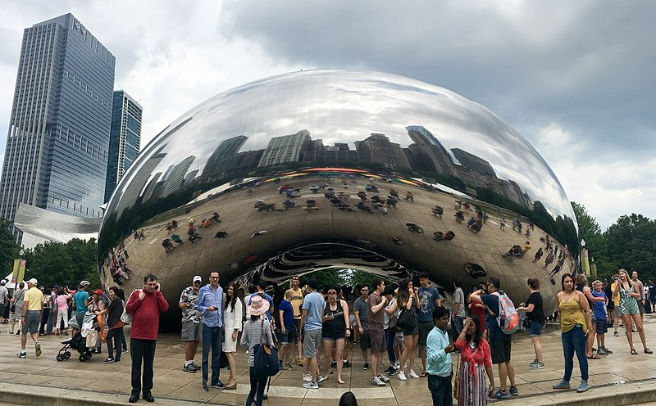
Image Warping
Computational Photography
Yuxiong Wang, University of Illinois
Slides adopted from Derek Hoiem
Many slides from Alyosha Efros + Steve Seitz
Photo by Piet Theisohn
Notes:
Show applications (alignment for hybrid image, face morphing, photo stitching) and example of transformation

Slide 2
Reminder: Proj 2 due soon
Much more difficult than project 1 – get started asap if not already
Must compute SSD cost for every pixel (slow but not horribly slow using filtering method; see tips at end of project page)
Learn how to debug visual algorithms: imshow, plot, breakpoints are helpful
  Debugging suggestion: For “quilt_simple”, first set upper-left patch to be upper-left patch in source and iteratively find minimum cost patch and overlay --- should reproduce original source image, at least for part of the output

Slide 3
Review from last class: Gradient Domain Editing
General concept: Solve for pixels of new image that satisfy constraints on the gradient and the intensity
  Constraints can be from one image (for filtering) or more (for blending)

Slide 4

Project 3: Reconstruction from Gradients
Preserve x-y gradients
Preserve intensity of one pixel
Source pixels: s
Variable pixels: v
minimize (v(x+1,y)-v(x,y) - (s(x+1,y)-s(x,y))^2
minimize (v(x,y+1)-v(x,y) - (s(x,y+1)-s(x,y))^2
minimize (v(1,1)-s(1,1))^2

Slide 5
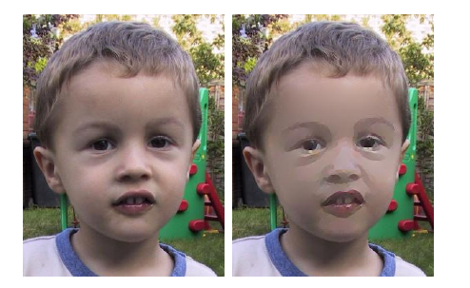
Project 3 (extra): NPR
Preserve gradients on edges
  e.g., get canny edges with edge(im, ‘canny’)
Reduce gradients not on edges
Preserve original intensity
Perez et al. 2003

Slide 6
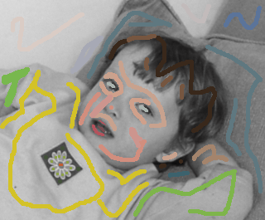

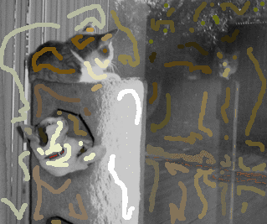
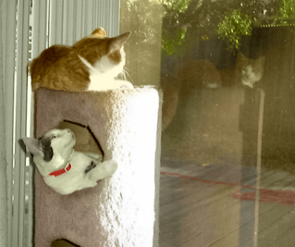
Colorization using optimization
Solve for uv channels (in Luv space) such that similar intensities have similar colors
Minimize squared color difference, weighted by intensity similarity
Solve with sparse linear system of equations
http://www.cs.huji.ac.il/~yweiss/Colorization/

Slide 7
Gradient-domain editing
Many image processing applications can be thought of as trying to manipulate gradients or intensities:
  Contrast enhancement
  Denoising
  Poisson blending
  HDR to RGB
  Color to Gray
  Recoloring
  Texture transfer
See Perez et al. 2003 for many examples

Slide 8
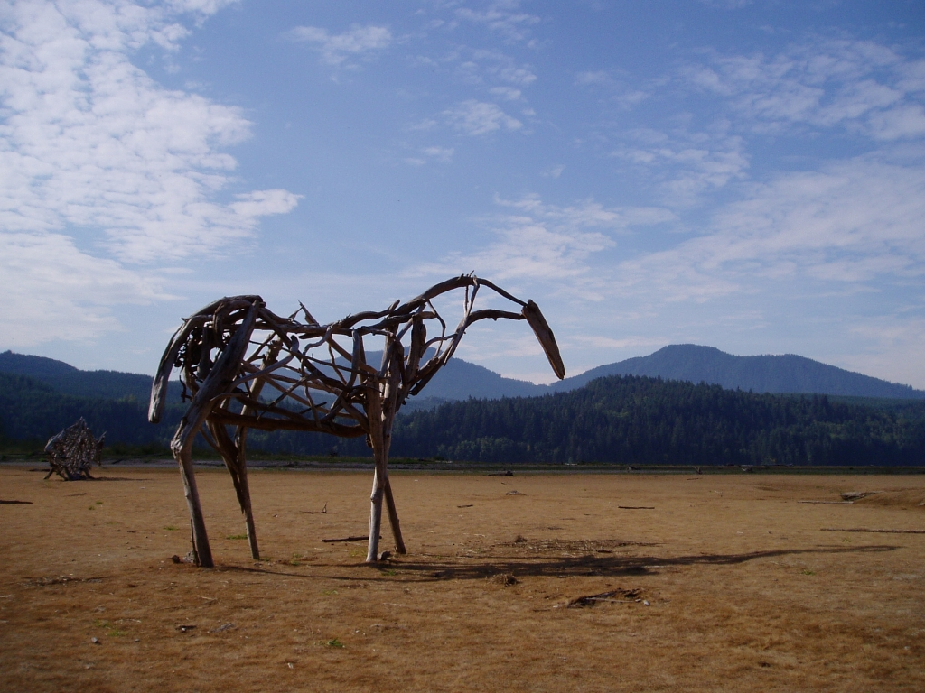
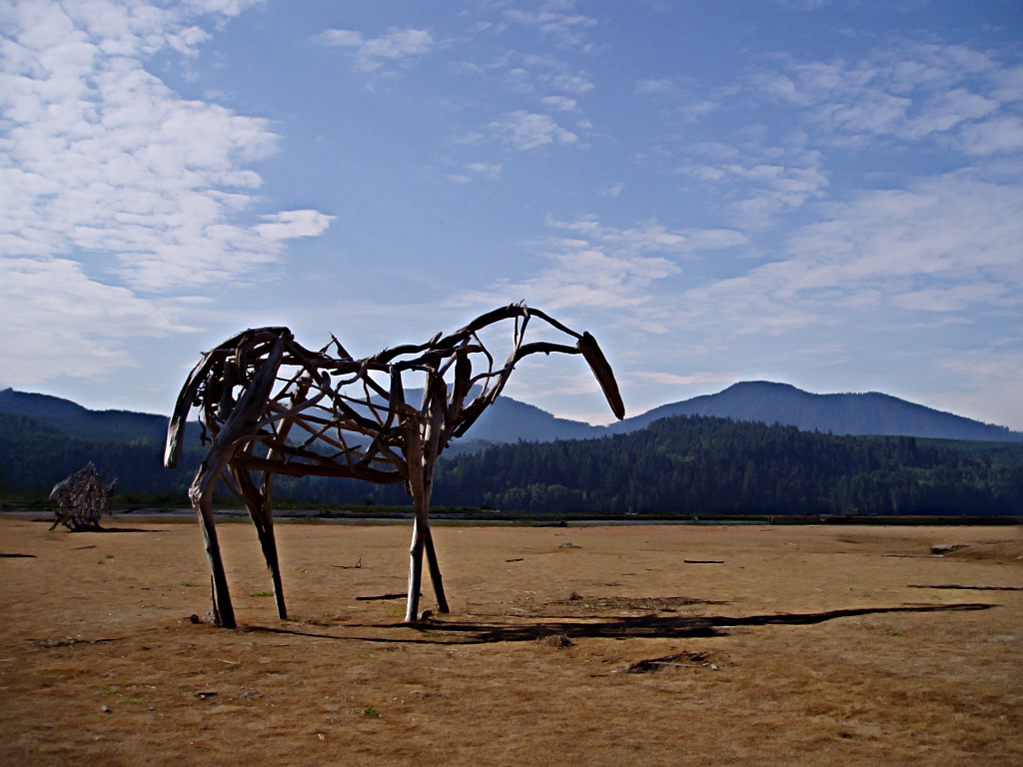
Gradient-domain processing
Saliency-based Sharpening

Slide 9


Gradient-domain processing
Non-photorealistic rendering

Slide 10
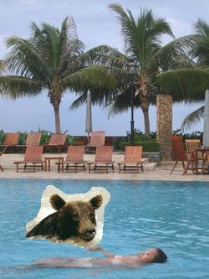
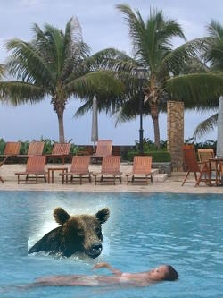

Take-home questions
1) I am trying to blend this bear into this pool. What problems will I have if I use:
  Alpha compositing with feathering
  Laplacian pyramid blending
  Poisson editing?
Lap. Pyramid
Poisson Editing

Slide 11
Take-home questions
2) How would you make a sharpening filter using gradient domain processing? What are the constraints on the gradients and the intensities?

Slide 12
Next two classes: warping and morphing
This class
  Global coordinate transformations
  Image alignment
Next class
  Interpolation and texture mapping
  Meshes and triangulation
  Shape morphing

Slide 13
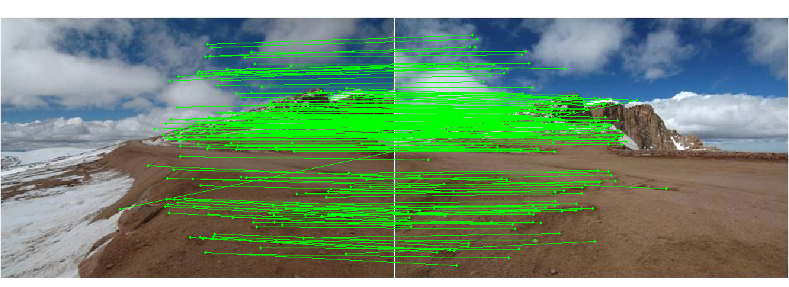
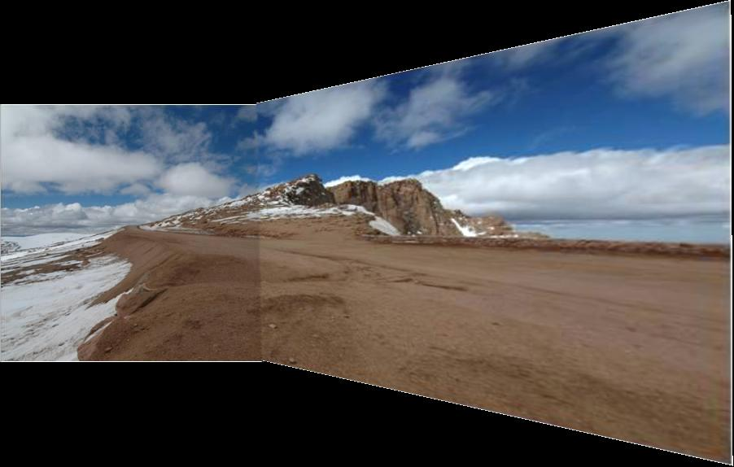
Photo stitching: projective alignment
Find corresponding points in two images
Solve for transformation that aligns the images

Slide 14

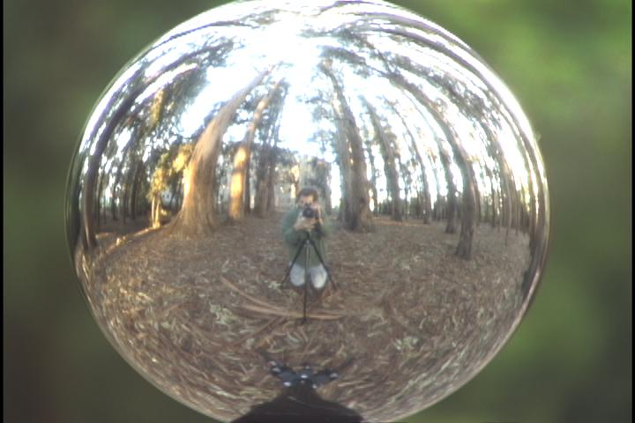
Capturing light fields
Estimate light via projection from spherical surface onto image

Slide 15
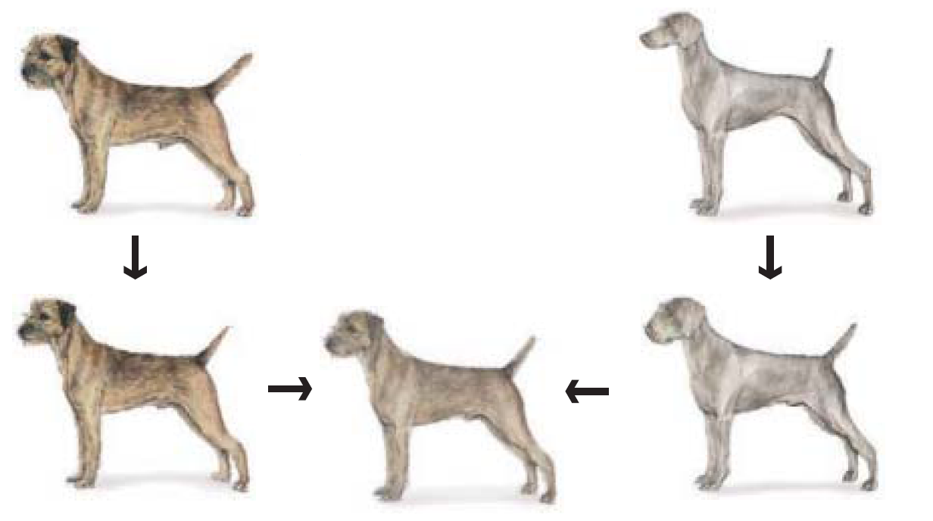
Morphing
Blend from one object to other with a series of local transformations

Slide 16
Image Transformations
image filtering: change range of image
g(x) = T(f(x))
f
f
T
x
x
image warping: change domain of image
g(x) = f(T(x))
f
f
T
x
x

Slide 17

Image Transformations
image filtering: change range of image
g(x) = T(f(x))
f
g
T
image warping: change domain of image
g(x) = f(T(x))
f
g
T

Slide 18
Parametric (global) warping
T
p = (x,y)
p’ = (x’,y’)
Transformation T is a coordinate-changing machine:
p’ = T(p)
What does it mean that T is global?
  Is the same for any point p
  can be described by just a few numbers (parameters)
For linear transformations, we can represent T as a matrix
p’ = Mp

Slide 19


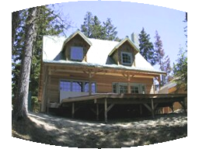

Parametric (global) warping
Examples of parametric warps:
translation
rotation
aspect
perspective
affine
cylindrical

Slide 20
Scaling
Scaling a coordinate means multiplying each of its components by a scalar
Uniform scaling means this scalar is the same for all components:
× 2

Slide 21
Scaling
Non-uniform scaling: different scalars per component:
X × 2,
Y × 0.5

Slide 22
Scaling
Scaling operation:
Or, in matrix form:
scaling matrix S
What is the transformation from (x’, y’) to (x, y)?

Slide 23
2-D Rotation
(x’, y’)
(x, y)
x’ = x cos(θ) - y sin(θ)
y’ = x sin(θ) + y cos(θ)
θ

Slide 24
2-D Rotation
Polar coordinates…
x = r cos (φ)
y = r sin (φ)
x’ = r cos (φ + θ)
y’ = r sin (φ + θ)
Trig Identity…
x’ = r cos(φ) cos(θ) – r sin(φ) sin(θ)
y’ = r sin(φ) cos(θ) + r cos(φ) sin(θ)
Substitute…
x’ = x cos(θ) - y sin(θ)
y’ = x sin(θ) + y cos(θ)
(x’, y’)
(x, y)
θ
φ

Slide 25
2-D Rotation
This is easy to capture in matrix form:
Even though sin(θ) and cos(θ) are nonlinear functions of θ,
  x’ is a linear combination of x and y
  y’ is a linear combination of x and y
What is the inverse transformation?
  Rotation by –θ
  For rotation matrices
R

Slide 26
2x2 Matrices
What types of transformations can be
represented with a 2x2 matrix?
2D Identity?
2D Scale around (0,0)?

Slide 27
2x2 Matrices
What types of transformations can be
represented with a 2x2 matrix?
2D Rotate around (0,0)?
2D Shear?

Slide 28
2x2 Matrices
What types of transformations can be
represented with a 2x2 matrix?
2D Mirror about Y axis?
2D Mirror over (0,0)?

Slide 29
2x2 Matrices
What types of transformations can be
represented with a 2x2 matrix?
2D Translation?
NO!

Slide 30
All 2D Linear Transformations
Linear transformations are combinations of …
  Scale,
  Rotation,
  Shear, and
  Mirror
Properties of linear transformations:
  Origin maps to origin
  Lines map to lines
  Parallel lines remain parallel
  Ratios are preserved
  Closed under composition

Slide 31
Homogeneous Coordinates
Q: How can we represent translation in matrix form?

Slide 32
Homogeneous Coordinates
Homogeneous coordinates
represent coordinates in 2 dimensions with a 3-vector

Slide 33
Homogeneous Coordinates
2D Points → Homogeneous Coordinates
Append 1 to every 2D point: (x y) → (x y 1)
Homogeneous coordinates → 2D Points
Divide by third coordinate (x y w) → (x/w y/w)
Special properties
Scale invariant: (x y w) = k * (x y w)
(x, y, 0) represents a point at infinity
(0, 0, 0) is not allowed
y
Scale Invariance
2
(2,1,1)
or (4,2,2)
or (6,3,3)
1
1
2
x

Slide 34
Homogeneous Coordinates
Q: How can we represent translation in matrix form?
A: Using the rightmost column:

Slide 35
Translation Example
t_{x} = 2
t_{y} = 1

Slide 36
Basic 2D transformations as 3x3 matrices
Translate
Scale
Rotate
Shear

Slide 37
Matrix Composition
Transformations can be combined by
matrix multiplication
p’ = T(t_{x},t_{y}) R(Θ) S(s_{x},s_{y}) p
Does the order of multiplication matter?

Slide 38
Affine Transformations
Affine transformations are combinations of
  Linear transformations, and
  Translations
Properties of affine transformations:
  Origin does not necessarily map to origin
  Lines map to lines
  Parallel lines remain parallel
  Ratios are preserved
  Closed under composition

Slide 39
Projective Transformations
Projective transformations are combos of
  Affine transformations, and
  Projective warps
Properties of projective transformations:
  Origin does not necessarily map to origin
  Lines map to lines
  Parallel lines do not necessarily remain parallel
  Ratios are not preserved
  Closed under composition
  Models change of basis
  Projective matrix is defined up to a scale (8 DOF)

Slide 40
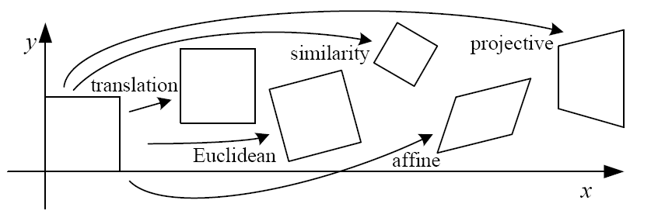
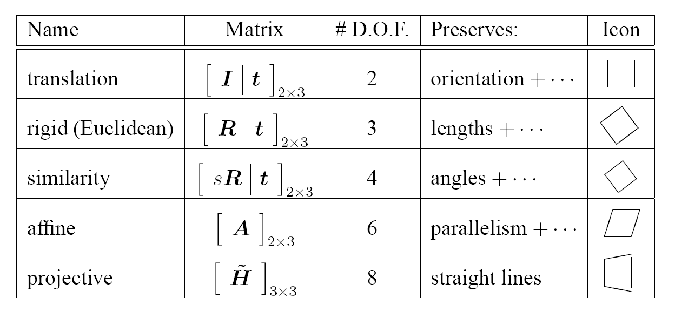
2D image transformations
These transformations are a nested set of groups
  Closed under composition and inverse is a member

Slide 41
Recovering Transformations
?
T(x,y)
y
y’
x
x’
f(x,y)
g(x’,y’)
What if we know f and g and want to recover the transform T?
  willing to let user provide correspondences
    How many do we need?

Slide 42
Translation: # correspondences?
?
T(x,y)
y
y’
x
x’
How many Degrees of Freedom?
How many correspondences needed for translation?
What is the transformation matrix?

Slide 43
Euclidean: # correspondences?
?
T(x,y)
y
y’
x
x’
How many DOF?
How many correspondences needed for translation+rotation?

Slide 44
Affine: # correspondences?
?
T(x,y)
y
y’
x
x’
How many DOF?
How many correspondences needed for affine?

Slide 45
Affine transformation estimation
Math
Matlab demo

Slide 46
Projective: # correspondences?
?
T(x,y)
y
y’
x
x’
How many DOF?
How many correspondences needed for projective?

Slide 47

Take-home Question
1) Suppose we have two triangles: ABC and A’B’C’. What transformation will map A to A’, B to B’, and C to C’? How can we get the parameters?
B
B’
?
T(x,y)
C’
A
C
A’
Source
Destination

Slide 48
Take-home Question
2) Show that distance ratios along a line are preserved under 2d linear transformations.
o
(x3,y3)
o
(x’3,y’3)
o
o
(x2,y2)
o
p1=(x1,y1)
o
(x’2,y’2)
p‘1=(x’1,y’1)
Hint: Write down x2 in terms of x1 and x3, given that the three points are co-linear

Slide 49
Next class: texture mapping and morphing

