Slide 1
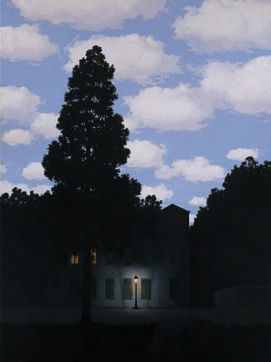
Histograms and Color Balancing
“Empire of Light”, Magritte
Computational Photography
Yuxiong Wang, University of Illinois
Slides adopted from Derek Hoiem

Slide 2
Administrative stuff
Project 1: due Friday
Part I: Hybrid Images
Part II: Enhance Contrast/Color
Start thinking about final project topics and find teammates

Slide 3
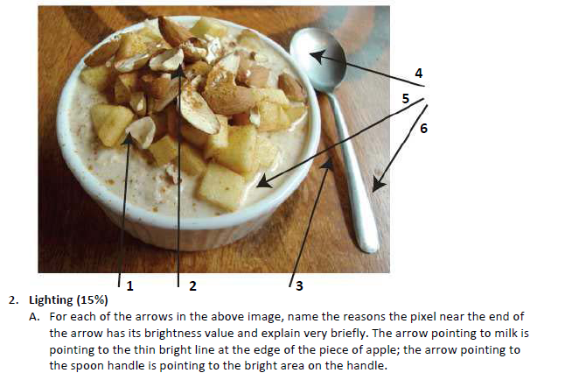
Review of last class
Possible factors: albedo, shadows, texture, specularities, curvature, lighting direction

Slide 4
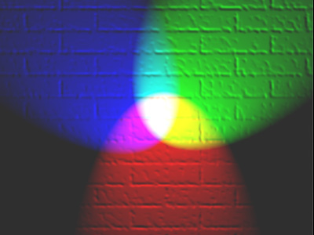
Today’s class
How can we represent color?
How do we adjust the intensity of an image to improve contrast, aesthetics?

Slide 5
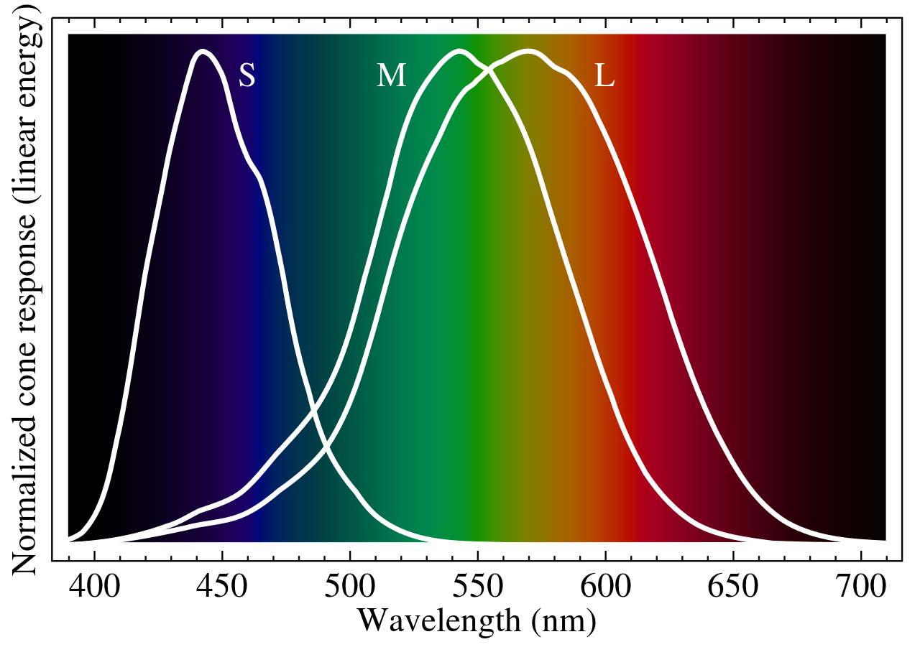
Human eye cone responsivity

Slide 6
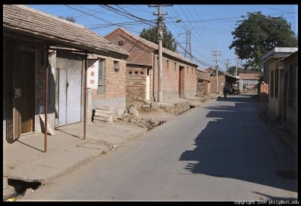
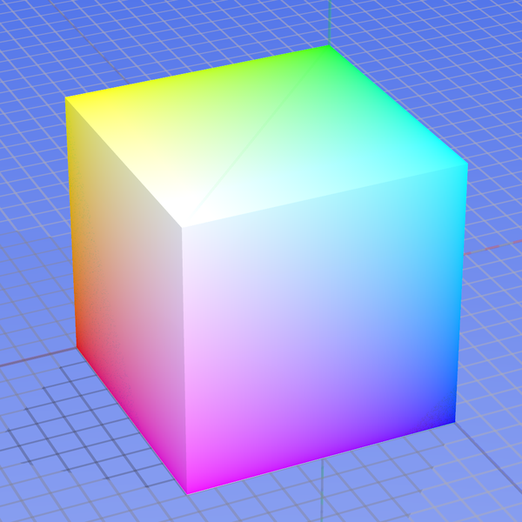
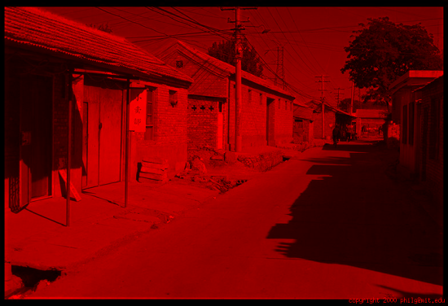
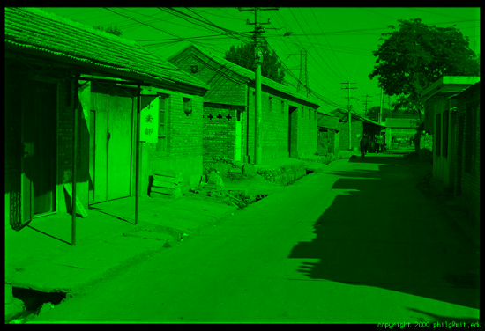
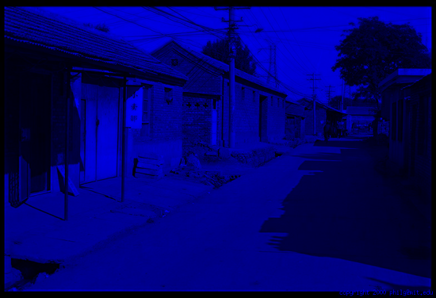
Color spaces: RGB
Default color space
0,1,0
R
(G=0,B=0)
1,0,0
G
(R=0,B=0)
0,0,1
B
(R=0,G=0)
Some drawbacks
Strongly correlated channels
Non-perceptual
Image from: http://en.wikipedia.org/wiki/File:RGB_color_solid_cube.png

Slide 7
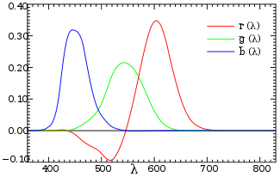
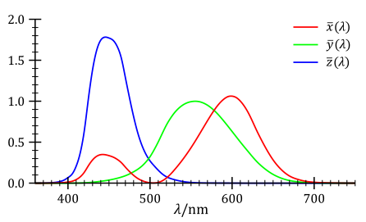
Trichromacy and CIE-XYZ
Perceptual equivalents with RGB
Perceptual equivalents with CIE-XYZ

Slide 8
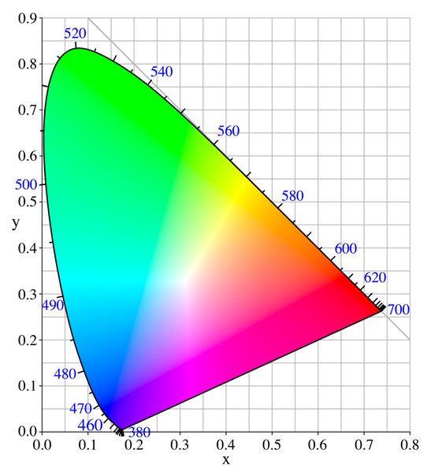
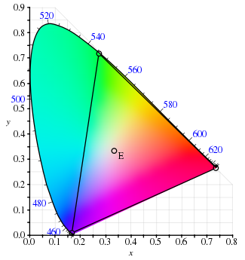
Color Space: CIE-XYZ
RGB portion is in triangle

Slide 9
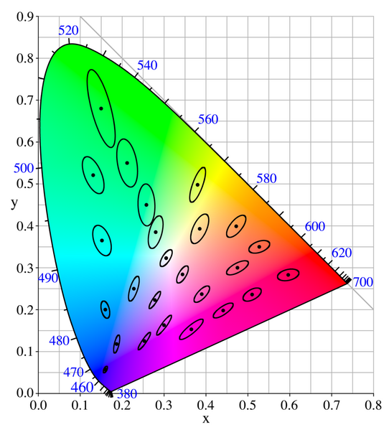
Perceptual uniformity

Slide 10
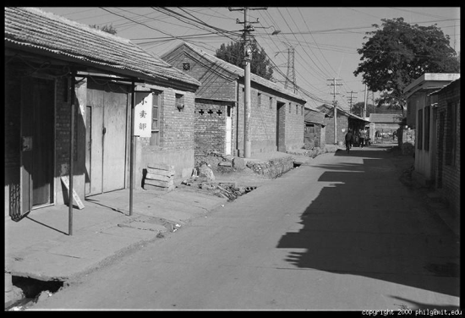
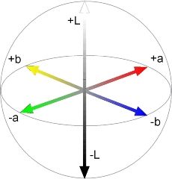
Color spaces: CIE L*a*b*
“Perceptually uniform” color space
L
(a=0,b=0)
a
(L=65,b=0)
b
(L=65,a=0)
Luminance = brightness
Chrominance = color

Slide 11
If you had to choose, would you rather go without luminance or chrominance?

Slide 12
If you had to choose, would you rather go without luminance or chrominance?

Slide 13
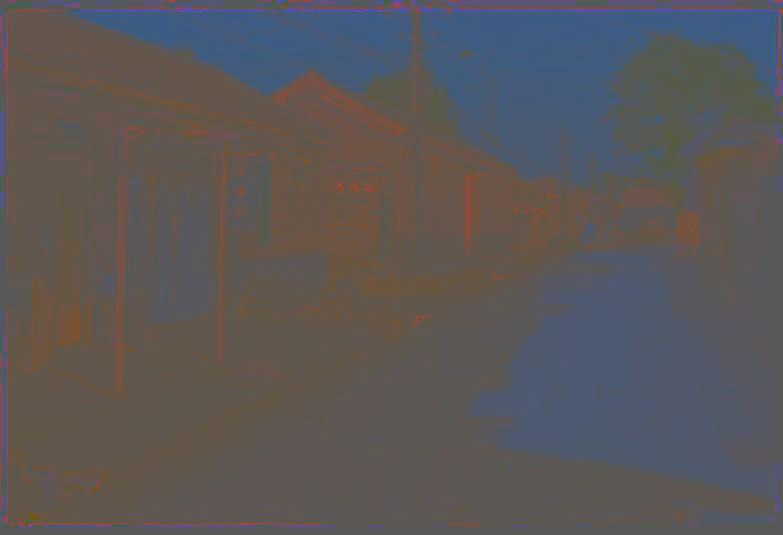
Most information in intensity
Only color shown – constant intensity

Slide 14
Most information in intensity
Only intensity shown – constant color

Slide 15
Most information in intensity
Original image
Image from Phillip Greenspun, used with permission

Slide 16
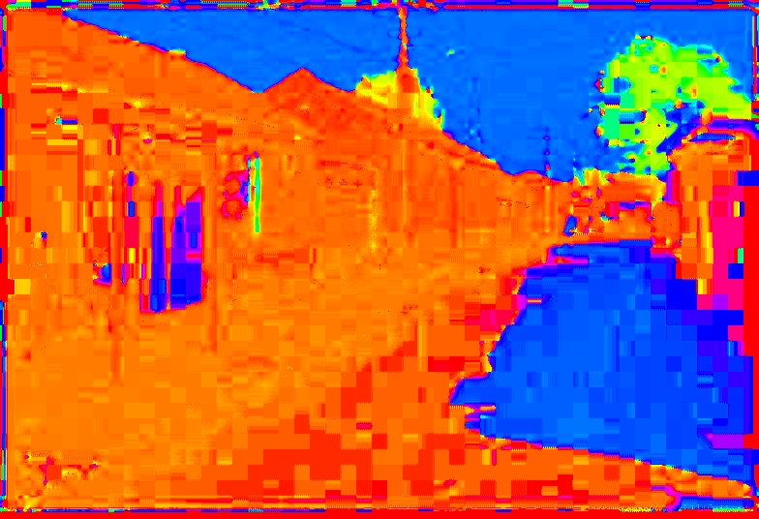
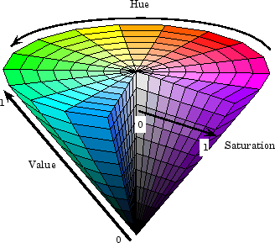
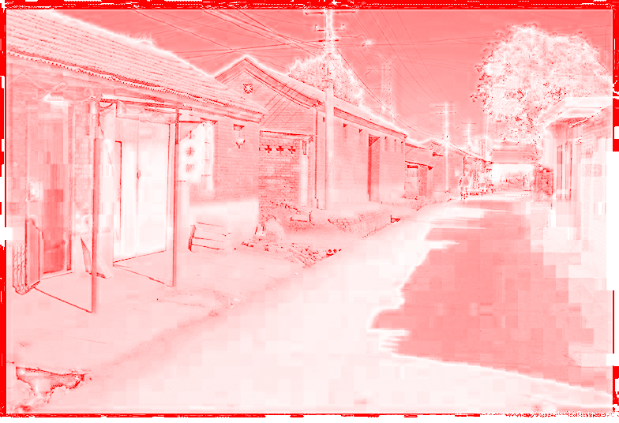
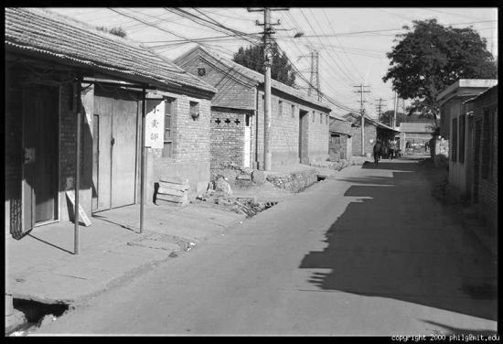
Color spaces: HSV
Intuitive color space
H
(S=1,V=1)
S
(H=1,V=1)
V
(H=1,S=0)

Slide 17
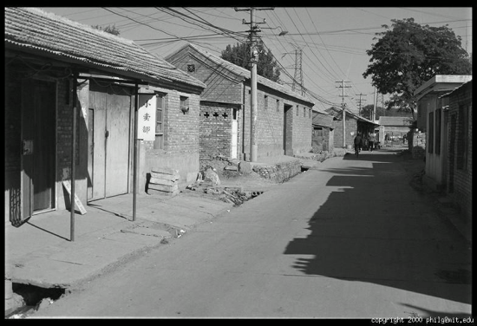
Color spaces: YCbCr
Fast to compute, good for compression, used by TV
Y=0
Y=0.5
Y
(Cb=0.5,Cr=0.5)
Cr
Cb
(Y=0.5,Cr=0.5)
Cb
Y=1
Cr
(Y=0.5,Cb=05)

Slide 18
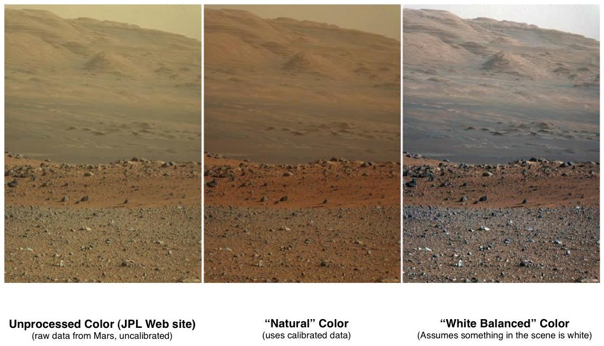
Color balancing

Slide 19
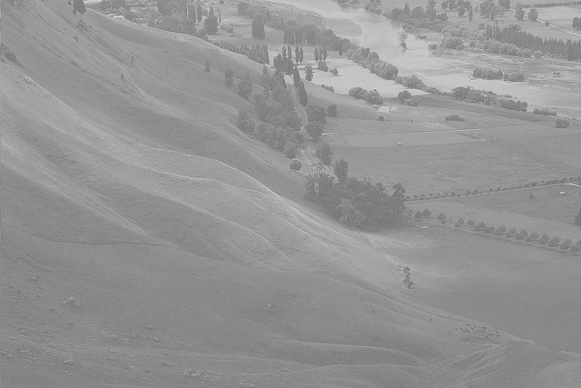
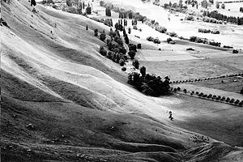
Contrast enhancement
http://en.wikipedia.org/wiki/Histogram_equalization

Slide 20
Important ideas
Typical images are gray on average; this can be used to detect distortions
Larger differences are more visible, so using the full intensity range improves visibility
It’s often easier to work in a non-RGB color space

Slide 21
Color balancing via linear adjustment
Simple idea: multiply R, G, and B values by separate constants
$\left[\begin{matrix}\tilde{r} \\ \tilde{g} \\ \tilde{b}\end{matrix}\right]$=$\left[\begin{matrix}αr & 0 & 0 \\ 0 & αg & 0 \\ 0 & 0 & αb\end{matrix}\right]\left[\begin{matrix}r \\ g \\ b\end{matrix}\right]$
How to choose the constants?
“Gray world” assumption: average value should be gray
White balancing: choose a reference as the white or gray color
Better to balance in camera’s RGB (linear) than display RGB (non-linear)
Notes:
Demo

Slide 22
Tone Mapping
Typical problem: compress values from a high range to a smaller range
E.g., camera captures 12-bit linear intensity and needs to compress to 8 bits

Slide 23
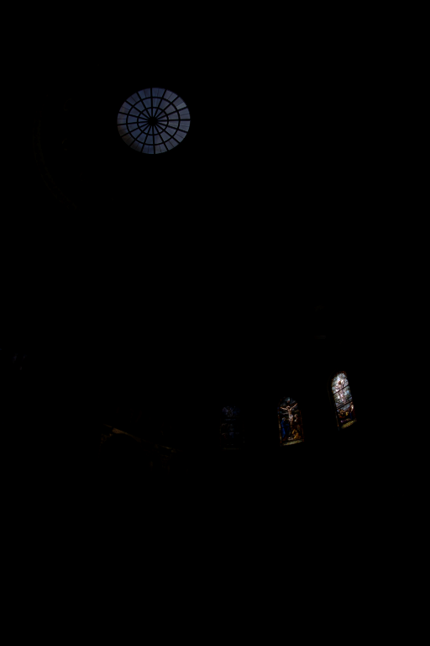
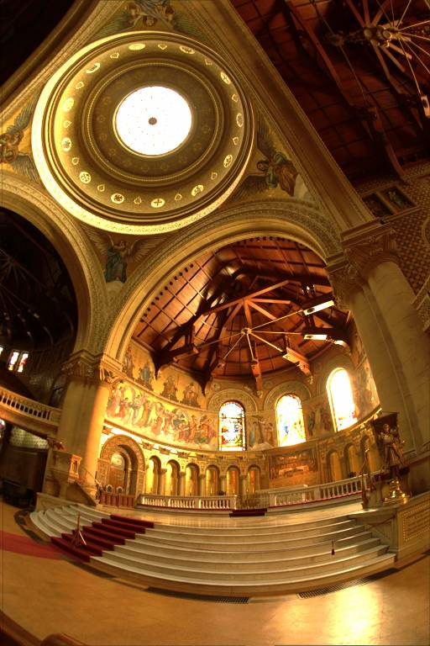
Example: Linear display of HDR
Scaled for brightest pixels
Scaled for darkest pixels

Slide 24
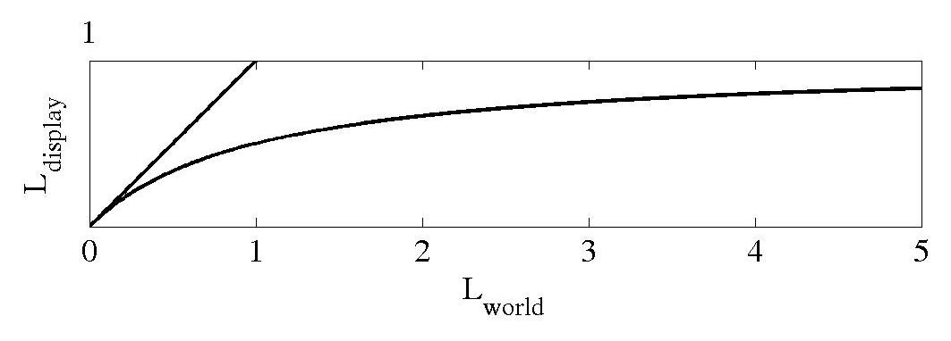
Global operator (Reinhart et al.)
Simple solution: map to a non-linear range of values

Slide 25
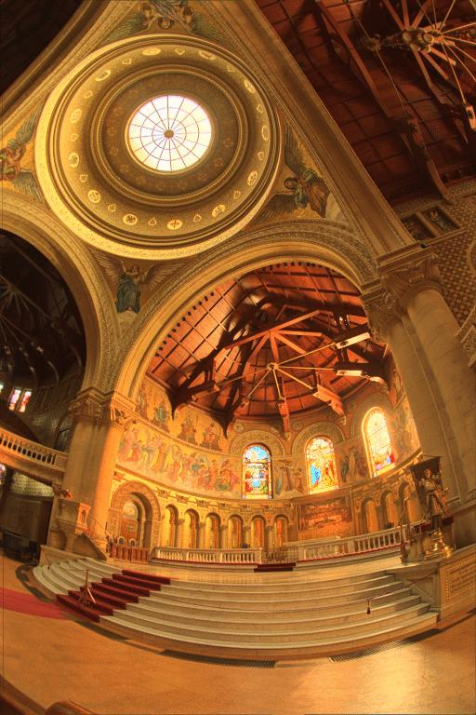
Reinhart Operator
Darkest 0.1% scaled to display

Slide 26
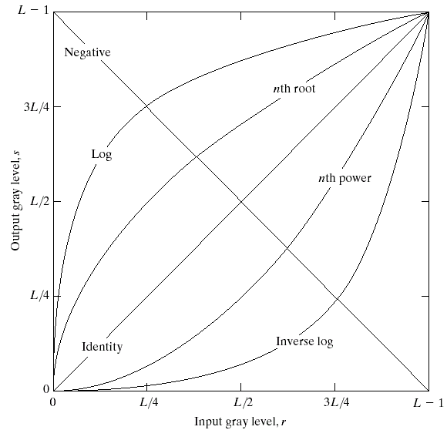
Point Processing: apply a function to each pixel intensity to map it to a new value

Slide 27
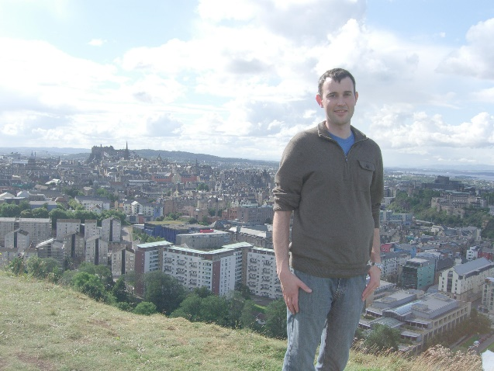
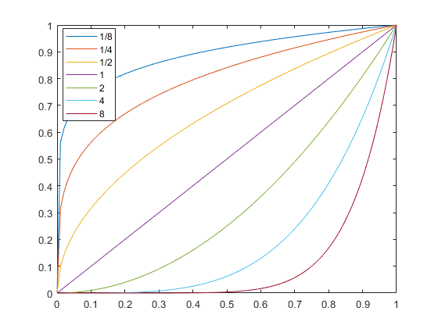
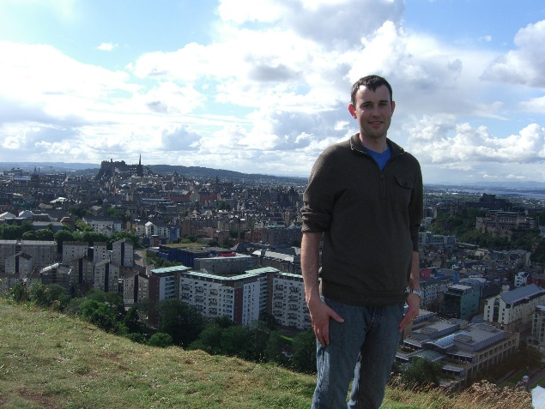
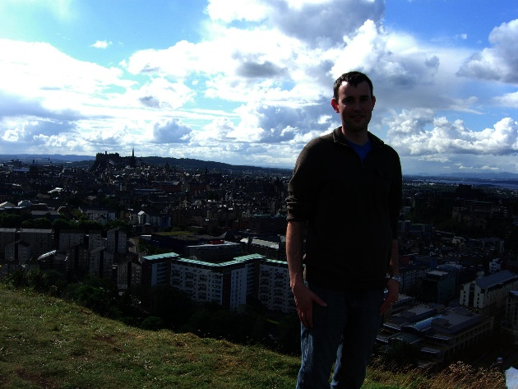
Gamma adjustment
$$iout=iinγ$$
$γ$ = 0.5
Intensity Out
$γ$ = 1
Intensity In
$γ$ = 2

Slide 28
Matlab example

Slide 29
Histogram equalization
Basic idea: reassign values so that the number of pixels with each value is more evenly distributed
Histogram: a count of how many pixels have each value
$$hi=\sum_{j∈pixels}{1(p_{j}}==i)$$
Cumulative histogram: count of number of pixels less than or equal to each value
$$ci=c_{i−1}+h_{i}$$
Notes:
Do simple example of histogram on board: 3 1 2 1 2 3 4 1 5 4 3 2 1 = [(1, 4), …]

Slide 30
Histogram is count of elements that have a particular value or range of values
A = [1 1 2 3 3 3 5 6]
H = hist(A, 1:6)
H = [2 1 3 0 1 1]
C = cumsum(H)
C = [2 3 6 6 7 8]
B = [5 6 6 6 8 8 9]
H = hist(B, 5:9)
H = ?
C = ?

Slide 31
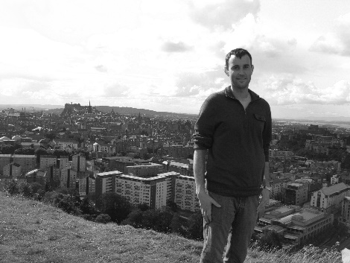
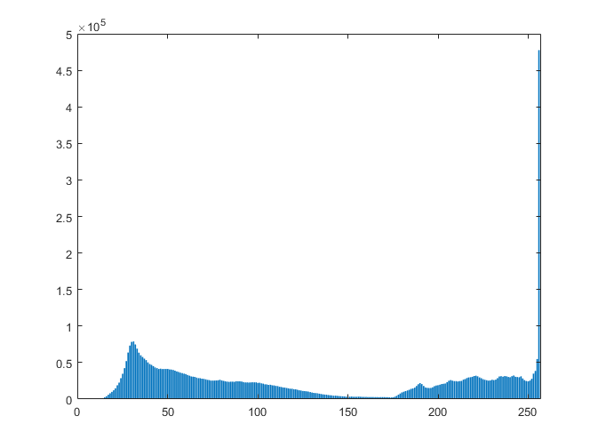
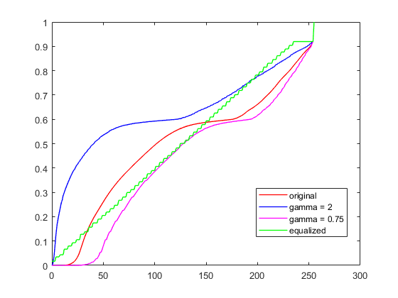
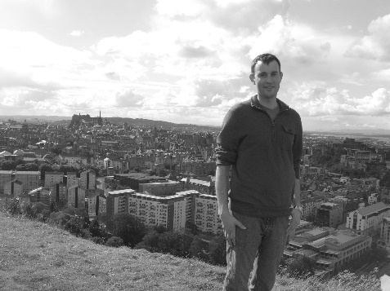
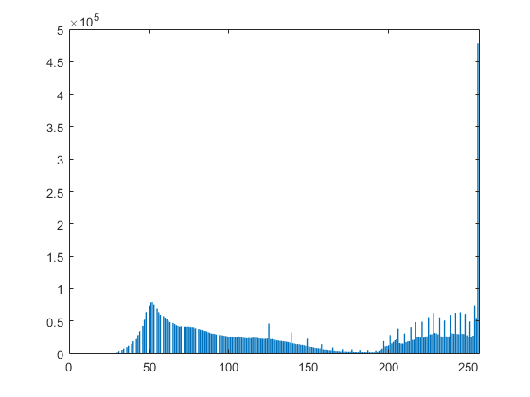
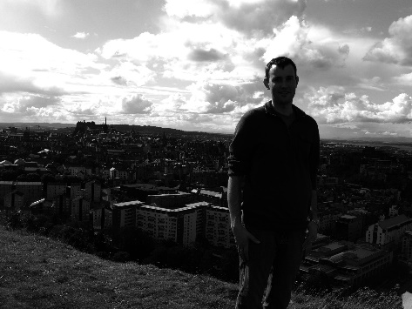
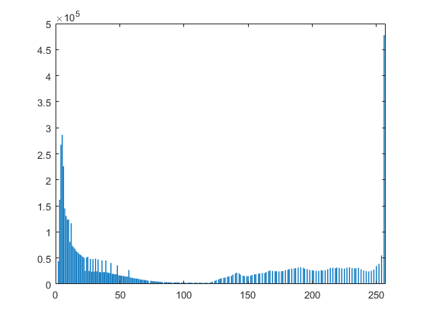
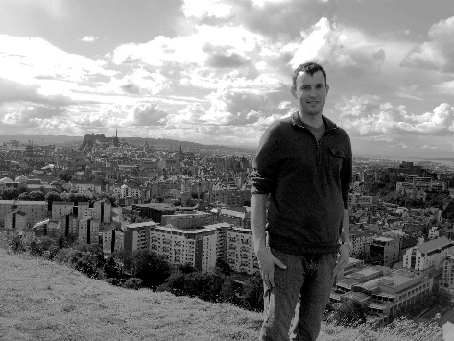
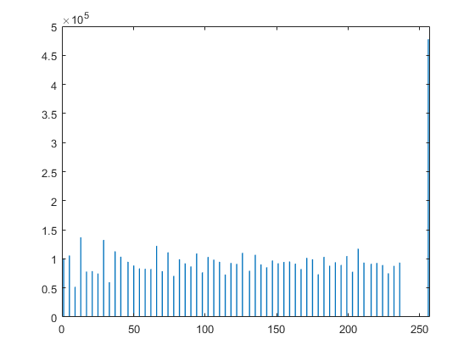
Image Histograms
Cumulative Histograms

Slide 32
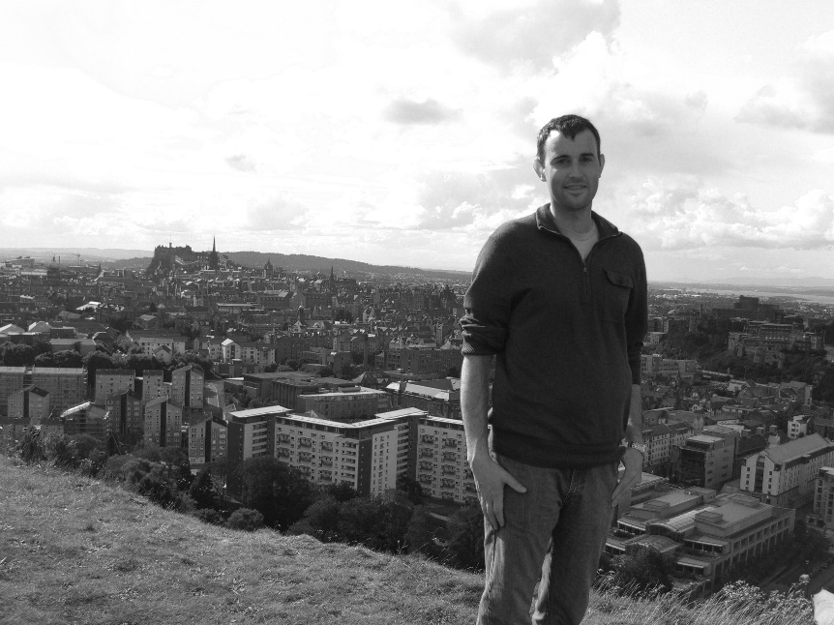
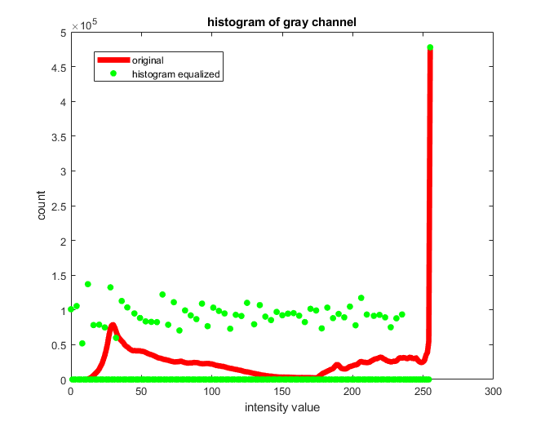
Histogram Equalization

Slide 33
Algorithm for global histogram equalization
Goal: Given image with pixel values$0≤pj≤255, j=0..N$
specify function $f(i)$ that remaps pixel values, so that the new values are more broadly distributed
Compute cumulative histogram: $c\left(i\right), i=0..255$
$h(i)=\sum_{j∈pixels}{1(p_{j}}==i)$, $c(i)=c(i−1)+h(i)$
2. $f\left(i\right)=α⋅\frac{c\left(i\right)}{N}⋅255+\left(1−α\right)⋅i$
Blends between original image and image with equalized histogram
Notes:
Show this on board for an image with alpha = 0:0.05:1. Cumulative histogram maps pixel intensity to its percentile

Slide 34
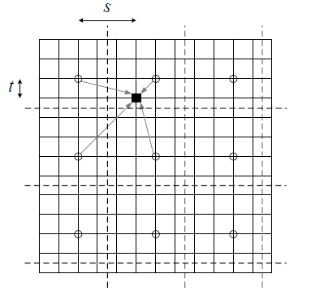
Locally weighted histograms
Compute cumulative histograms in non-overlapping MxM grid
For each pixel, interpolate between the histograms from the four nearest grid cells
Figure from Szeliski book (Fig. 3.9)
Pixel (black) is mapped based on interpolated value from its cell and nearest horizontal, vertical, diagonal neighbors
Notes:
adapthisteq in Matlab

Slide 35
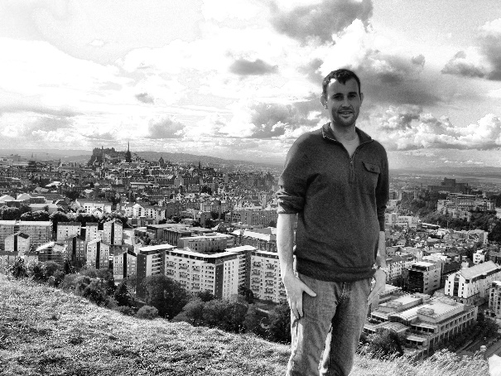
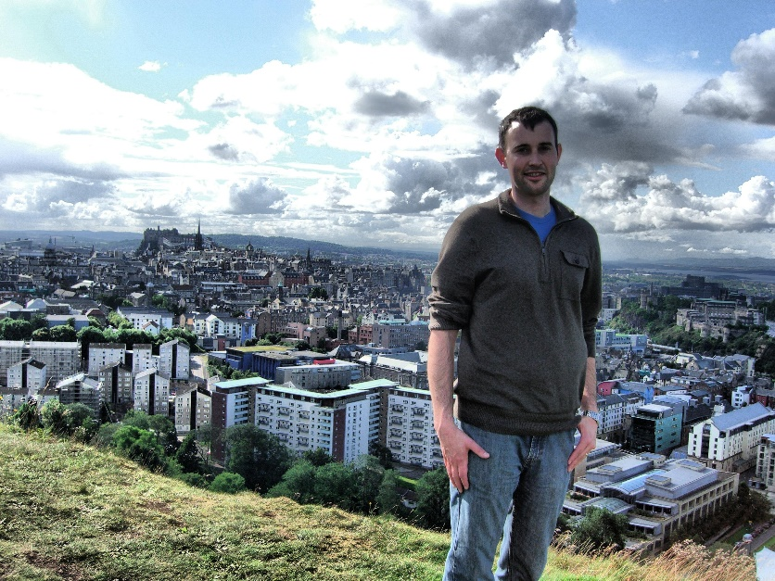
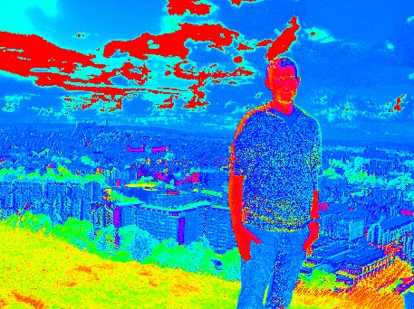
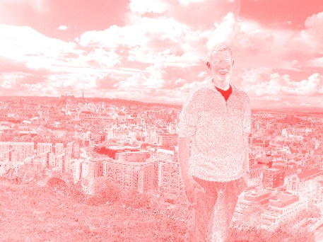
Application of adaptive histogram equalization to color image
rgb2hsv
Locally Adaptive Histogram Equalization of “v” channel
hsv2rgb

Slide 36
Before
After

Slide 37
Other issues
Dealing with color images
Often better to split into luminance and chrominance to avoid unwanted color shift
Manipulating particular regions
Can use mask to select particular areas for manipulation
Useful Python functions/modules
skimage.color: color conversion, e.g. rgb2hsv
numpy: histogram, cumsum

Slide 38
Matlab Example 2

Slide 39
Things to remember
Familiarize yourself with the basic color spaces: RGB, HSV, Lab
Simple auto contrast/color adjustments: gray world assumption, histogram equalization
When improving contrast in a color image, often best to operate on luminance channel

Slide 40
Next class: texture synthesis and transfer

