Slide 1
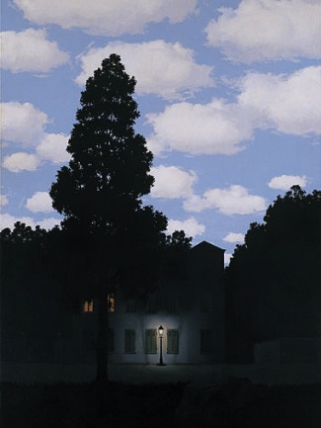
Light and Color
Computational Photography
Yuxiong Wang, University of Illinois
“Empire of Light”, Magritte

Slide 2
Announcement
Project 1 due Friday (9/17), 11:59pm
  Don’t use built-in code for pyramids, contrast equalization, etc.
  Ask if not sure

Slide 3
Today’s class
How is incoming light measured by the eye or camera?
Incoming Light
Lens
Sensors/Retina

Slide 4
Today’s class
How is incoming light measured by the eye or camera?
How is light reflected from a surface?
Light source
Reflected Light
Incoming Light
Lens
Sensors/Retina
Notes:
Basis for vision, graphics

Slide 5
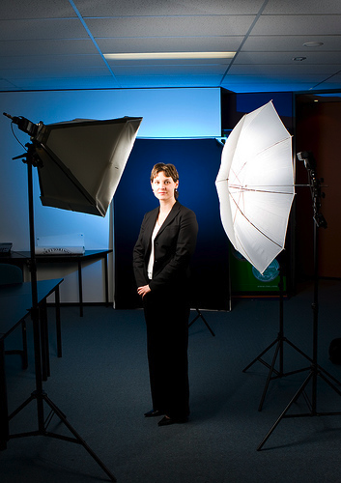
Photo by nickwheeleroz, Flickr
Slide: Forsyth

Slide 6
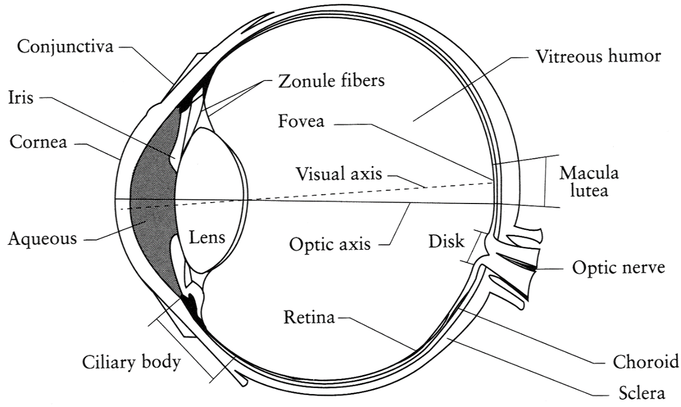
The Eye
The human eye is a camera!
  Iris - colored annulus with radial muscles
  Pupil - the hole (aperture) whose size is controlled by the iris
  What’s the “film”?
    photoreceptor cells (rods and cones) in the retina
Image credit: Fig. 1.1, Principles of Digital Image Synthesis, Volume 1. Andrew Glassner

Slide 7
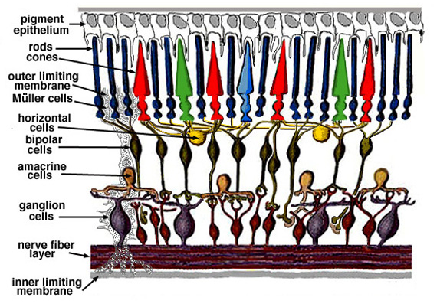
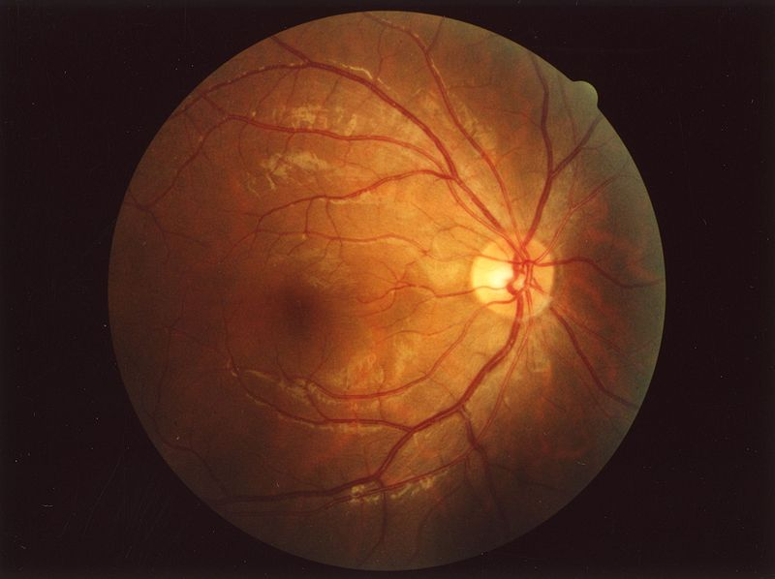
Retina up-close
Light
Notes:
Floaty things in your vision are white blood cells in capillaries. Some animals have two foveas (some birds) and some have none (cats and dogs). 100x sensors than nerve fibers: much processing (e.g., center surround) in retina itself.
Ganglion measure light intensity to adjust the pupil size and regulate melatonin and the body clock. Amacrine serve a variety of purposes. Remainder are for processing.

Slide 8
Two types of light-sensitive receptors
Cones
cone-shaped
less sensitive
operate in high light
color vision
Rods
rod-shaped
highly sensitive
operate at night
gray-scale vision
slower to respond
Slide Credit: Efros

Slide 9
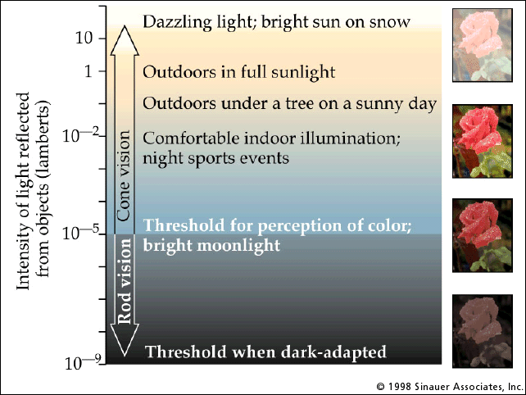
Rod / Cone sensitivity
Notes:
Sock matching in dark is difficult. Static contrast ratio of 100:1, dynamic range of 10^14.

Slide 10
Distribution of Rods and Cones
Night Sky: why are there more stars off-center?
© Stephen E. Palmer, 2002
Slide Credit: Efros

Slide 11
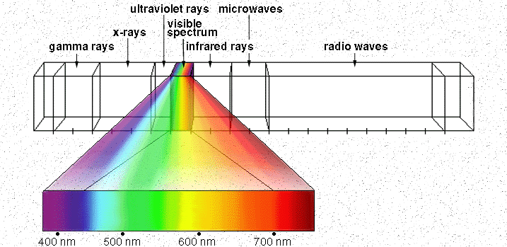

Electromagnetic Spectrum
Human Luminance Sensitivity Function
http://www.yorku.ca/eye/photopik.htm
Slide Credit: Efros
Notes:
At least 3 spectral bands required (e.g. R,G,B)

Slide 12
Visible Light
Why do we see light of these wavelengths?
…because that’s where the
Sun radiates EM energy
© Stephen E. Palmer, 2002
Complete “Color Vision” by Palmer slides

Slide 13
The Physics of Light
Any patch of light can be completely described
physically by its spectrum: the number of photons
(per time unit) at each wavelength 400 - 700 nm.
© Stephen E. Palmer, 2002

Slide 14
The Physics of Light
Some examples of the spectra of light sources
© Stephen E. Palmer, 2002

Slide 15
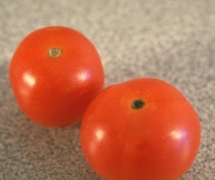
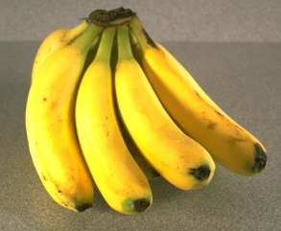
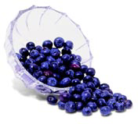
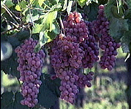
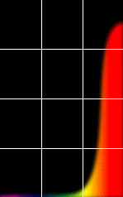
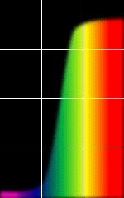
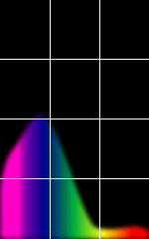
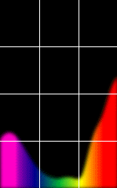
The Physics of Light
Some examples of the reflectance spectra of surfaces
Red
Yellow
Blue
Purple
% Photons Reflected
400 700
400 700
400 700
400 700
Wavelength (nm)
© Stephen E. Palmer, 2002

Slide 16
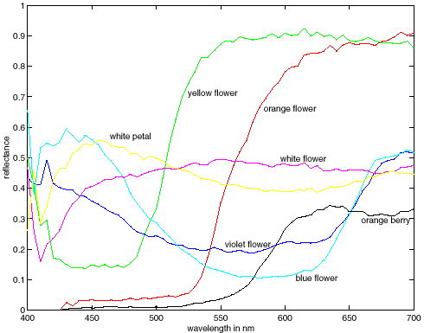
More Spectra
metamers

Slide 17
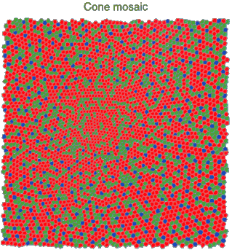
Physiology of Color Vision
Three kinds of cones:
Why are M and L cones so close?
Why are there 3?
© Stephen E. Palmer, 2002
Notes:
Dogs have 2, birds and butterflies have 4

Slide 18
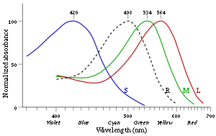
3 is better than 2…
“M” and “L” on the X-chromosome
  Why men are more likely to be color blind
“L” has high variation, so some women are tetrachromatic
Some animals have 1 (night animals), 2 (e.g., dogs), 4 (fish, birds), 5 (pigeons, some reptiles/amphibians), or even 12 (mantis shrimp)
http://en.wikipedia.org/wiki/Color_vision

Slide 19
We don’t perceive a spectrum (or even RGB)
We perceive
  Hue: mean wavelength, color
  Saturation: variance, vividness
  Intensity: total amount of light
Same perceived color can be recreated with combinations of three primary colors (“trichromacy”)

Slide 20
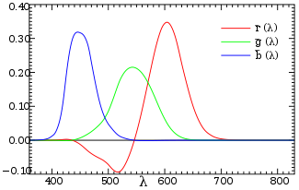
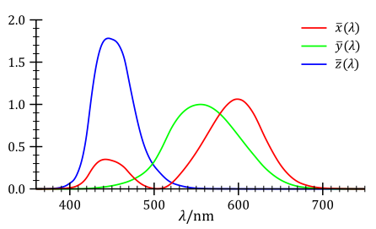
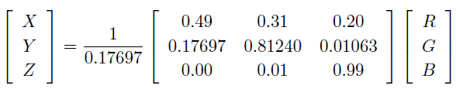
Trichromacy and CIE-XYZ
Perceptual equivalents with RGB
Perceptual equivalents with CIE-XYZ

Slide 21

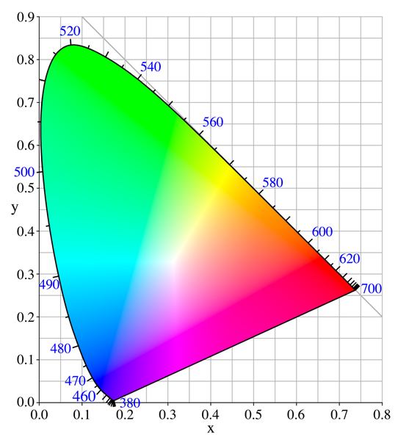

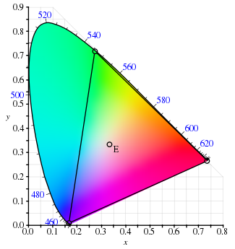
CIE-XYZ
RGB portion is in triangle

Slide 22
The Psychophysical Correspondence
There is no simple functional description for the perceived
color of all lights under all viewing conditions, but …...
A helpful constraint:
Consider only physical spectra with normal distributions
mean
area
variance
© Stephen E. Palmer, 2002

Slide 23
The Psychophysical Correspondence
Mean
Hue
# Photons
Wavelength
© Stephen E. Palmer, 2002

Slide 24
The Psychophysical Correspondence
Variance
Saturation
# Photons
Wavelength
© Stephen E. Palmer, 2002

Slide 25
The Psychophysical Correspondence
Area
Brightness
# Photons
Wavelength
© Stephen E. Palmer, 2002

Slide 26


Color Sensing: Bayer Grid
Estimate RGB at each cell from neighboring values
http://en.wikipedia.org/wiki/Bayer_filter

Slide 27

Alternative to Bayer: RGB+W
Kodak 2007

Slide 28
How is light reflected from a surface?
Depends on
Illumination properties: wavelength, orientation, intensity
Surface properties: material, surface orientation, roughness, etc.
light source
λ
?

Slide 29
Lambertian surface
Some light is absorbed (function of albedo)
Remaining light is reflected in all directions (diffuse reflection)
Examples: soft cloth, concrete, matte paints
light source
light source
λ
λ
absorption
diffuse reflection

Slide 30
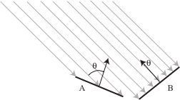
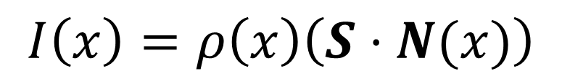

Diffuse reflection
Intensity does depend on illumination angle because less light comes in at oblique angles.
$ρ=$albedo
$S=$ directional source
$N=$ surface normal
$I=$ image intensity
$$I\left(x\right)=ρ\left(x\right)\left(S⋅N(x)\right)$$
Slide: Forsyth

Slide 31
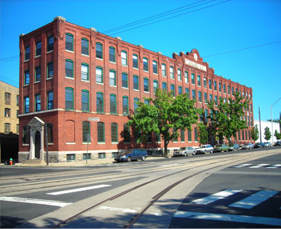
1
2

Slide 32
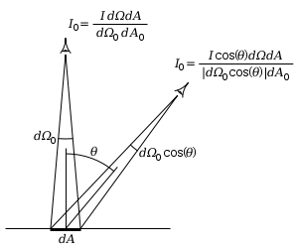
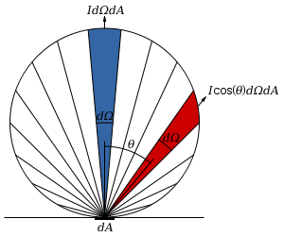
Diffuse reflection
Perceived intensity does not depend on viewer angle.
  Amount of reflected light proportional to cos(theta)
  Visible solid angle also proportional to cos(theta)
http://en.wikipedia.org/wiki/Lambert%27s_cosine_law

Slide 33
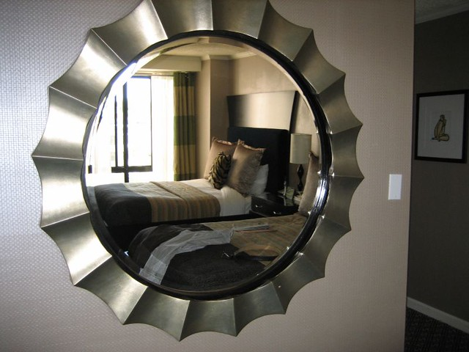
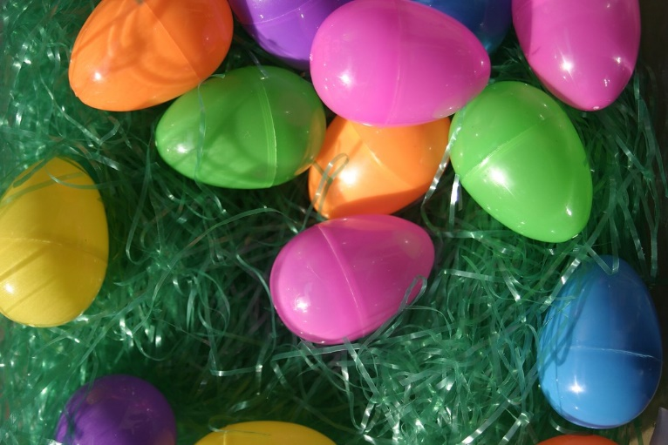


Specular Reflection
by Richard
Reflected direction depends on light orientation and surface normal
E.g., mirrors are fully specular
light source
λ
specular reflection
by Jeff Petersen
$$Θ$$
$$Θ$$
by Jeff Petersen

Slide 34
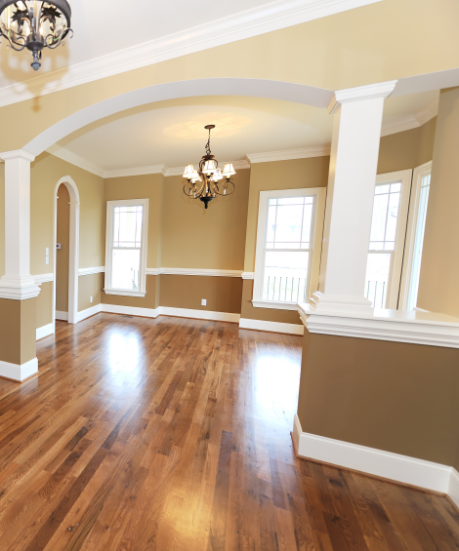
Many surfaces have both specular and diffuse components
Specularity = spot where specular reflection dominates (typically reflects light source)
Photo: northcountryhardwoodfloors.com

Slide 35
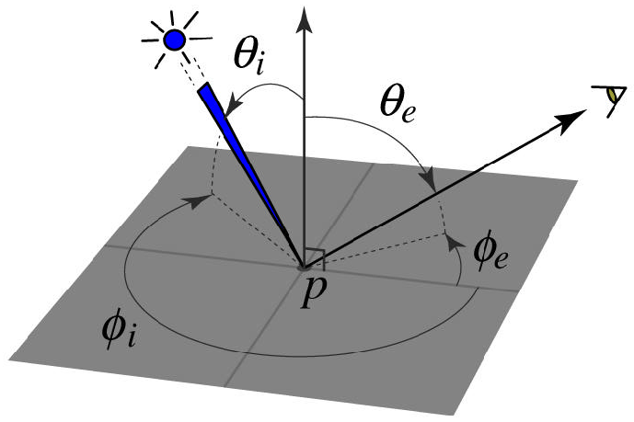
BRDF: Bidirectional Reflectance Distribution Function
Model of local reflection that tells how bright a surface appears when viewed from one direction when light falls on it from another
surface normal
Slide credit: S. Savarese

Slide 36

More complicated effects
transparency
light source
light source
refraction
λ
λ

Slide 37
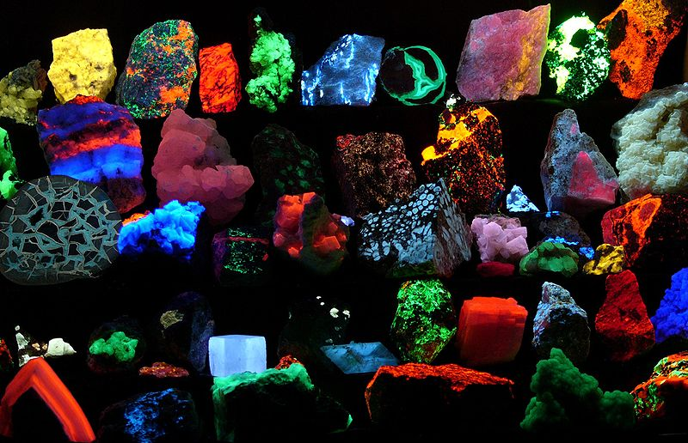
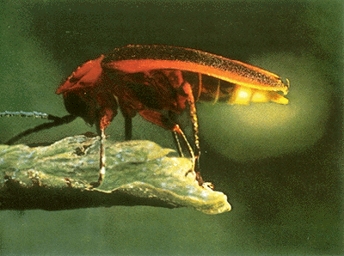
light source
light source
fluorescence
phosphorescence
λ₁
t=1
λ₂
t>1

Slide 38
light source
light source
subsurface scattering
interreflection
λ
λ

Slide 39
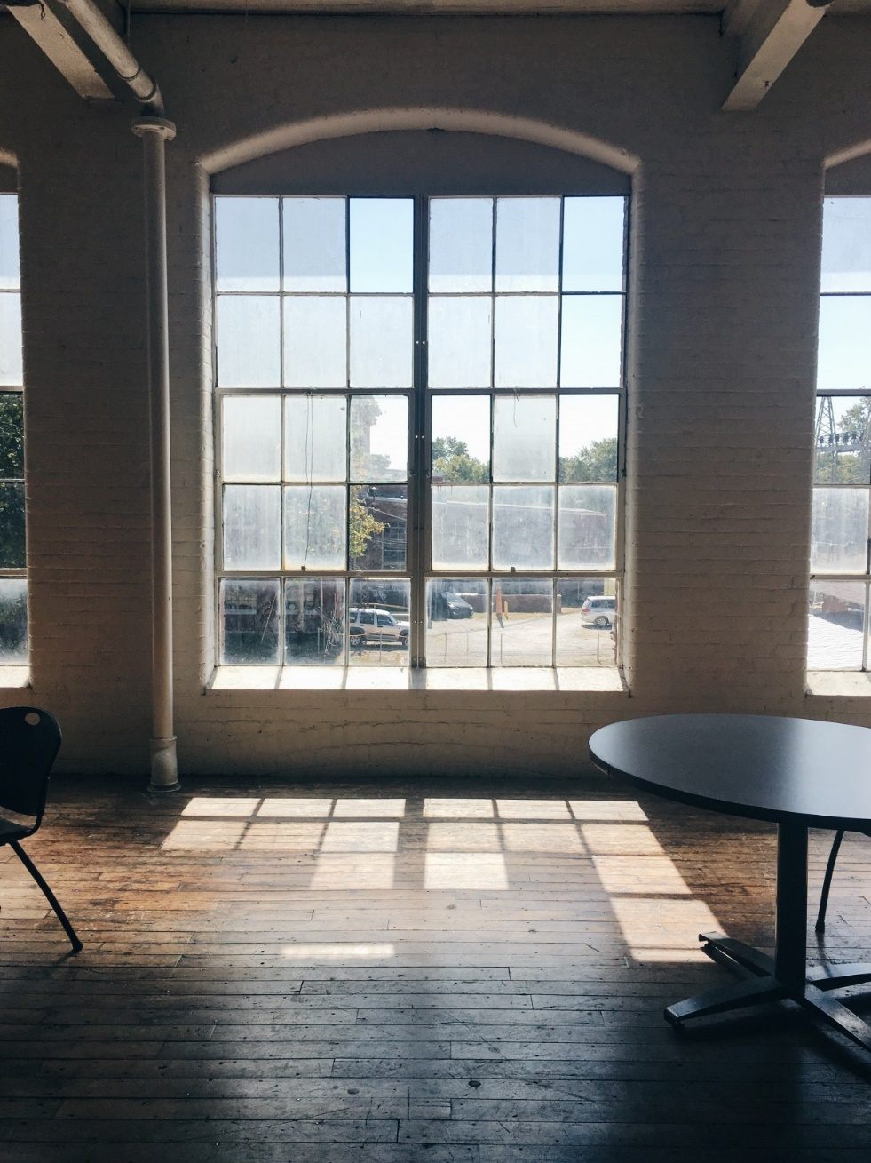
Inter-reflection is a major source of light

Slide 40
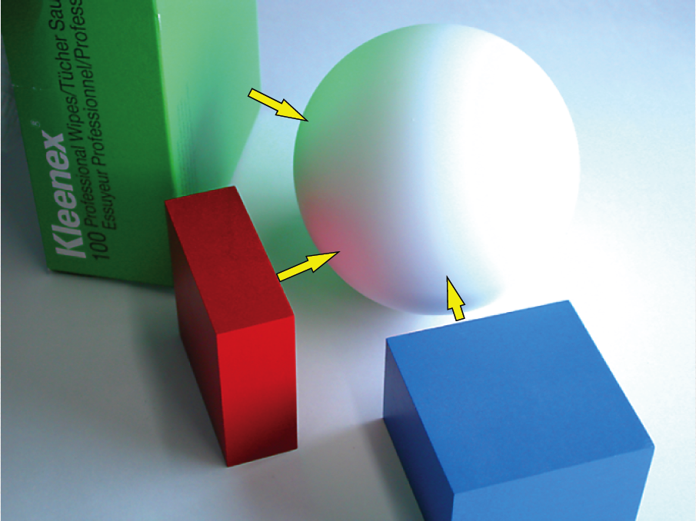
Inter-reflection affects the apparent color of objects
From Koenderink slides on image texture and the flow of light

Slide 41
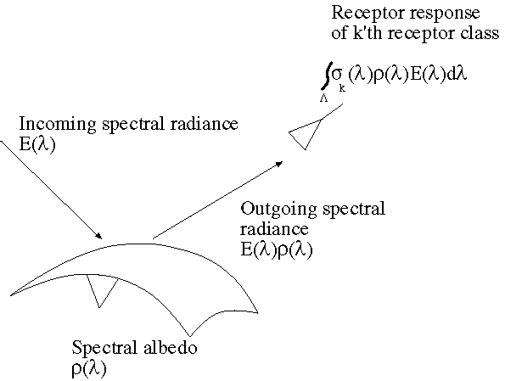
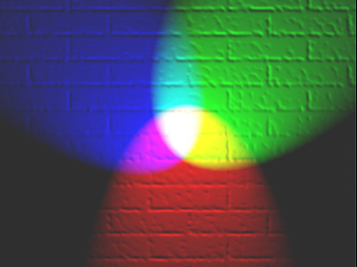
The color of objects
Colored light arriving at the camera involves two effects
  The color of the light source (illumination + inter-reflections)
  The color of the surface
Slide: Forsyth

Slide 42
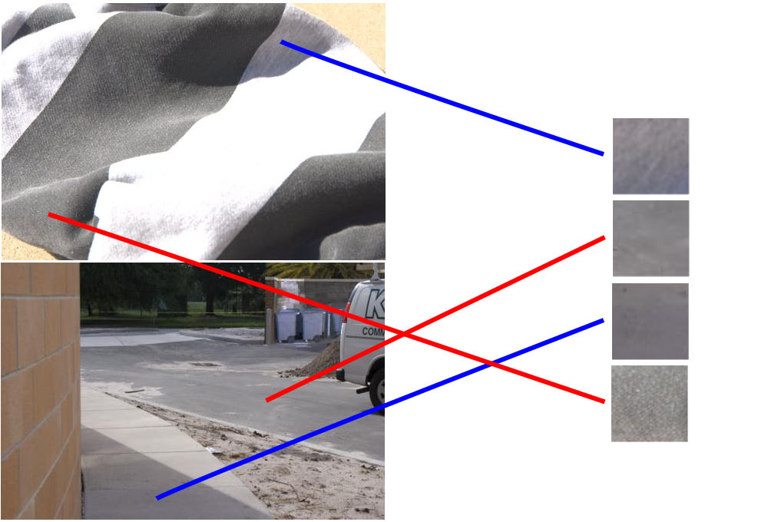
Color constancy
Interpret surface in terms of albedo or “true color”, rather than observed intensity
  Humans are good at it
  Computers are not nearly as good

Slide 43
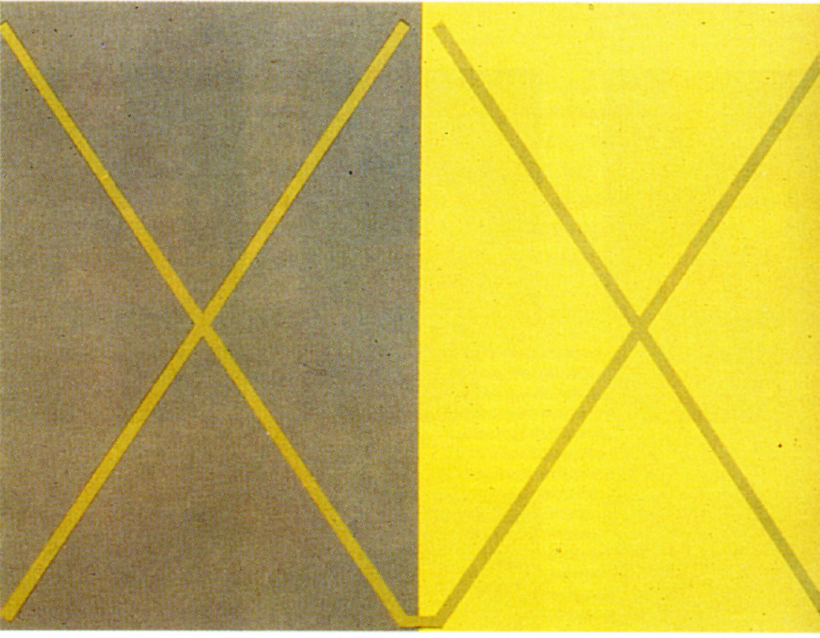
Color illusions

Slide 44
Color illusions

Slide 45
Color illusions

Slide 46

Color illusions

Slide 47
Color illusions

Slide 48
Color illusions
http://www.echalk.co.uk/amusements/OpticalIllusions/colourPerception/colourPerception.html

Slide 49
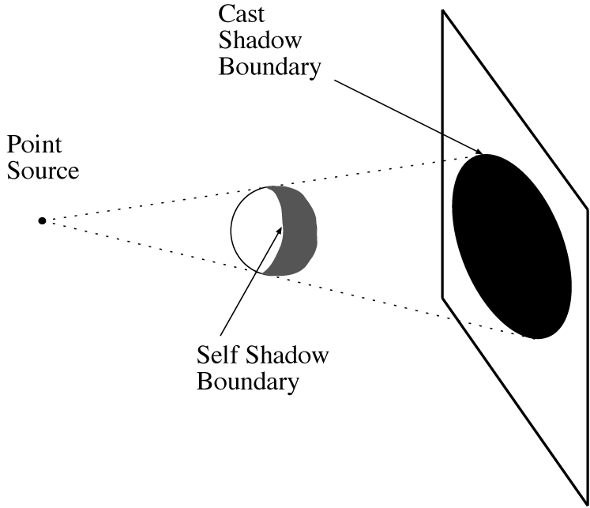
Shadows cast by a point source
A point that can’t see the source is in shadow
For point sources, the geometry is simple
Slide: Forsyth

Slide 50
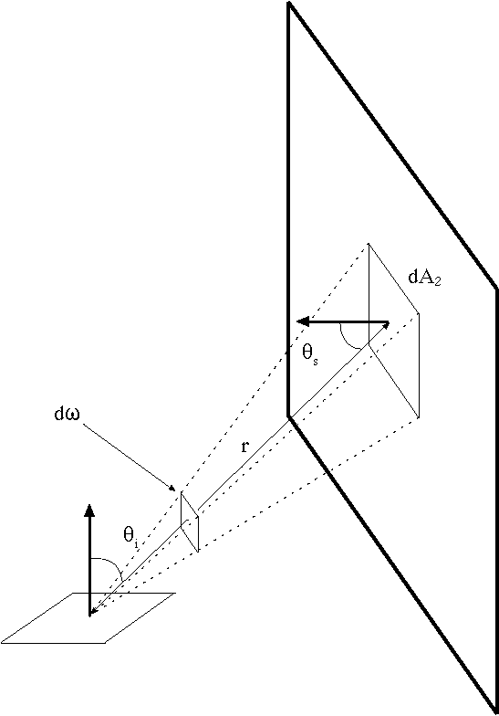
Area sources
Examples: diffuser boxes, white walls
The energy received at a point due to an area source is obtained by adding up the contribution of small elements over the whole source
Slide: Forsyth

Slide 51
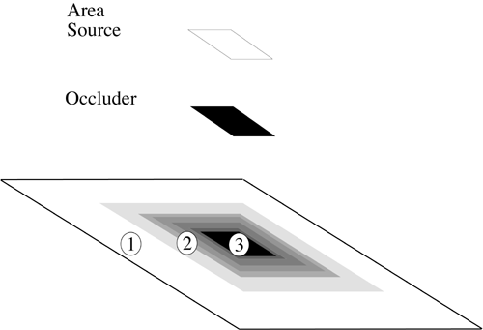
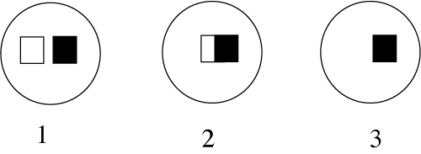
Area Source Shadows
Slide: Forsyth

Slide 52
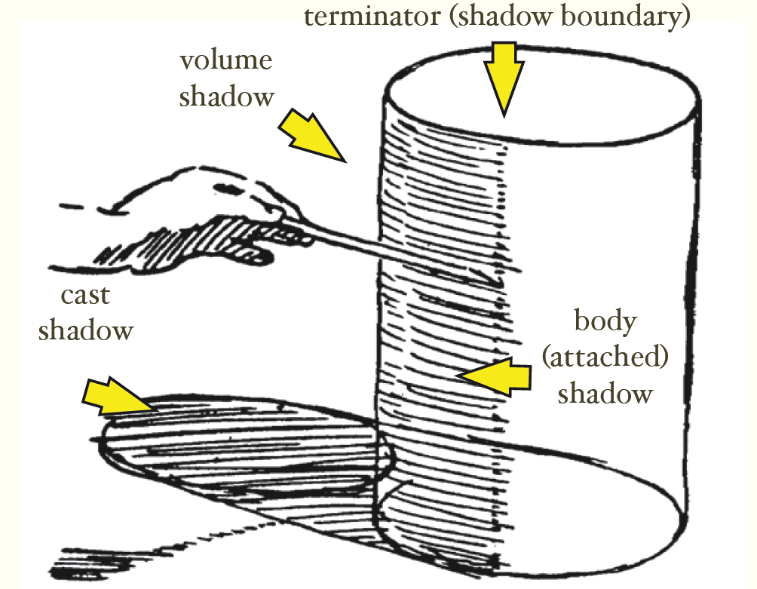
Shading and shadows are major cues to shape and position
From Koenderink slides on image texture and the flow of light
Slide: Forsyth

Slide 53

Recap
6
3
5
4
1
2
1. Why is (2) brighter than (1)? Each points to the asphalt.
2. Why is (4) darker than (3)? 4 points to the marking.
3. Why is (5) brighter than (3)? Each points to the side of the wooden block.
4. Why isn’t (6) black, given that there is no direct path from it to the sun?

Slide 54
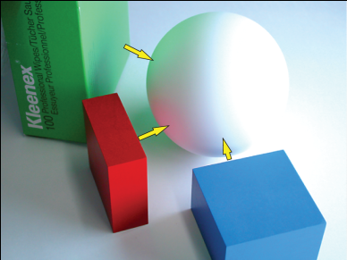
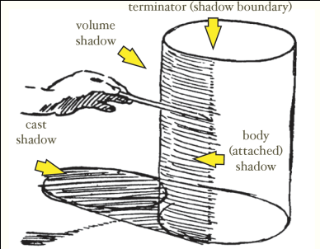
Things to remember
Light has a spectrum of wavelengths
  Humans (and RGB cameras) have color sensors sensitive to three ranges
Observed light depends on: illumination intensities, surface orientation, material (albedo, specular component, diffuse component), etc.
Every object is an indirect light source for every other
Shading and shadows are informative about shape and position

Slide 55
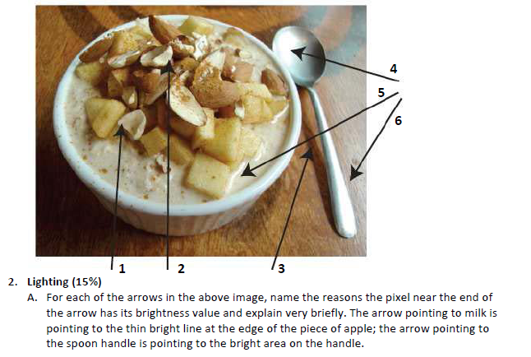
Take-home questions
Possible factors: albedo, shadows, texture, specularities, curvature, lighting direction

