Slide 1
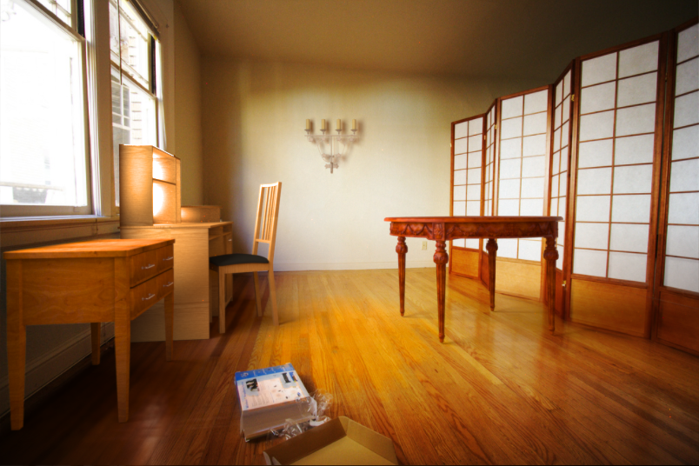
The image as a virtual stage
Computational Photography
Yuxiong Wang, University of Illinois
Slides adopted from Derek Hoiem
Adapted from slides by Kevin Karsch

Slide 2
Today
Inserting objects into legacy photos
  Uses single-view geometry and image-based lighting concepts
Demo for using Blender

Slide 3
SIGGRAPH ASIA 2011

Slide 4
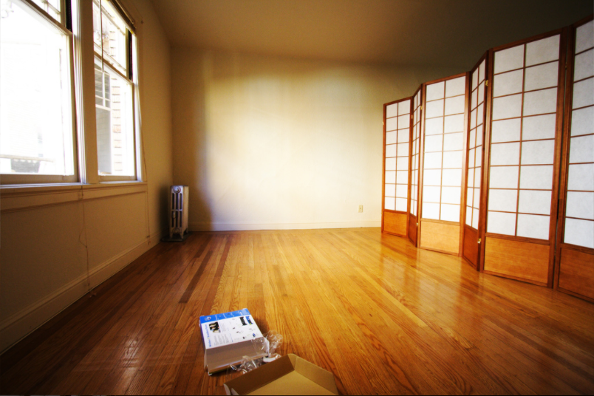

Slide 5
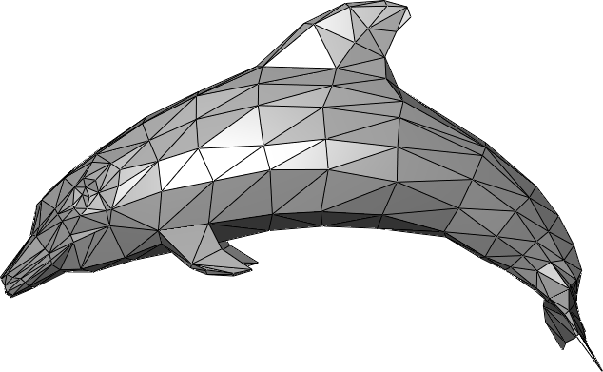
The polygonal mesh
Discrete representation of a surface
  Represented by vertices -> edges -> polygons (faces)

Slide 6
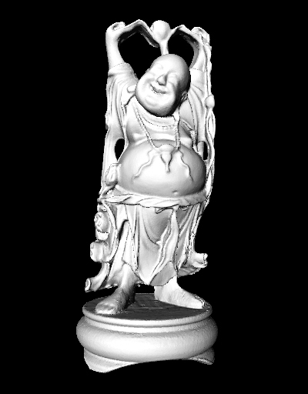
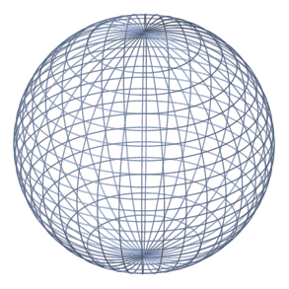
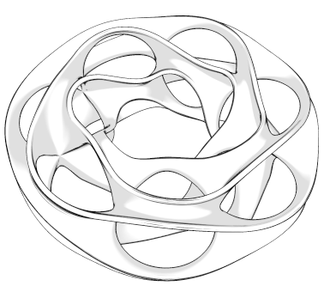
Insert these…

Slide 7
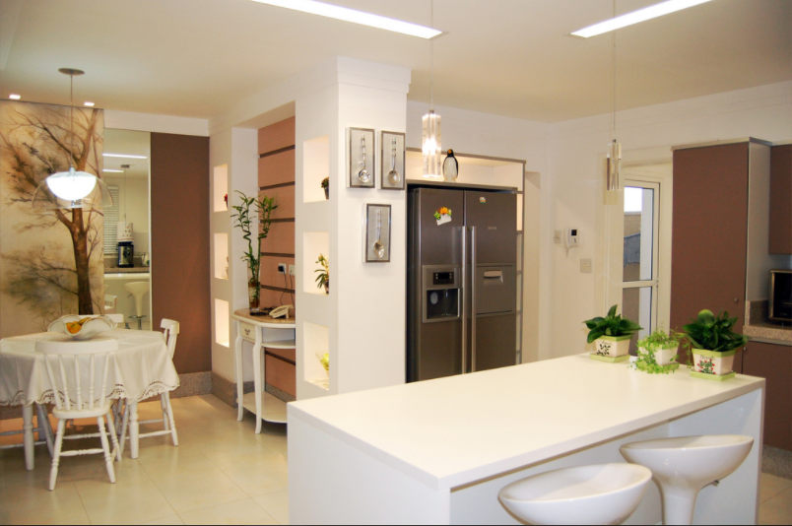
…into this

Slide 8
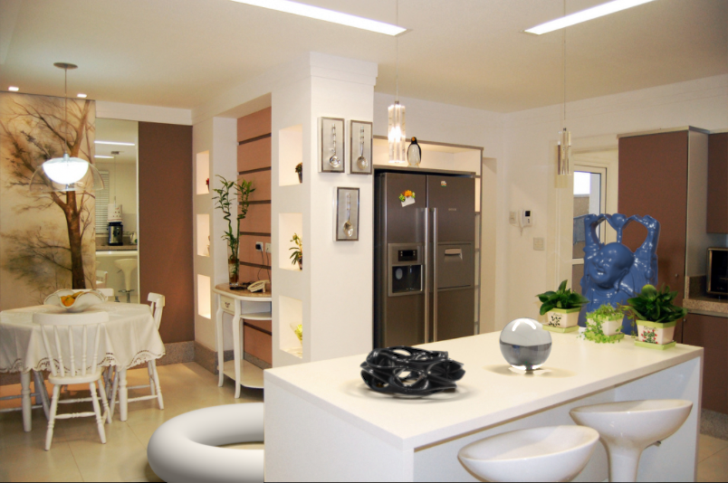
…into this

Slide 9
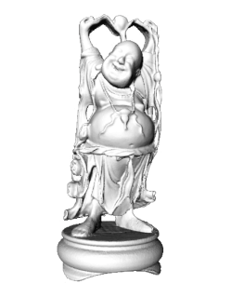

Inserting 3D objects into photographs
Goal: Realistic insertion using a single LDR photo
Arbitrary lighting environments
Intuitive, quick and easy to create content
  Home planning/redecoration
  Movies (visual effects)
  Video games
Notes:
Building on past techniques, the primary goal of our paper is to allow users with minimal photo editing experience to insert objects into legacy images without requiring access to the scene.
2) Handle a host of lighting environments
3) Quick and easy to use
4) Create results like this one in minutes
Ideally, our method without scene access should be as realistic as methods with scene access, in essence making this system less painstaking than others.
This tool can bring about new applications in film and advertising, and also allow homeowners to virtually redecorate their living rooms, or users to create video game content with their own pictures.

Slide 10
Challenges
Estimate a physical scene model including:
  Geometry
  Surface properties
  Lighting info
  Camera parameters
Walls/floor
Lights
Table
Camera
Notes:
And we need to know the camera parameters to accurately render objects into the scene

Slide 11
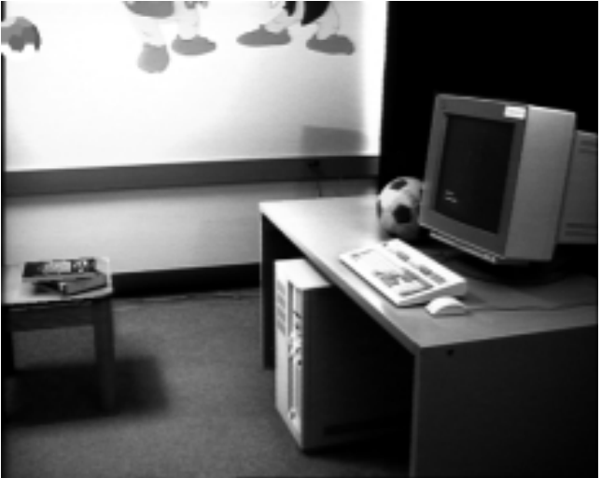
Earlier approaches with scene access
Manual authoring
[Fournier et al. ’93]
Notes:
There’s currently, a few ways to obtain this representation.
One way is to manually author or measure the scene.
This can be difficult, and it takes a a great deal of time to get things looking right.
Lighting is especially hard to get right with only visual feedback, and takes a lot of trial and error.

Slide 12
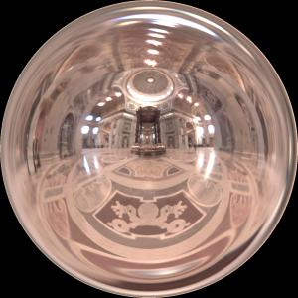
Earlier approaches with scene access
Manual authoring
Light probe, Inverse GI
[Fournier et al. ’93]
[Debevec ’98, Yu et al. ‘99]
Notes:
In 98, Debevec made a breakthrough with his idea of capturing the lighting environment using a light probe.
The light probe method simplified the authoring steps and enabled photorealistic results by capturing HDR lighting information from all angles of a scene.
However, the downside is that it requires access to the scene and some knowledge of image based lighting.
Inverse global illumination also allowed for physical material acquisition, but required multiple scene photos.

Slide 13
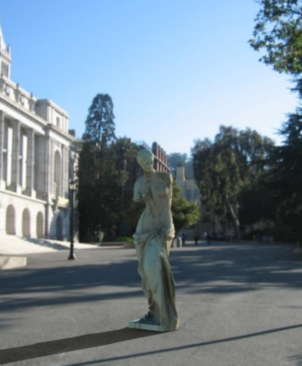
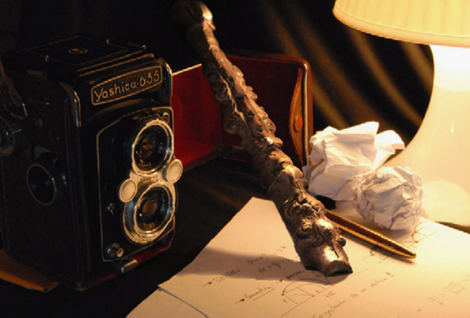
Earlier approaches without scene access
Outdoor illumination
Point source detection
[Wang and Samaras ’03,
Lopez-Moreno et al. ‘10]
[Lalonde et al. ‘09]
Notes:
What if we have a picture that we want to insert objects into, but we don’t have access to the scene?
Well, there’s been a couple approaches for handling this case, which are essentially interested in estimating one or more point lights from a picture.
Still, scene geometry, surface properties, or camera parameters must be estimated manually.
Also, if the lighting environment is more complex than a couple point lights, then an alternative method is required.

Slide 14
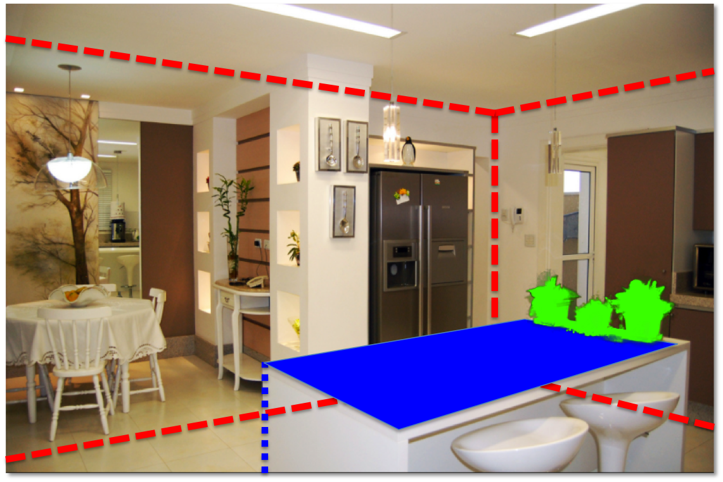
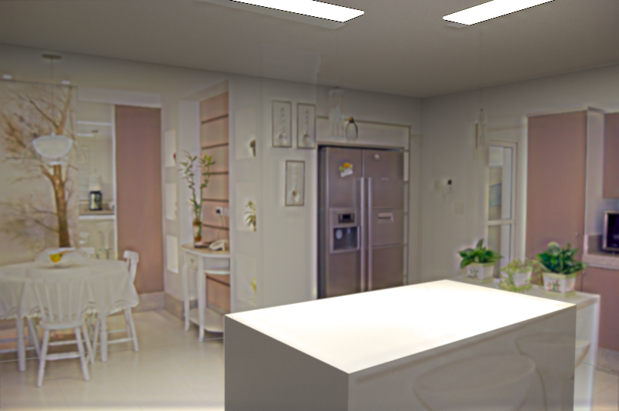
System overview
Input image
Object insertion
Scene authoring
Scene synthesis
Notes:
Our approach is to recover the 3D scene interactively, using a small amount of user guidance.
The user gives some information about the scene by clicking in the image, and we synthesize estimates of geometry, materials, and lighting automatically.
Our estimates of geometry and materials aren’t exact, and we developed an optimization that adjusts initial lighting estimates to account for imperfections in the rest of our model.
This is crucial, as it allows for our method to tolerate a coarse model of geometry and inexact material estimates.
We also ensure that the model produced by our system can be imported into standard 3D modeling tools, and rendered with any off the shelf physical renderer.

Slide 15
Overview of getting geometry and lighting

Slide 16
Bounding geometry
Spatial Layout [Hedau et al. ’09]
Remember Tour into the Picture? This is also a box model, but camera doesn’t have to face the back wall
- Three vanishing points
Notes:
Given an input image, we first estimate scene boundaries using the spatial layout method of Hedau et al.
This method estimates vanishing points as well as the ceiling, floor, and walls in an image.
Our interface allows these estimate to be corrected if there are any errors.

Slide 17
Bounding geometry
Supporting geometry
Spatial Layout [Hedau et al. ’09]
Manual input
Notes:
The user can add to this initial geometric representation by extruding what we call supporting geometry from the floor.
This type of geometry generally consists of planar surfaces, and can be used to quickly model things like tables, chairs, and other common scene elements.
To specify supporting geometry, the user clicks the surface boundary in the image as well as its contact point with the floor.

Slide 18

Bounding geometry
Supporting geometry
Spatial Layout [Hedau et al. ’09]
Occluding geometry
Spectral matting[Levin et al. ’09]
Manual input
Notes:
We also allow the user to add more complex occluding geometry by segmenting parts of the image and modeling them as cardboard cutouts.
These cutouts will occlude any objects inserted behind them.
We use the interactive spectral matting approach to robustly determine the object boundaries.

Slide 19
Manual input
Bounding geometry
Supporting geometry
Spatial Layout [Hedau et al. ’09]
Occluding geometry
Light sources
Spectral matting[Levin et al. ’09]
Manual input
Notes:
Finally, any visible light sources in the scene are marked, and I’ll describe our procedure to automatically estimate intensity and other lighting parameters a little bit later in the talk.

Slide 20
Area lights
Textured billboard
(with transparency)
Bounding cuboid
Extruded polygon
Notes:
By applying some well known single-view metrology and reconstruction techniques, we can recover a rough 3D layout for this image using these annotations.

Slide 21
What the spatial layout provides

Slide 22
Extruded geometry, billboards enable occlusion
Notes:
Here’s another result.

Slide 23
Box, supporting surfaces enable object placement
Notes:
Here’s another result.

Slide 24
Box, extruded geometry, lighting enables shadows, inter-reflections, caustics
Notes:
Here’s another result.

Slide 25
Camera geometry ensures correct perspective
Notes:
Here’s another result.

Slide 26
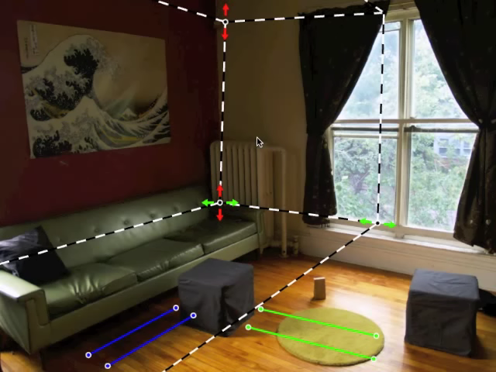
Notes:
Getting this input is quick and easy, here’s a quick video showing the markup process in our interface.
We start with an estimate of the bounding geometry, then the user corrects any errors in the estimate by adjusting scene corners and vanishing points.
We parameterize vanishing points with a pair of line segments, and here you can see the user adjusting two of the horizontal vanishing points.
Now the light sources are marked; for this scene there’s only one source.
Finally, pieces of occluding geometry are indicated by scribbling.
All in all, authoring this scene took about a minute, and this is the result.

Slide 27

Solving for camera viewpoint
Given 3 orthogonal VPs (at least two finite), can compute projection operator
${λp}_{2}=KRP_{3}$
2D point in homogeneous coordinates
3D point in Cartesian coordinates
Intrinsic camera matrix
Rotation matrix

Slide 28
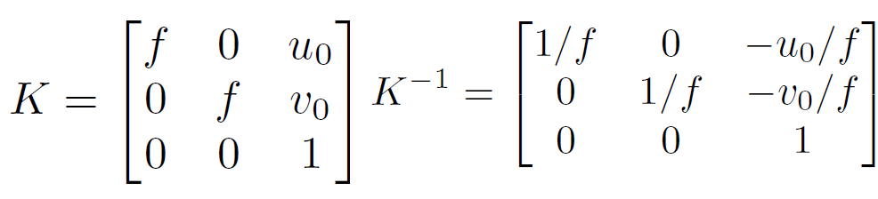
Solving for camera viewpoint
Given 3 orthogonal VPs (at least two finite), can compute projection operator: intrinsic matrix

Slide 29
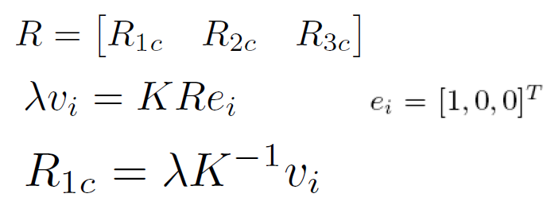
Solving for camera viewpoint
Given 3 orthogonal VPs (at least two finite), can compute projection operator

Slide 30
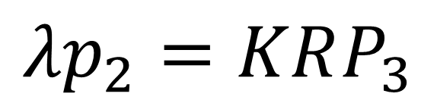
Projecting to image space
Given K, R, and a position in 3D, we can find its corresponding 2D image location:
$${λp}_{2}=KRP_{3}$$

Slide 31
What about the reverse?
Given K, R, and a 2D position on the image, what do we know about its 3D location?

Slide 32
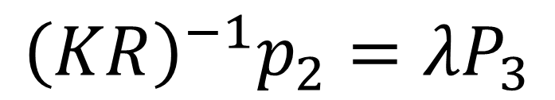
What about the reverse?
Given K, R, and a 2D position on the image, what do we know about its 3D location?
Implies a line along which the 3D point lies
Points on known surfaces can be localized
$${{\left(KR\right)}^{−1}p}_{2}={λP}_{3}$$
Notes:
Draw ray example on board

Slide 33
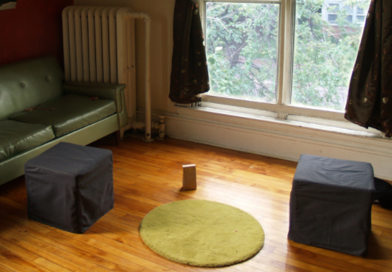
Modeling occlusions

Slide 34
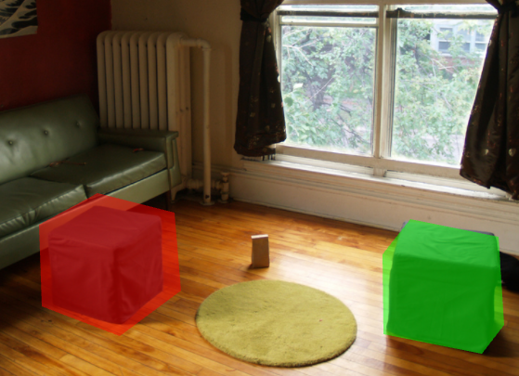
User-defined boundary
Tedious/inaccurate
How can we make this better?

Slide 35
Segmentation with graph cuts
Source (Label 0)
Cost to assign to 0
Cost to split nodes
Cost to assign to 1
Sink (Label 1)
Notes:
- Explanation with user initialization + pixel colors

Slide 36
Segmentation with graph cuts
Source (Label 0)
Cost to assign to 0
Cost to split nodes
Cost to assign to 1
Sink (Label 1)

Slide 37
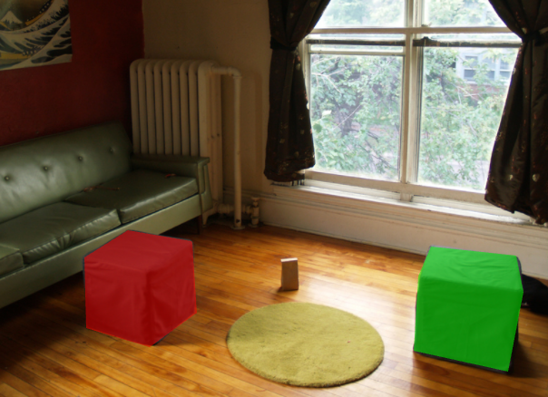
Refined segmentation

Slide 38
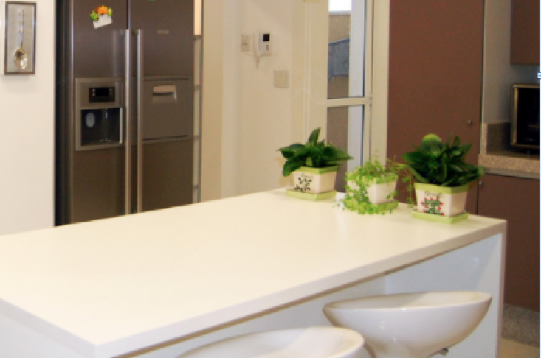
Spectral Matting

Slide 39
Spectral Matting
Create NxN matrix describing neighboring pixel similarity (Laplacian matrix, L)
Extract “smallest” eigenvectors of L
Soft segmentation defined by linear combination of eigenvectors
  Scribbles provide constraints to assign to foreground
[“Spectral Matting” Levin Rav-Acha Lischinski 2008]

Slide 40
Spectral Matting
image
spectral components

Slide 41
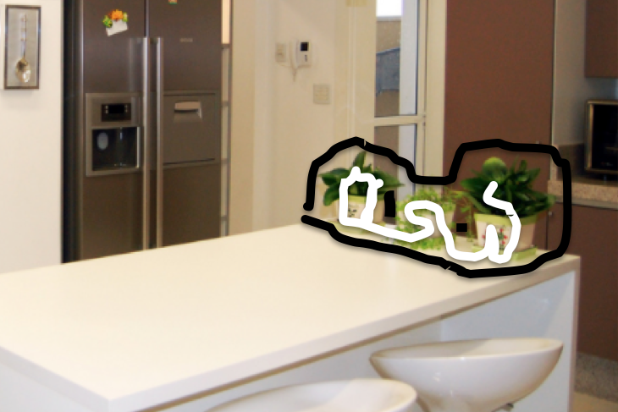
Spectral matting

Slide 42
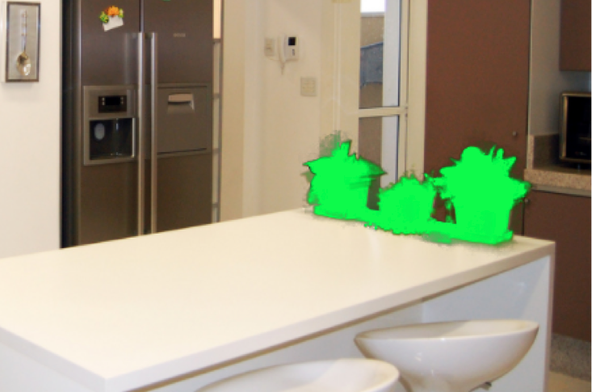
Spectral matting

Slide 43
Segmentations as “billboards”

Slide 44
Segmentations as “billboards”

Slide 45
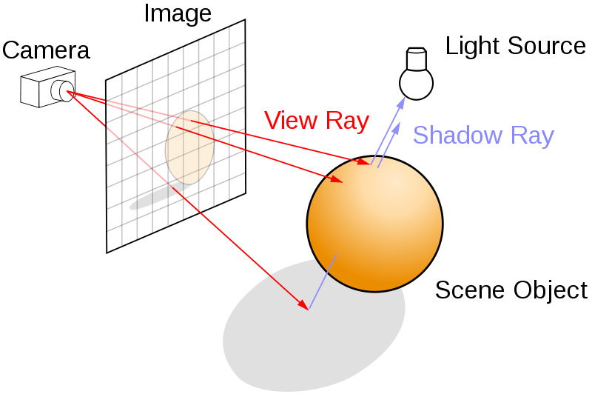
Rendering via ray tracing

Slide 46
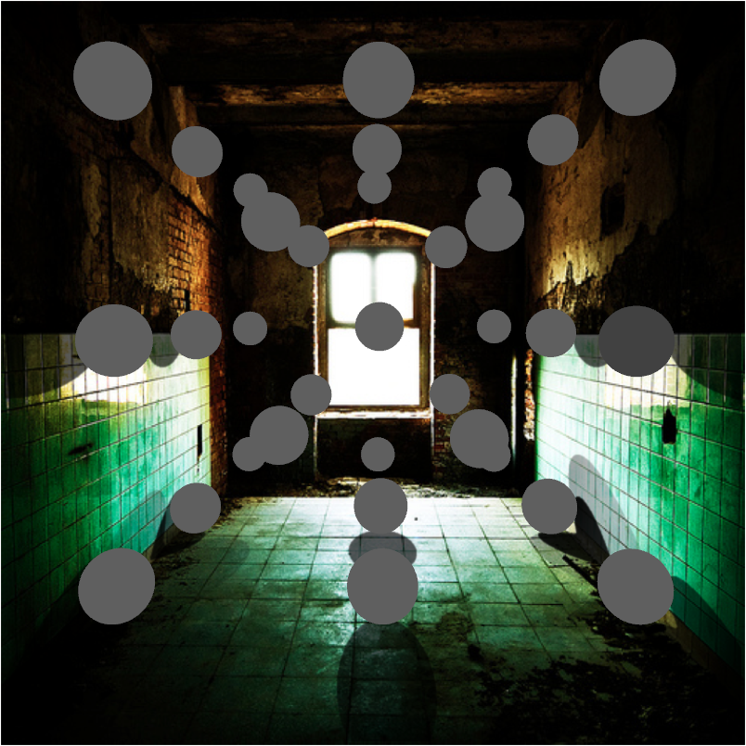
Insertion without relighting

Slide 47
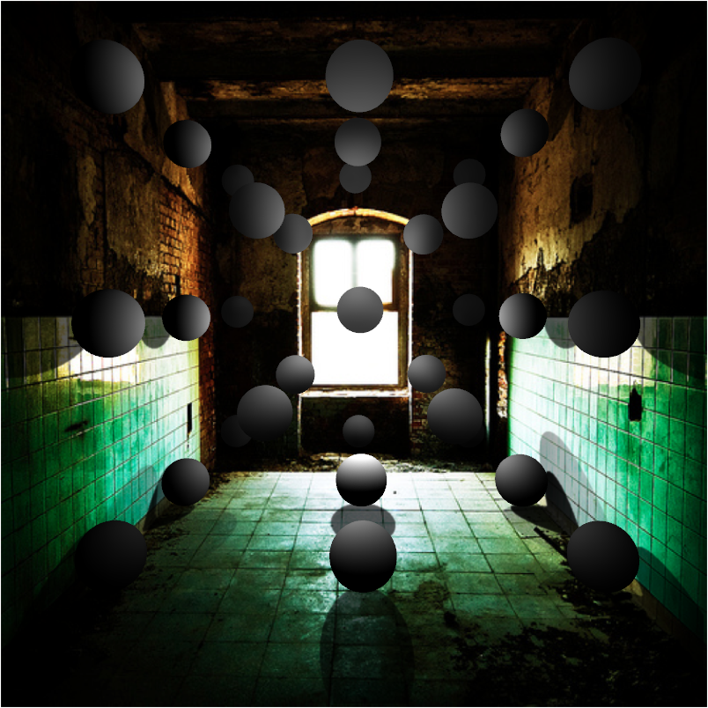
…with relighting

Slide 48
Estimating light
Hypothesize physical light sources in the scene
  Physical → CG representations of light sources found in the real world (area lights, etc)
Visible sources in image marked by user
  Refined to best match geometry and materials
User annotates light shafts; direction vector
  Shafts automatically matted and refined

Slide 49
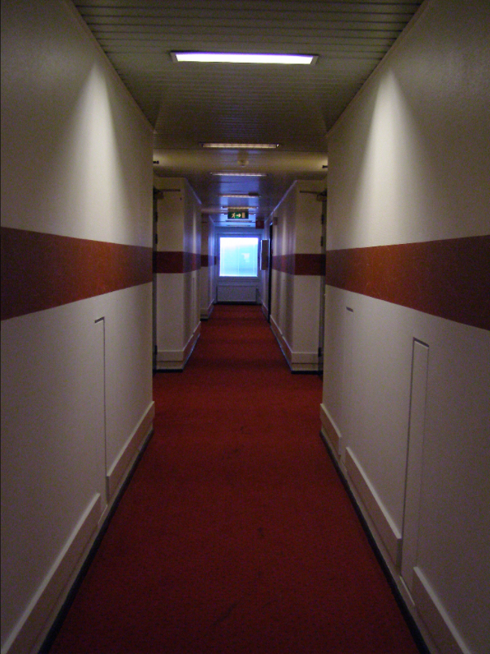
Lighting estimation

Slide 50
Lighting estimation
Actual light position

Slide 51
Lighting estimation
Actual light position
User-initialized light position

Slide 52
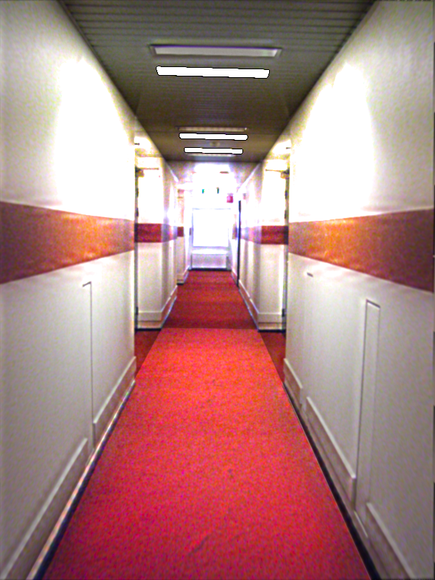
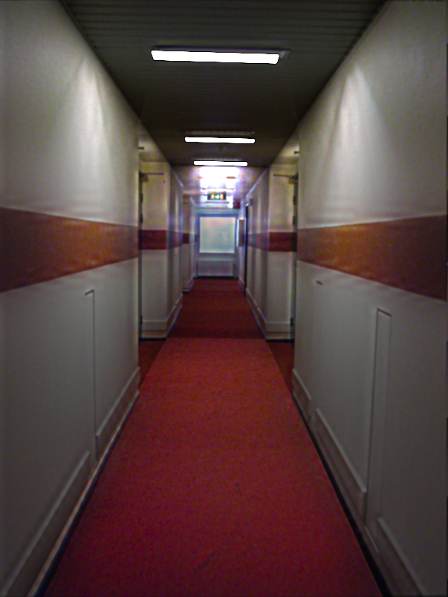
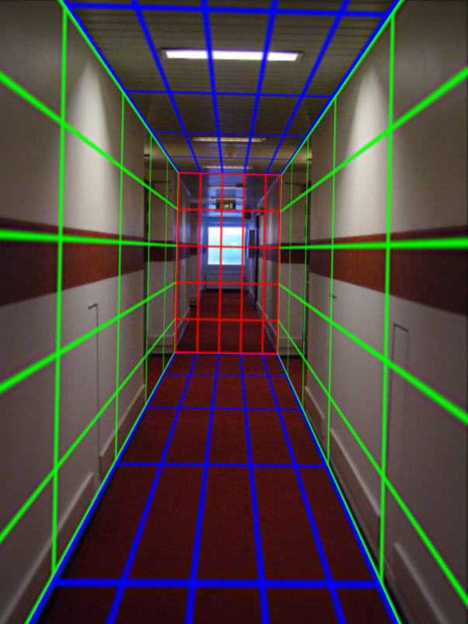
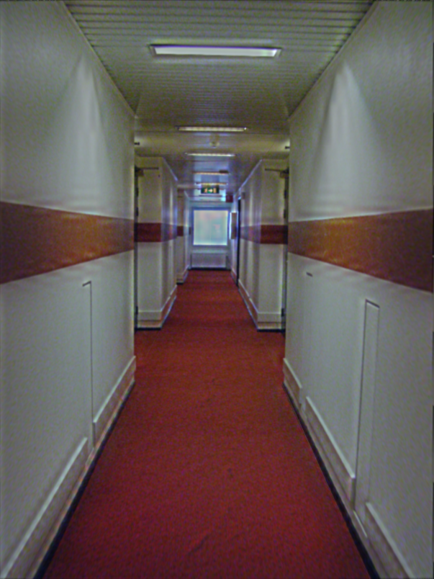
Light refinement
Match original image to rendered image
Match rendered image with input
Trust initial
light parameters

Slide 53
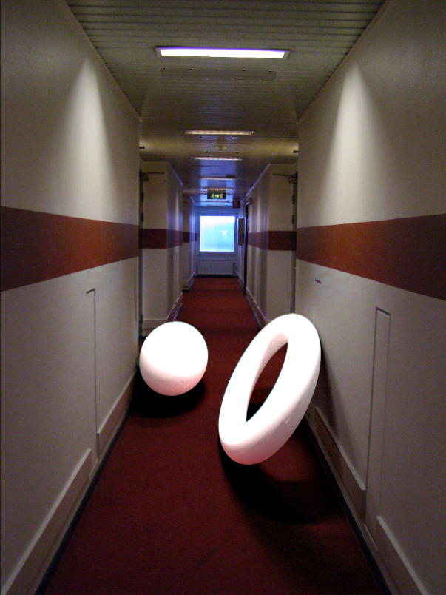
Initial light parameters

Slide 54
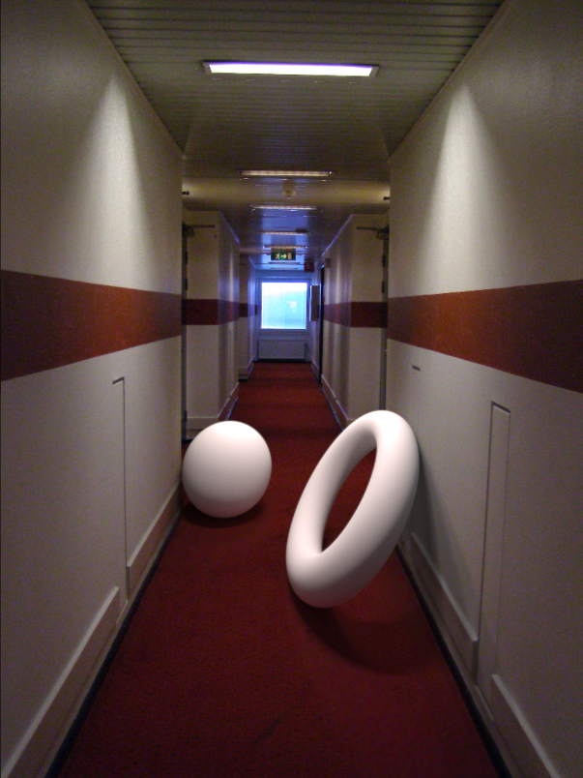
Refined light parameters

Slide 55
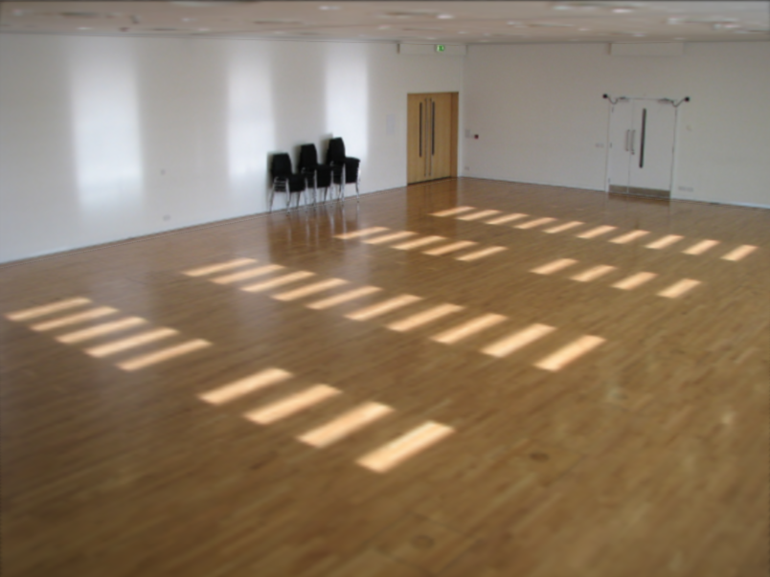
External light shafts

Slide 56
External light shafts
Source bounding box
Shaft bounding box

Slide 57
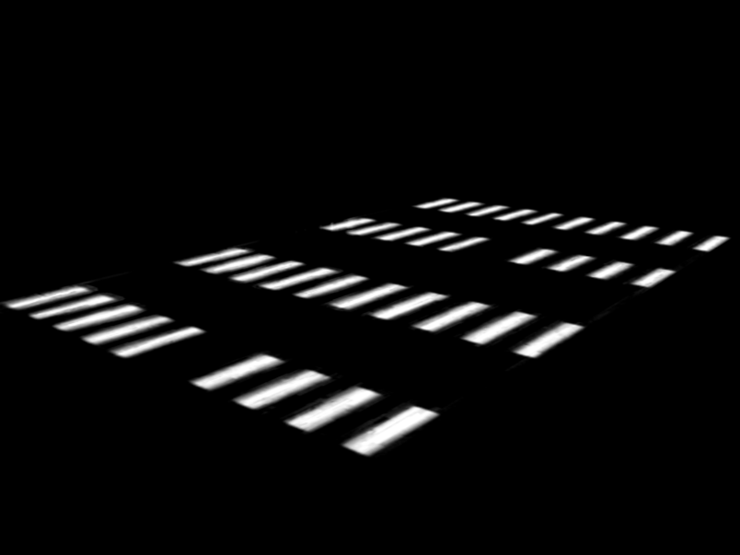

External light shafts
Shadow matting via Guo et al. [2011]

Slide 58
Setting light shaft direction

Slide 59
External light shafts
Shaft direction

Slide 60
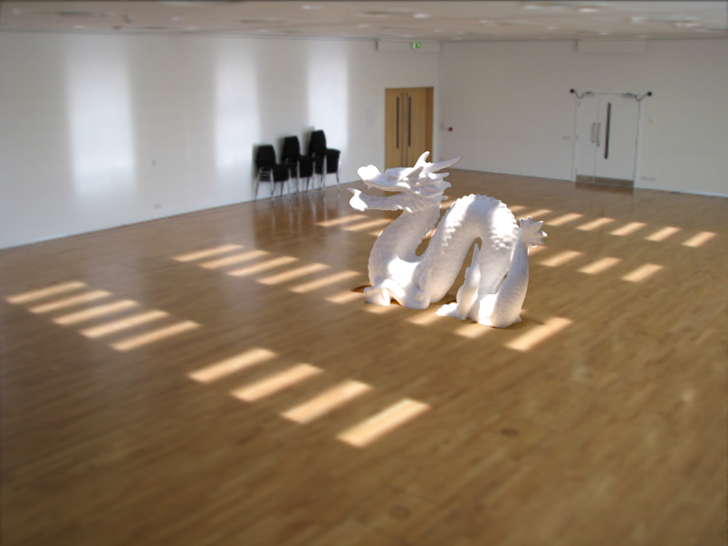
Light shaft result

Slide 61
Inserting objects
Representation of geometry, materials and lights is now compatible with 3D modeling software
Two methods of insertion/interaction
  Novice: image space editing
  Professional: 3D modeling tools (e.g. Maya)
Scene rendered with physically based renderer (e.g. LuxRender, Blender’s Cycles)

Slide 62
Blender demo

Slide 63
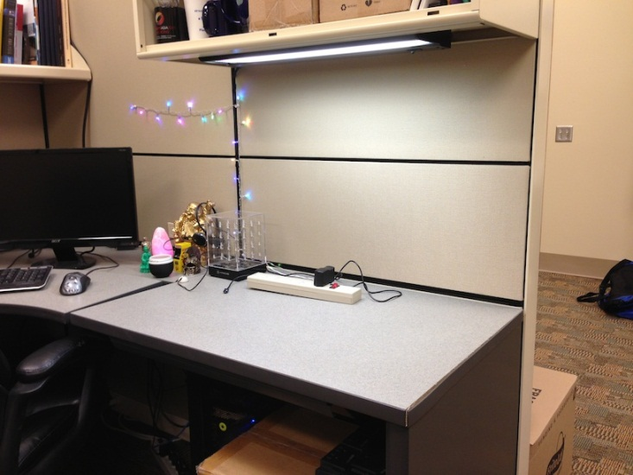
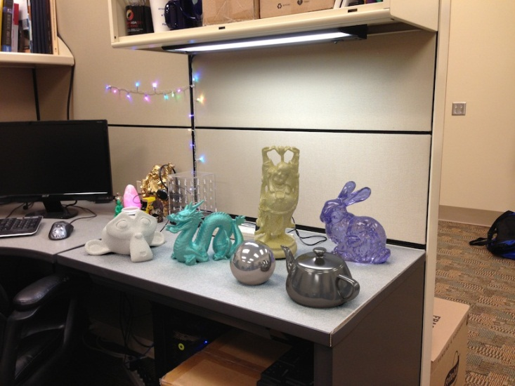
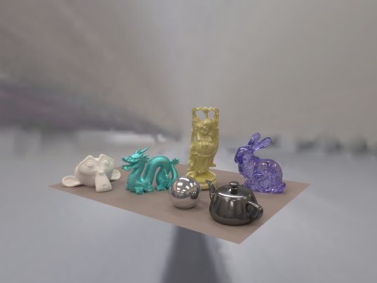
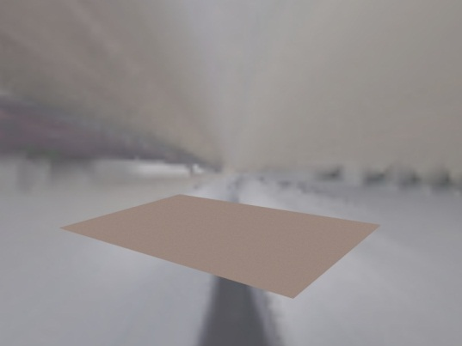

Final composite
Additive differential technique [Debevec 1998]
composite = M.*R + (1-M).*I + (1-M).*(R-E)*c
effect multiplier
I (background)
composite
R (rendered)
E (empty)
M (mask)

Slide 64
Putting it all together
Video: https://vimeo.com/28962540

Slide 65
Research directions
Can we do better with
  Multiple images?
  Videos?
  Depth?
Better scene understanding?
How to insert image fragments?

Slide 66
Fully Automated Scene Modeling
Karsch et al. 2014: http://vimeo.com/101866891

Slide 67
Summary
We can accurately predict how a 3D object would look in a depicted scene by recovering
  Viewpoint: camera matrix, single view geometry
  Scene geometry: single-view geometry
  Material: “intrinsic image approaches”
  Lighting: solve for lights such that rendering reproduces image
Next classes: interest points, matching and alignment, and stitching

