Slide 1
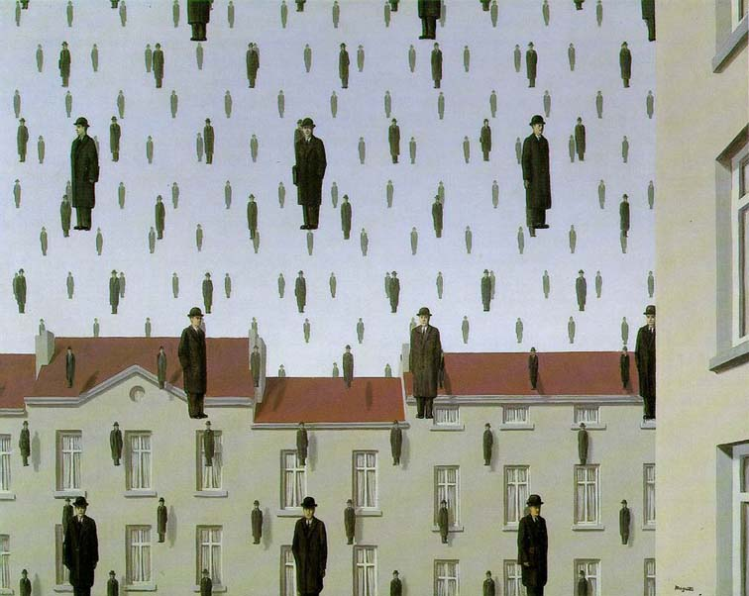
Templates and Image Pyramids
Computational Photography
Yuxiong Wang, University of Illinois
Slides adopted from Derek Hoiem

Slide 2
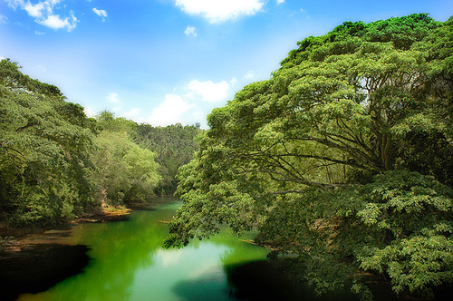
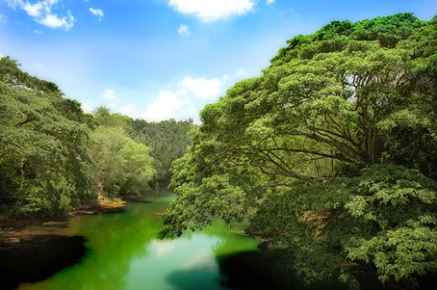
Why does a lower resolution image still make sense to us? What do we lose?
Image: http://www.flickr.com/photos/igorms/136916757/

Slide 3
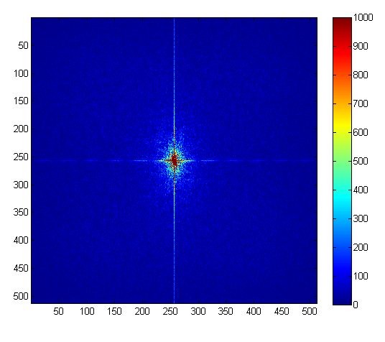
Why does a lower resolution image still make sense to us? What do we lose?
FFT linear scale
+
Image: http://www.flickr.com/photos/igorms/136916757/

Slide 4
Why do we get different, distance-dependent interpretations of hybrid images?
?

Slide 5
Hybrid Image in FFT
Hybrid Image
Low-passed Image
High-passed Image

Slide 6
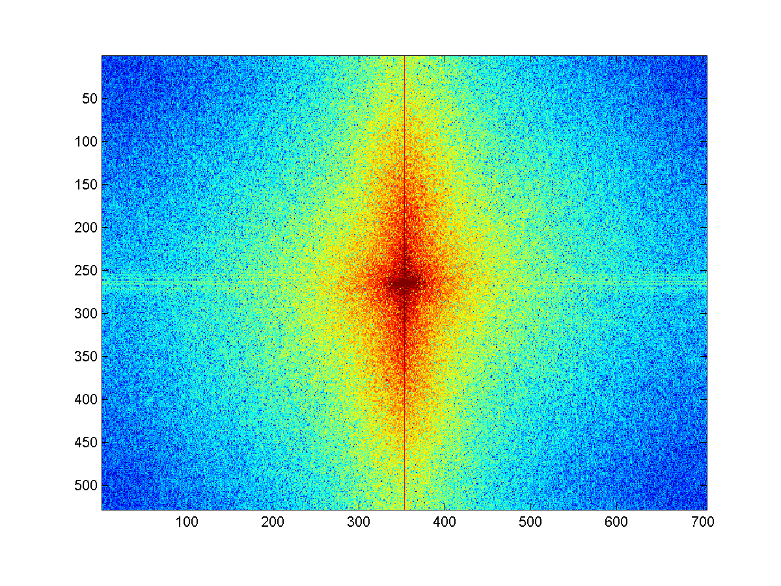
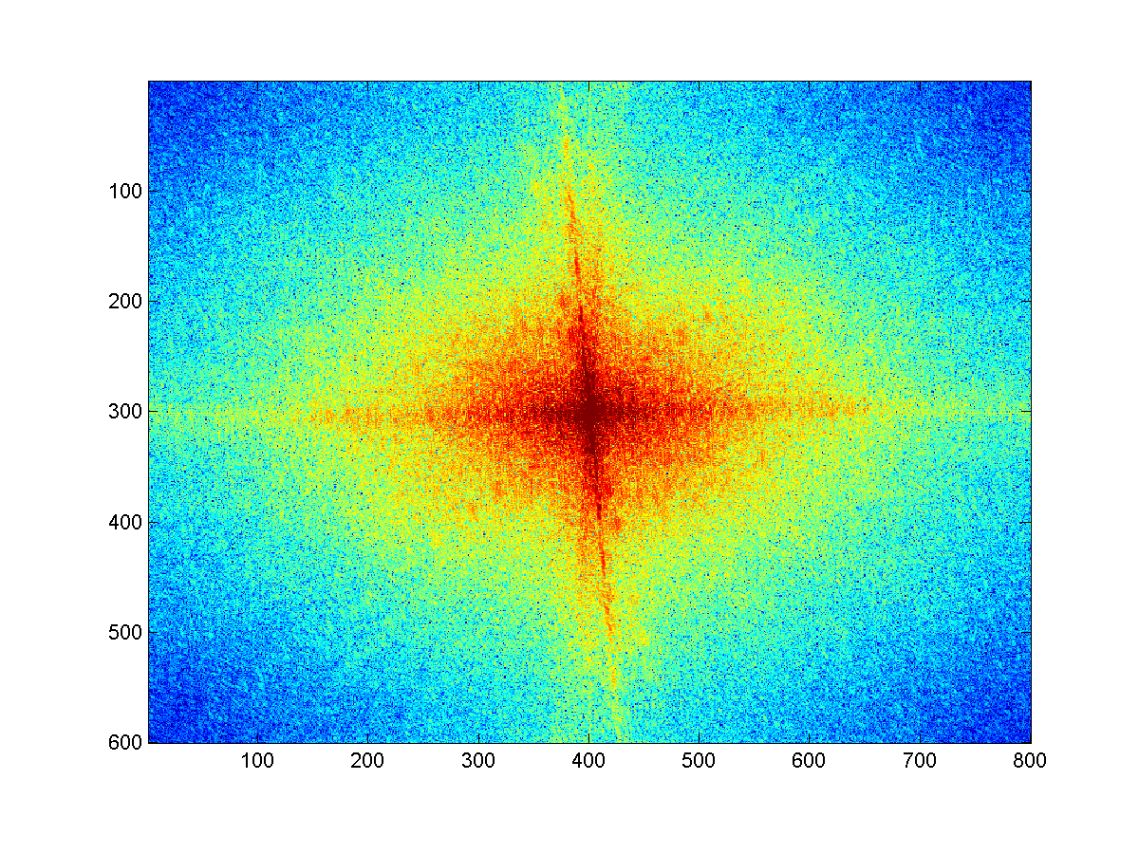
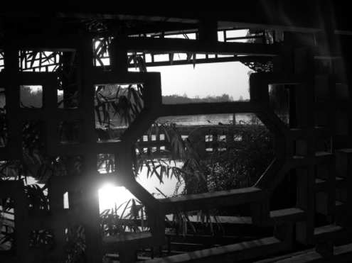
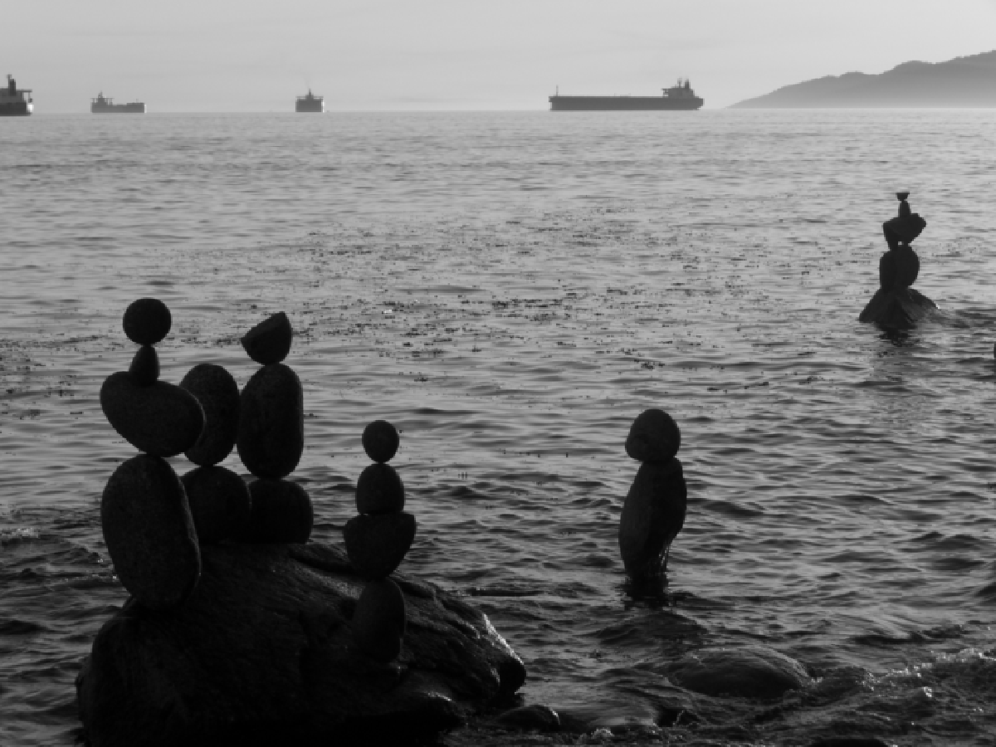
Review
Match the spatial domain image to the Fourier magnitude image
1
2
3
4
5
B
A
C
E
D

Slide 7
Today’s class: applications of filtering
Template matching
Coarse-to-fine alignment
Denoising, Compression

Slide 8
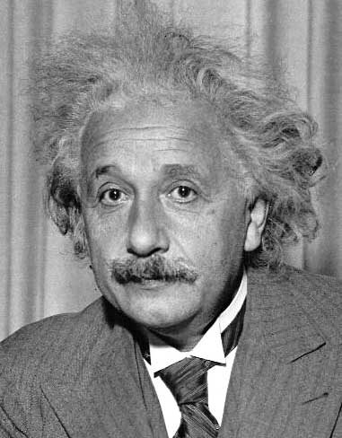
Template matching
Goal: find in image
Main challenge: What is a good similarity or distance measure between two patches?
Correlation
Zero-mean correlation
Sum Square Difference
Normalized Cross Correlation

Slide 9
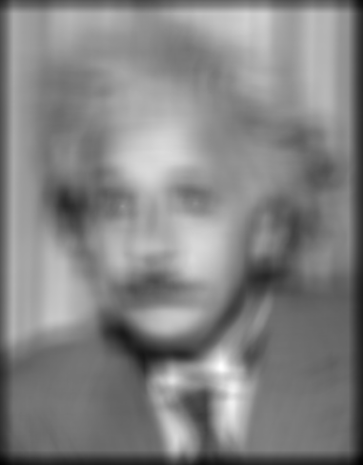
Matching with filters
Goal: find in image
Method 0: filter the image with eye patch
f = image
g = filter
What went wrong?
Input
Filtered Image
Notes:
Problem: response is stronger for higher intensity

Slide 10
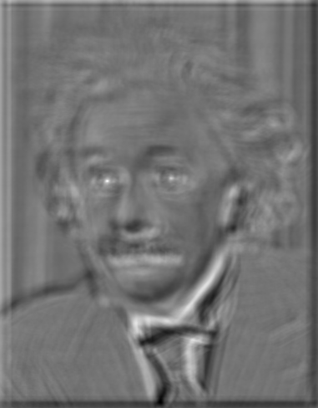
Matching with filters
Goal: find in image
Method 1: filter the image with zero-mean eye
$$h\left[m,n\right]=\sum_{k, l}{(g\left[k,l\right]−\overline{g})(f[m+k,n+l])}$$
mean of $g$
True detections
False detections
Input
Filtered Image (scaled)
Thresholded Image
Notes:
Likes bright pixels where filters are above average, dark pixels where filters are below average. Problems: response is sensitive to gain/contrast, pixels in filter that are near the mean have little effect, does not require pixel values in image to be near or proportional to values in filter.

Slide 11
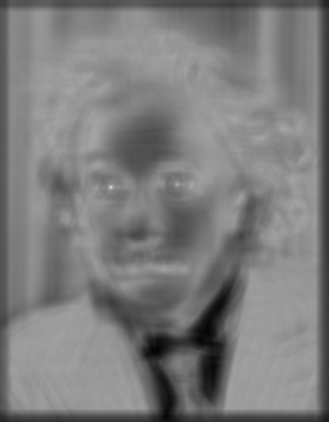
Matching with filters
Goal: find in image
Method 2: SSD
True detections
Input
1- sqrt(SSD)
Thresholded Image
Notes:
Problem: SSD sensitive to average intensity

Slide 12
Matching with filters
Can SSD be implemented with linear filters?
constant
linear filter
Element-wise square f, then sum with ones kernel of size g

Slide 13
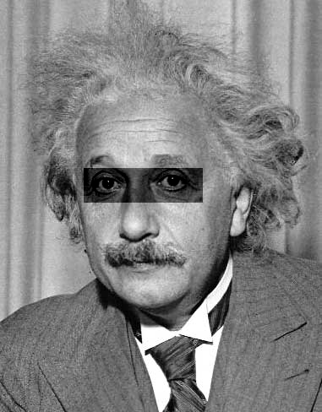
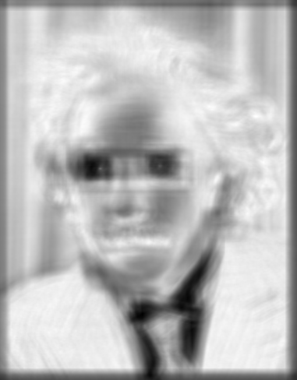
Matching with filters
Goal: find in image
Method 2: SSD
What’s the potential downside of SSD?
Input
1- sqrt(SSD)
Notes:
Problem: SSD sensitive to average intensity

Slide 14
Matching with filters
Goal: find in image
Method 3: Normalized cross-correlation
mean template
mean image patch
Python: cv2.matchTemplate(im,template,cv2.TM_CCOEFF_NORMED)
Notes:
Invariant to mean and scale of intensity

Slide 15
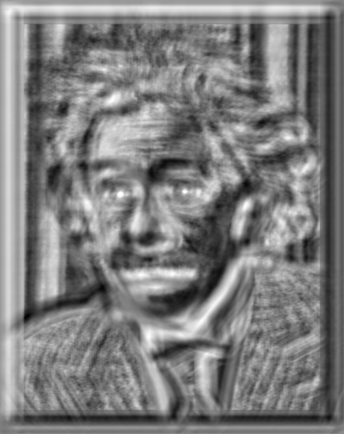
Matching with filters
Goal: find in image
Method 3: Normalized cross-correlation
True detections
Input
Normalized X-Correlation
Thresholded Image

Slide 16
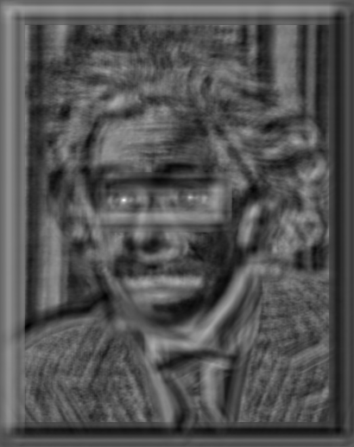
Matching with filters
Goal: find in image
Method 3: Normalized cross-correlation
True detections
Input
Normalized X-Correlation
Thresholded Image

Slide 17
Q: What is the best method to use?
A: Depends
Zero-mean filter: fastest but not a great matcher
SSD: next fastest, sensitive to overall intensity
Normalized cross-correlation: slowest, invariant to local average intensity and contrast

Slide 18
Q: What if we want to find larger or smaller eyes?
A: Image Pyramid

Slide 19
Review of Sampling
Gaussian
Filter
Image
Low-Pass Filtered Image
Sample
Low-Res Image

Slide 20
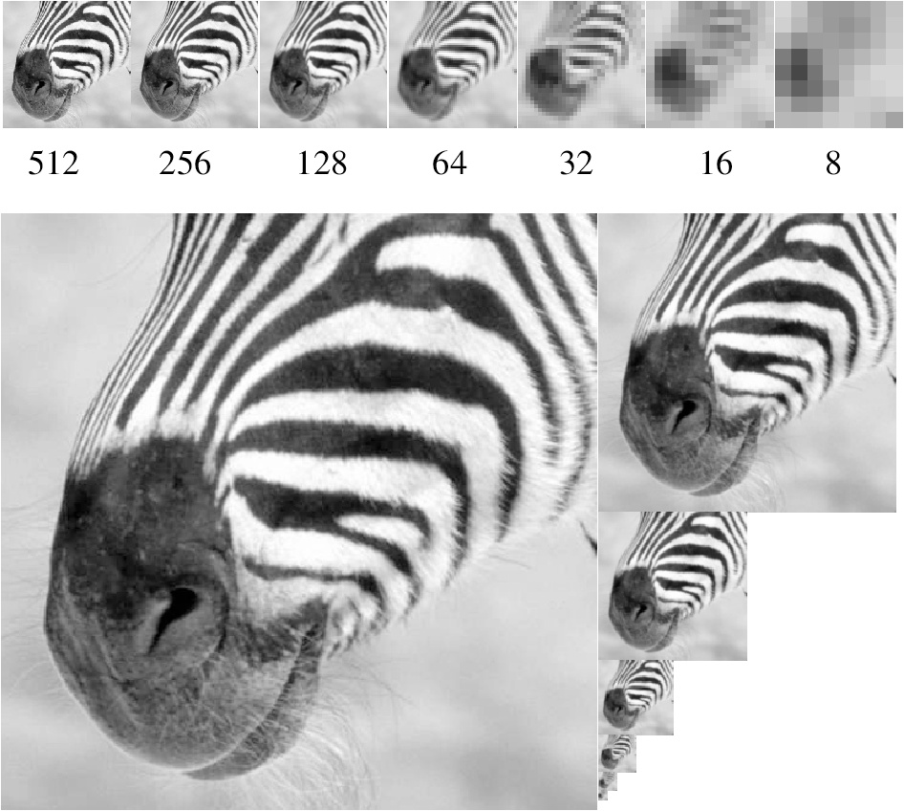
Gaussian pyramid
Source: Forsyth

Slide 21
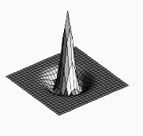
Laplacian filter
unit impulse
Gaussian
Laplacian of Gaussian
Source: Lazebnik

Slide 22
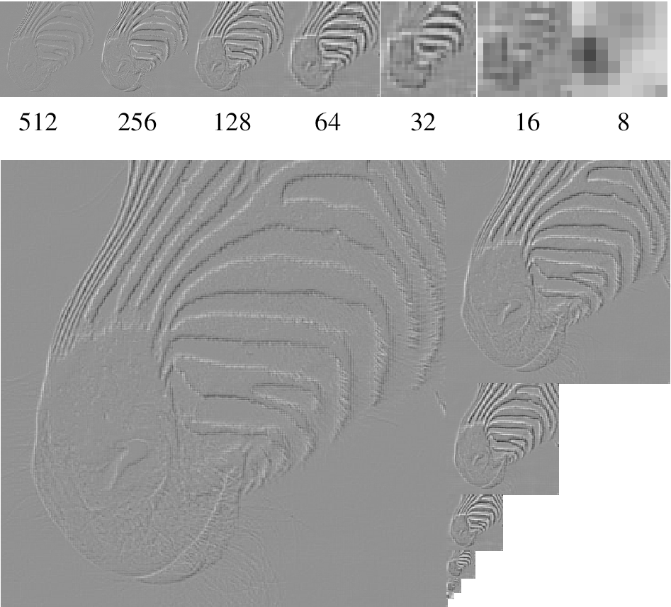
Laplacian pyramid
Source: Forsyth

Slide 23
Computing Gaussian/Laplacian Pyramid
Can we reconstruct the original from the Laplacian pyramid?

Slide 24
Creating a 2-level Laplacian pyramid
Image aka
Gaussian_0
Gaussian Smooth
Smoothed_0
Subsample
Lap 1 /
Gauss 1
+
-
Laplacian_0 =
Guassian_0 – Smoothed_0

Slide 25
Reconstructing the image from Laplacian pyramid
Upsample and smooth
Laplacian_0
Smoothed_0
Lap 1 /
Gauss 1
+
+
Image =
Smoothed_0 + Laplacian0

Slide 26
Hybrid Image in Laplacian Pyramid
Extra points for project 1
High frequency → Low frequency

Slide 27
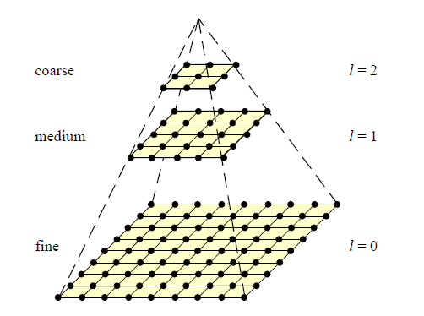
Coarse-to-fine Image Registration
Compute Gaussian pyramid
Align with coarse pyramid
Find minimum SSD position
Successively align with finer pyramids
Search small range (e.g., 5x5) centered around position determined at coarser scale

Slide 28
Coarse-to-fine Image Registration
Im1
Im2
Level 0
HxW
Level 1
H/2 x W/2
Level 2
H/4 x W/4

Slide 29
Coarse-to-fine Image Registration
Im1
Im2
.
x
$$tx_{0},ty_{0}=\underset{tx∈2⋅tx_{1}+\left\{−s..s\right\},ty=2⋅ty_{1}+\{−s..s\}}{argmin}{\text{SSD}(im1_{1},\text{translate}\left(im2_{1},tx,ty\right))}$$
.
x
$$tx_{1},ty_{1}=\underset{tx∈2⋅tx_{2}+\left\{−s..s\right\},ty=2⋅ty_{2}+\{−s..s\}}{argmin}{\text{SSD}(im1_{1},\text{translate}\left(im2_{1},tx,ty\right))}$$
x
$$tx_{2},ty_{2}=\underset{tx∈\left\{−\frac{W}{8}..\frac{W}{8}\right\},ty∈\{−\frac{H}{8}..\frac{H}{8}\}}{argmin}{\text{SSD}(im1_{2},\text{translate}\left(im2_{2},tx,ty\right))}$$

Slide 30
Coarse-to-fine Image Registration
Compute Gaussian pyramid
Align with coarse pyramid
Find minimum SSD position
Successively align with finer pyramids
Search small range (e.g., 5x5) centered around position determined at coarser scale
Why is this faster?
Are we guaranteed to get the same result?

Slide 31
Question
Can you align the images using the FFT?

Slide 32
Compression
How is it that a 4MP image can be compressed to a few hundred KB without a noticeable change?

Slide 33
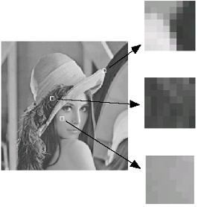
Lossy Image Compression (JPEG)
Block-based Discrete Cosine Transform (DCT)
Slides: Efros

Slide 34
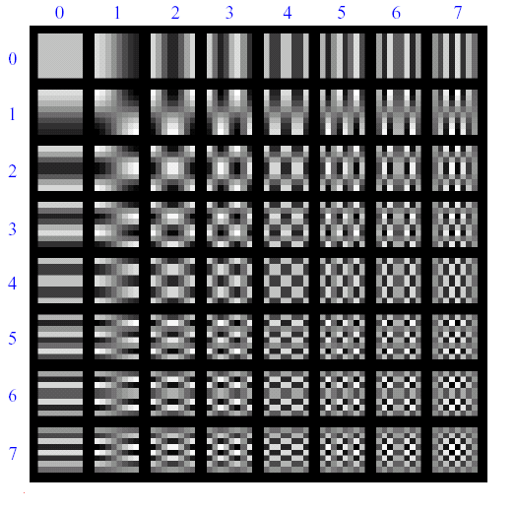
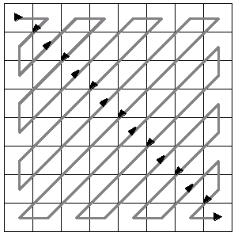
Using DCT in JPEG
The first coefficient B(0,0) is the DC component, the average intensity
The top-left coeffs represent low frequencies, the bottom right – high frequencies

Slide 35
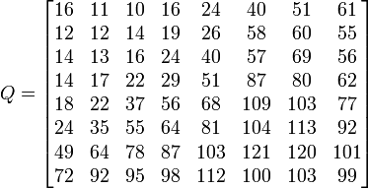
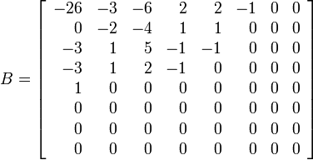
Image compression using DCT
Quantize
More coarsely for high frequencies (which also tend to have smaller values)
Many quantized high frequency values will be zero
Encode
Can decode with inverse dct
Filter responses
Quantization table
Quantized values

Slide 36
JPEG Compression Summary
Convert image to YCrCb
Subsample color by factor of 2
People have bad resolution for color
Split into blocks (8x8, typically), subtract 128
For each block
Compute DCT coefficients
Coarsely quantize
Many high frequency components will become zero
Encode (e.g., with Huffman coding)
http://en.wikipedia.org/wiki/YCbCr
http://en.wikipedia.org/wiki/JPEG

Slide 37
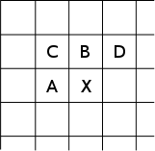
Lossless compression (PNG)
Predict that a pixel’s value based on its upper-left neighborhood
Store difference of predicted and actual value
Pkzip it (DEFLATE algorithm)

Slide 38
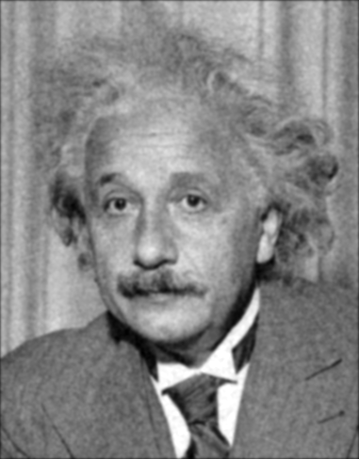
Denoising
Gaussian Filter
Additive Gaussian Noise

Slide 39
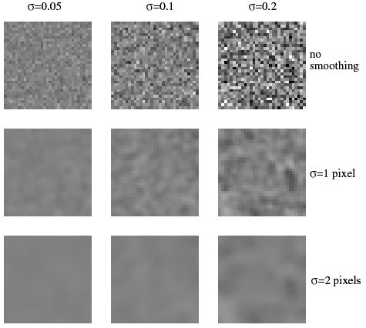
Reducing Gaussian noise
Smoothing with larger standard deviations suppresses noise, but also blurs the image
Source: S. Lazebnik

Slide 40
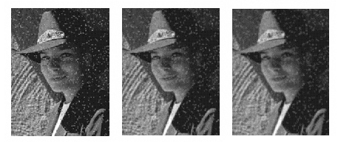
Reducing salt-and-pepper noise by Gaussian smoothing
3x3
5x5
7x7
Notes:
What’s wrong with these results?

Slide 41
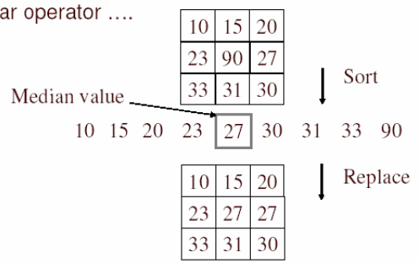
Alternative idea: Median filtering
A median filter operates over a window by selecting the median intensity in the window
Is median filtering linear?
Source: K. Grauman
Notes:
Better at salt’n’pepper noise
Not convolution: try a region with 1’s and a 2, and then 1’s and a 3

Slide 42
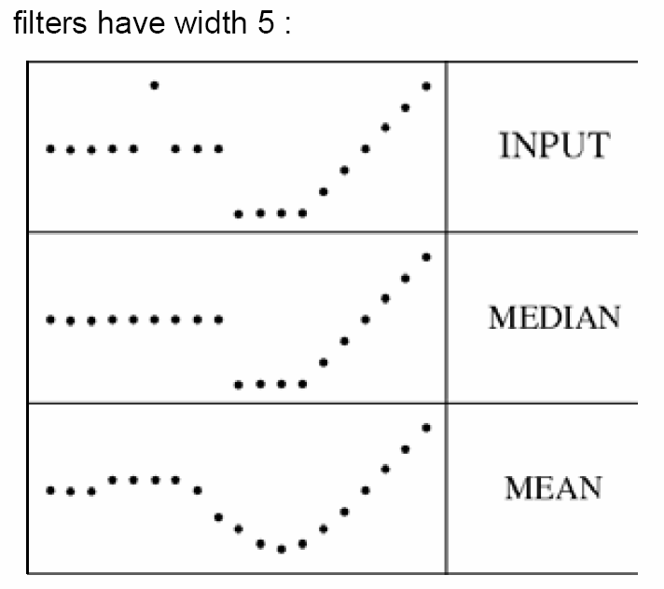
Median filter
What advantage does median filtering have over Gaussian filtering?
Robustness to outliers
Source: K. Grauman

Slide 43
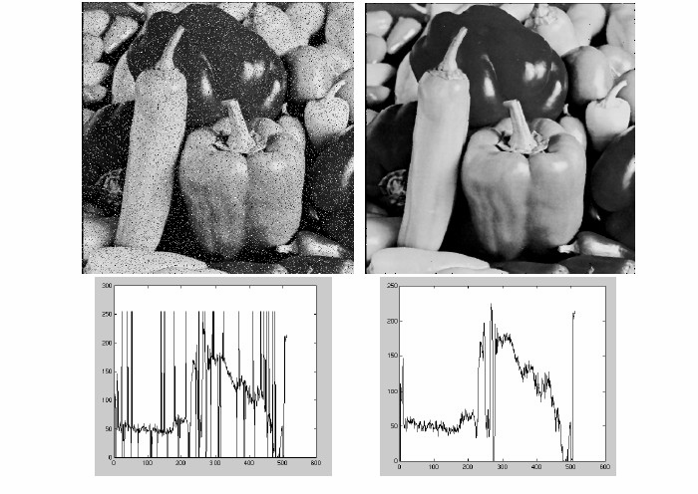
Median filter
Salt-and-pepper noise
Median filtered
Python: scipy.ndimage.median_filter (image, size)
Source: M. Hebert

Slide 44
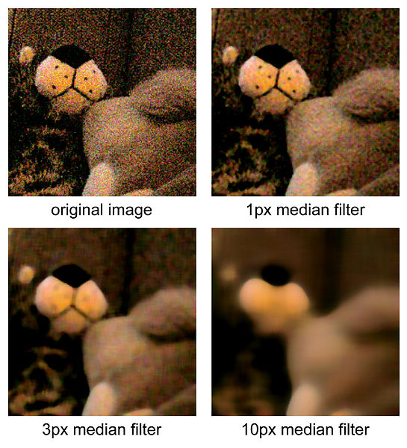
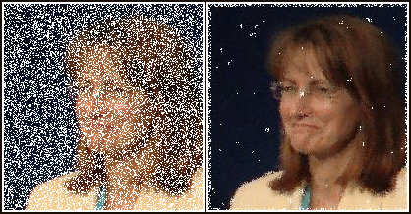
Median Filtered Examples
http://en.wikipedia.org/wiki/File:Medianfilterp.png
http://en.wikipedia.org/wiki/File:Median_filter_example.jpg

Slide 45
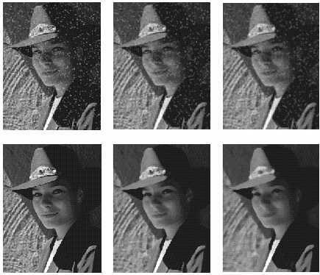
Median vs. Gaussian filtering
3x3
5x5
7x7
Gaussian
Median

Slide 46
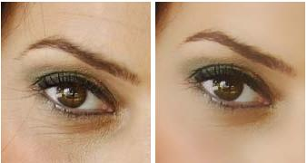
Other filter choices
Weighted median (pixels further from center count less)
Clipped mean (average, ignoring few brightest and darkest pixels)
Bilateral filtering (weight by spatial distance and intensity difference)
cv2.bilateralFilter(size, sigma_color, signal_spatial)
Bilateral filtering
Image:
http://vision.ai.uiuc.edu/?p=1455

Slide 47
Review of Last 3 Days
Filtering in spatial domain
Slide filter over image and take dot product at each position
Remember linearity (for linear filters)

Slide 48
Review of Last 3 Days
Linear filters for basic processing
Edge filter (high-pass)
Gaussian filter (low-pass)
[-1 1]
Gaussian
FFT of Gradient Filter
FFT of Gaussian

Slide 49
Review of Last 3 Days
Derivative of Gaussian

Slide 50
Review of Last 3 Days
Filtering in frequency domain
Can be faster than filtering in spatial domain (for large filters)
Can help understand effect of filter
Algorithm:
Convert image and filter to FFT
Pointwise-multiply FFTs
Convert result to spatial domain with inverse FFT

Slide 51
Review of Last 3 Days
Applications of filters
Template matching (SSD or normalized x-corr)
SSD can be done with linear filters, is sensitive to overall intensity
Gaussian pyramid
Coarse-to-fine search, multi-scale detection
Laplacian pyramid
Can be used for blending (later)
More compact image representation

Slide 52
Review of Last 3 Days
Applications of filters
Downsampling
Need to sufficiently low-pass before downsampling
Compression
In JPEG, coarsely quantize high frequencies
Reducing noise (important for aesthetics and for later processing such as edge detection)
Gaussian filter, median filter, bilateral filter

Slide 53
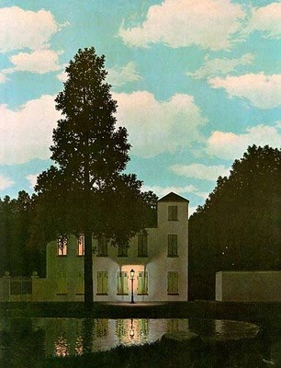
Next lecture
Light and color

